Slide 1
How has Major League Baseball Changed Over the Years?
Analysis by Lance Wagner

Slide 2
What is the focus?
Mainly looking at position, throwing/batting handedness, and offensive statistics
Will include other analysis as thoughts come up
Also open to ideas
Some Initial Analysis
How the throwing/batting handedness changed for positions over the year
The change from first basemen primarily used for fielding to batting
The lack of primary position shortstops compared to other positions
Finding the beginning of the Steroid Era and Three True Outcome Era

Slide 3
Overview of the Data
The History of Baseball
A complete history of Major League Baseball statistics from 1871 to 2018
Sean Lahman
http://www.seanlahman.com/baseball-archive/statistics/
26 CSV files of varying size
Notes:
https://www.kaggle.com/seanlahman/the-history-of-baseball
Sean Lahman – Sports research, Database journalism, data-mining

Slide 4
What I needed for my Analysis
Batting Statistics
6.5 MB
105,826 Records and 22 Fields
Player Information
2.6 MB
19,618 Records and 24 Fields
Field Information
6.9MB
140,922 Records and 18 Fields
Notes:
Sample Record in each data set

Slide 5
Look At Raw Data

Slide 6
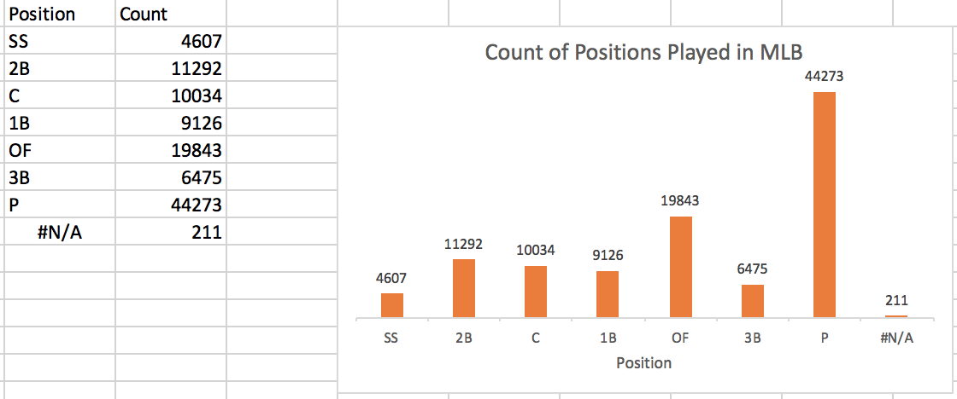
Position Summary Statistics

Slide 7
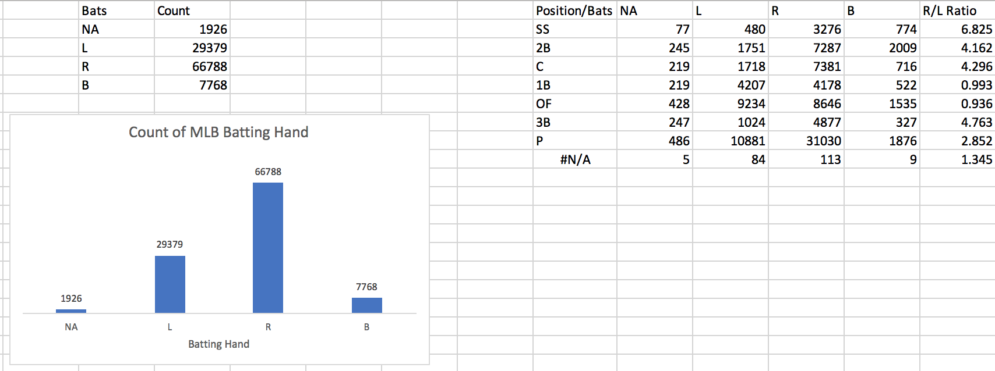
Batting Handedness

Slide 8
Questions?

