Slide 1
Life Expectancy
Halie Lewis
DSCI 201

Slide 2


Where is the Data From?
Kaggle
  WHO, United Nations
119 KB CSV
22 Columns
2939 entries
Wikipeida.com
who.int

Slide 3
About the Data
Life expectancy: 2000-2015
193 Countries
  183 Useable
Key Columns: Expenditure, life expectancy, schooling, immunizations, mortality rates, alcohol consumption …

Slide 4
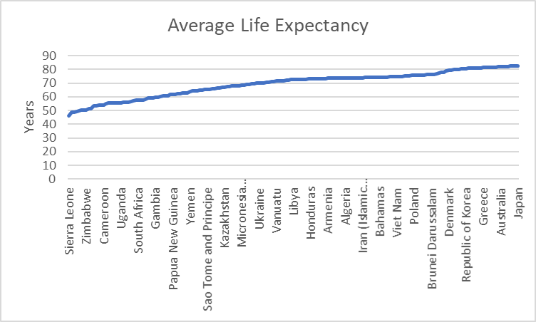
Questions for Analysis
What are the countries with the higher life expectancy doing differently than those with lower life expectancy?

Slide 5
For those countries that have seen a major change in life expectancy (positive or negative) what factors changed?
How much do countries with high life expectancy spend on health care? Is this necessary?
Percentage of Total Expenditure
Min | 0.37
Q1 | 4.26
Q2 | 5.75
Q3 | 7.4925
Max | 17.6

Slide 6
Does education play a notable role?
Do immunizations play a notable role?
  Polio, Diphtheria, Hepatitis B
Schooling | Years
Min | 0
Q1 | 10.1
Q2 | 12.3
Q3 | 14.3
Max | 20.7

Slide 7

Conclusion
What I hope to find.
Questions?
Infoplease.com

