Slide 1
Project Proposal
John Kaul

Slide 2
Data Set
Basic Overview
  Contains information on every NCAA basketball game, for every Division I school, since the 2010-2011 basketball season until the 2017-2018 season
  Contains 40 columns
  Contains 90,969 rows

Slide 3
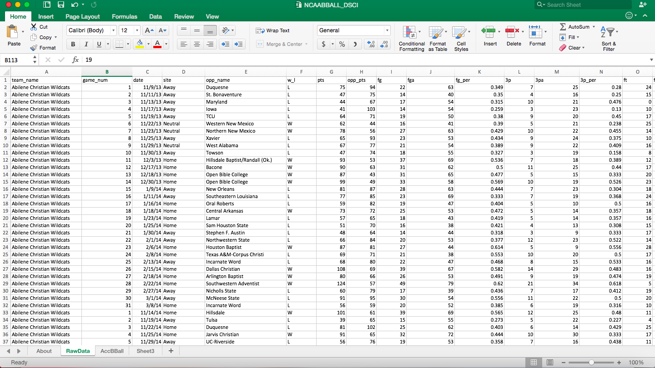
Column A-O

Slide 4
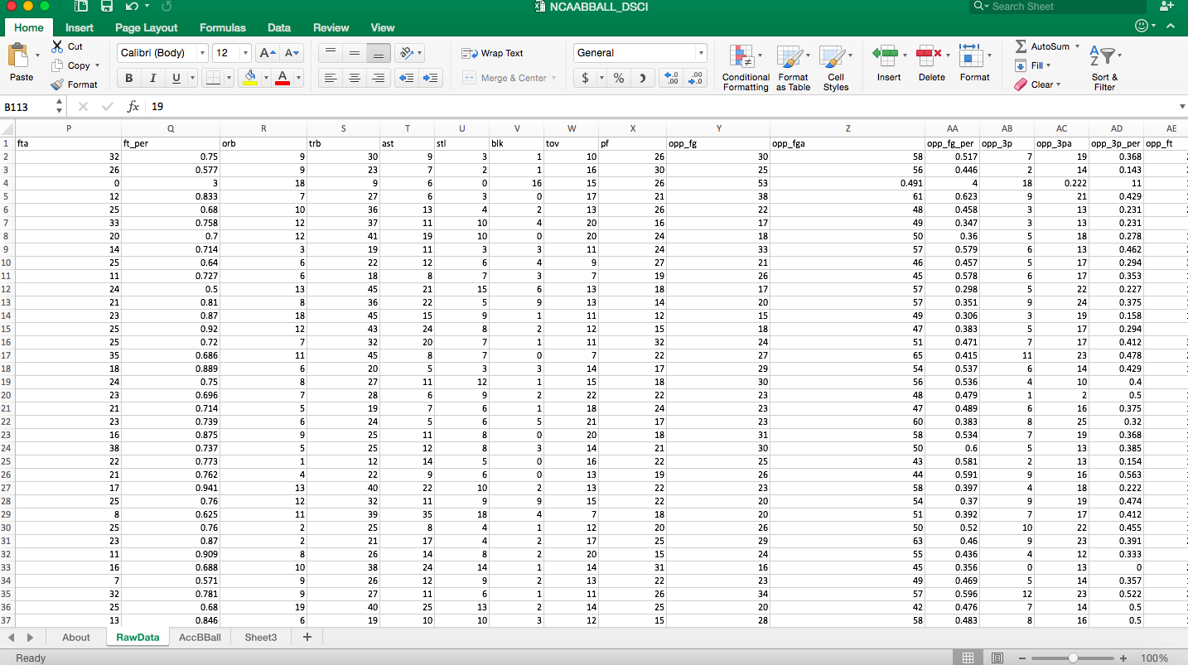
Columns P-AD

Slide 5
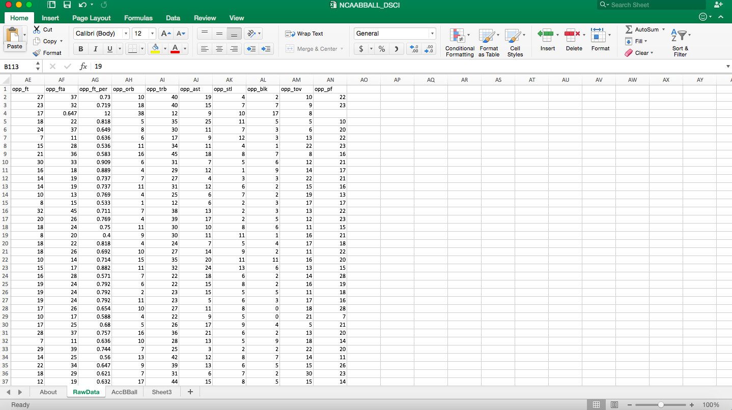
Columns AE-AN

Slide 6
Analysis Ideas
Analyze what schools have the best to worst winning percentage from the 2010/2011 season to the 2017/2018 season.
Analyze if home field advantage is actually true.
Analyze do teams who statically play better than the other team always win for the most part.

Slide 7
Reference
https://www.kaggle.com/nateduncan/2011current-ncaa-basketball-games/version/1

