Slide 1
A Few Presentation Guidelines
DSCI 101
Fall 2020

Slide 2
Upcoming Dates
No more homework
11/10 Lab Day
Sign up for a time slot
we will discuss your project
11/12 Excel Test

Slide 3
Upcoming Dates
11/19 All work due
Except for PPT slides (Due 12/3)
12/3 Presentations
Sign up for a time slot.

Slide 4
Other Important Items
Review the rubric on the assignment pages
For the report also review
Expectations for basic statistics in the notes.
Remember, I expect a summary of all fields used in the project.

Slide 5
Presentations
Due on Dec 3
Please be prepared to present when class starts.
You need to attend all presentation sessions
You will lose 10% by skipping a session.
In addition, that would be very rude to your classmates.

Slide 6
Presentations
You have fifteen minutes
For your presentation and questions.
You should fill at least ½ of that time.
You should allow some time for questions.
Look at the presentation page for guidelines.

Slide 7
Presentation: Overview
What is the basic subject?
What is your question?
Did you answer your question?
What is the answer?
Remember, most of the audience has no knowledge of your data.
Talk about any unique terms associated with your data.

Slide 8
Presentation: Data Overview
Where did the data come from?
What is the basic subject?
Describe size (rows and columns)
Give a basic overview of the fields you used.
Just a general overview so the audience understands what you are working with.
You will cover import fields in more depth later.
Remember, most of the audience has no idea what your dataset contains.

Slide 9
Presentation: Problems with Data
Describe any problems with your data.
Describe what you did to solve these problems and why.
If there are no problems, simply state that.
You can discuss specific problems with the data field discussion (next).

Slide 10
Presentation: Description of Basic Fields
Describe several important fields.
Give counts
And the five number summary
Or list of unique values and counts.
Include a chart describing the data.
Discuss any problems with the data.

Slide 11
Presentation: Data Analysis Techniques
Discuss additional techniques you used to analyze your data.
For most of you I would expect a pivot table.
For some, you may have used a more advanced technique, Discuss it.
Don’t stress out over this, just tell us what you did.
If you did something clever or novel, we want to hear about it.

Slide 12
Presentation: Findings
What did you discover?
Give us a chart, table, or something
Is this important?
Did it confirm a hunch?
Is it new information?
Did it refute “common knowledge”?
Was it a surprise?

Slide 13
Presentation: Future Work
What would you look at if you had more time?
What other investigations on your data might you perform?
What other data might you want to collect to further your investigation?
What would you do differently if you had the chance?

Slide 14
Presentation: Required Components
At least one chart
Readable
Well labeled
A single transformation applied to all slides
At least one set of animations beyond just text appearing.

Slide 15
Animation
Not just text appearing
Have a chart appear with some text
Then have a shape point out some important factor.
Nearly 50% BAD, 100% Bald!

Slide 16
Presentation Guidelines
These are based on an article by Matthew A Christian
“Death by PowerPoint or Twelve Steps to Better E-Presentations”
Self published in 2002

Slide 17
Know your audience
We all should understand counts, five number summaries and pivot tables.
We don’t know the data
If your data involves specialized knowledge, please share!
We don’t know statistics
If you decided to use a test to verify your findings, please let us know.
We are probably curious about data sizes
Fill us in on those details.

Slide 18
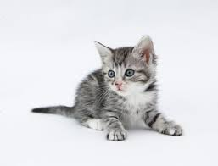
Content is King
Focus on your message
Kittens are nice!
Cartoons are funny!
Balloons are great!
But make sure they contribute to the message.

Slide 19
Purchase a color wheel, and use it.
This is just wrong.
And so is this.
You should probably avoid red!
And orange is not the best.
Contrast is everything.

Slide 20
KISS: Keep it Simple Stupid!
Christian says three bullet points.
I feel a few more is acceptable.
But probably not more than 8
Simple statements
Not paragraphs
Keep the animations simple and discrete.
And just one transistion.

Slide 21
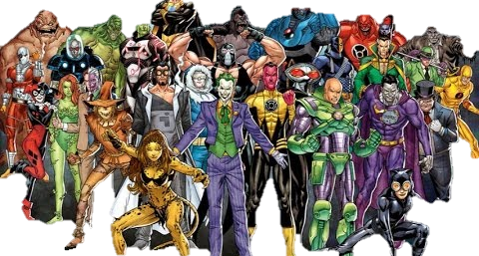
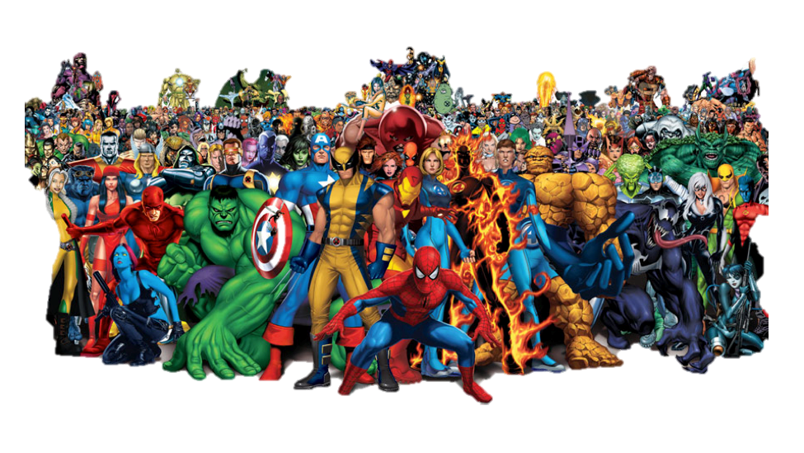
KISS: Not This
Context
Super Heroes have been in popular culture for a long time and now more than ever. Since its creation, super heroes have not been very diverse, but that is changing rapidly. This dataset aims to provide an overview about heroes and their physical as well as power characteristics, helping researchers and curious minds identify trends and patterns.
Content
This data was collected in June/2017 from superherodb and not updated since, so it may not be up to date. There are two datasets here. The first one lists the characteristics of every super hero found on my source, the second contains information about every superpower and lists if they are present in any given hero.
Acknowledgements
This data was scraped from SuperHeroDb.

Slide 22
KISS: Not This!
Animations are nice
But don’t use the slow ones.
Or the Strange Ones
Don’t let the animations distract from the message

Slide 23
Fonts are like Donuts
No more than two or three at a time.
Stay away from the “fun” ones that are hard to read.
They don’t help with the message.
And they might just render incorrectly!

Slide 24
Careful With Charts

Slide 25
Careful with Charts.

Slide 26
And with Tables
 | bad |  |  | bad Total | good |  |  | good Total | NA |  | NA Total | neutral |  |  | neutral Total | Grand Total
Hair Color | Female | Male | NA |  | Female | Male | NA |  | Male | NA |  | Female | Male | NA
amber |  | 1 |  | 1 | 1 |  |  | 1 |  |  |  |  |  |  |  | 2
black | 1 | 7 |  | 8 | 4 | 6 | 1 | 11 |  |  |  |  | 4 |  | 4 | 23
blue | 13 | 35 | 1 | 49 | 63 | 101 | 3 | 167 | 2 | 1 | 3 |  | 5 | 1 | 6 | 225
blue / white |  |  |  |  |  | 1 |  | 1 |  |  |  |  |  |  |  | 1
bown |  |  |  |  |  | 1 |  | 1 |  |  |  |  |  |  |  | 1
brown | 5 | 30 |  | 35 | 10 | 72 | 4 | 86 |  |  |  |  | 5 |  | 5 | 126
gold |  | 1 |  | 1 |  | 2 |  | 2 |  |  |  |  |  |  |  | 3
green | 8 | 13 |  | 21 | 34 | 17 |  | 51 |  |  |  | 1 |  |  | 1 | 73
green / blue |  |  |  |  |  | 1 |  | 1 |  |  |  |  |  |  |  | 1
grey |  | 2 |  | 2 |  | 4 |  | 4 |  |  |  |  |  |  |  | 6
hazel |  |  |  |  | 3 | 3 |  | 6 |  |  |  |  |  |  |  | 6
indigo |  |  |  |  |  |  |  |  |  |  |  | 1 |  |  | 1 | 1
NA | 5 | 39 | 4 | 48 | 35 | 78 | 5 | 118 | 3 |  | 3 | 1 | 1 | 1 | 3 | 172
purple |  | 2 |  | 2 | 2 |  |  | 2 |  |  |  |  |  |  |  | 4
red | 1 | 21 | 1 | 23 | 2 | 13 | 4 | 19 | 1 |  | 1 | 1 | 2 |  | 3 | 46
silver |  |  |  |  |  | 1 |  | 1 |  |  |  |  |  |  |  | 1
violet | 1 |  |  | 1 | 1 |  |  | 1 |  |  |  |  |  |  |  | 2
white |  | 5 |  | 5 | 3 | 8 | 1 | 12 |  |  |  |  |  |  |  | 17
white / red |  | 1 |  | 1 |  |  |  |  |  |  |  |  |  |  |  | 1
yellow |  | 7 | 1 | 8 | 2 | 8 |  | 10 |  |  |  |  | 1 |  | 1 | 19
yellow (without irises) | 1 |  |  | 1 |  |  | 1 | 1 |  |  |  |  |  |  |  | 2
yellow / blue |  |  |  |  | 1 |  |  | 1 |  |  |  |  |  |  |  | 1
yellow / red |  | 1 |  | 1 |  |  |  |  |  |  |  |  |  |  |  | 1
Grand Total | 35 | 165 | 7 | 207 | 161 | 316 | 19 | 496 | 6 | 1 | 7 | 4 | 18 | 2 | 24 | 734

Slide 27
A Suggestion
I will be happy to arrange a private zoom session where you can practive.
Come in and try your Charts/Tables on the screen BEFORE you present.
Bring your slide up.
Take a look, can you read it?
Make sure you can use screen share and any other tool you might need.

Slide 28
Questions?
Thanks.
Please watch
How to avoid death By PowerPoint by David JP Phillips
https://www.youtube.com/watch?v=Iwpi1Lm6dFo

