Slide 1
Boston, MA’s Climate Change
By: Denare Whyatt
DSCI101

Slide 2
Project Overview
My Project was to analyze the weather reports of Boston, MA to determine if there were noticeable changes in the temperatures due to climate change.
My goals were to prove:
          The temperature steadily increased to represent global warming
          The increase of ocean levels due to lack of ice from the poles
          The increase of humidity due to increased temperatures

Slide 3
Data Overview
Data set was found on Kaggle.com
Contained in the CSV file:
    3,749 entries
    27 Original fields
  Only 14 of the fields were used
  Size of 299 KB
All data was found at www.wunderground.com using the Boston airport as a location to determine information
Information recorded is based on DD/MM/YYYY

Slide 4
Data Dictionary
Year
Month
Day
High Temp (F)
Avg Temp (F)
Low Temp (F)
Dew Point
High Dew Point (F)
Avg Dew Point (F)
Low Dew Point (F)
Humidity
High Humidity (%)
Avg Humidity (%)
Low Humidity (%)
Sea level pressure
High Sea Level Press (in)
Avg Sea Level Press (in)
Low Sea Level Press (in)
High Visibility (mi)
Avg Visibility (mi)
Low Visibility (mi)
High Wind (mph)
Avg Wind (mph)
High Wind Gust (mph)
Snowfall (in)
Precipitation (in)
Events

Slide 5
Problems with Data
The data set contained no problems (Blank Spaces, unfilled data, etc.)
The year 2018 was left incomplete and had to be excluded from results due to the potential of skewing data

Slide 6
Data Analysis Technique
I used pivot charts and tables to represent my data based on the yearly averages for each analysis.

Slide 7
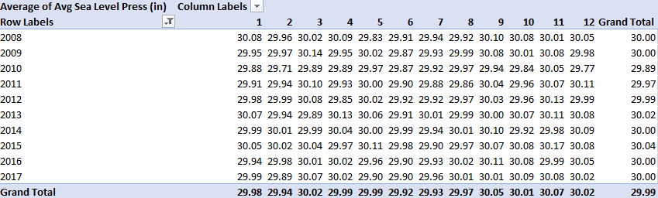
Average Sea Level Pressure Yearly

Slide 8
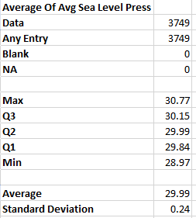
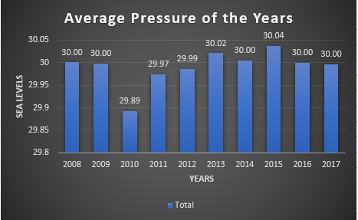
Average Sea Level Pressure Yearly

Slide 9
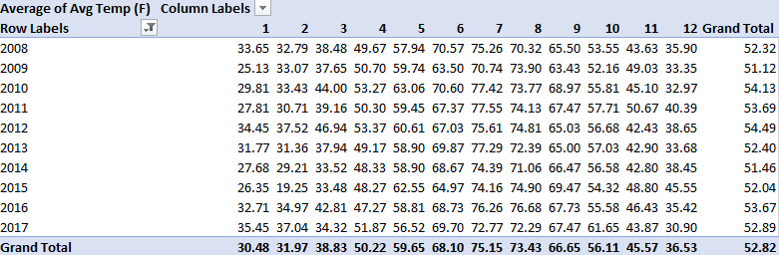
Average Temperature Yearly

Slide 10
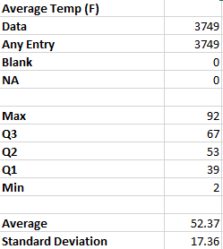
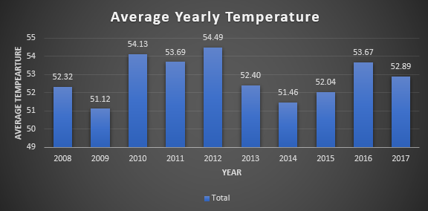
Average Temperature Yearly

Slide 11
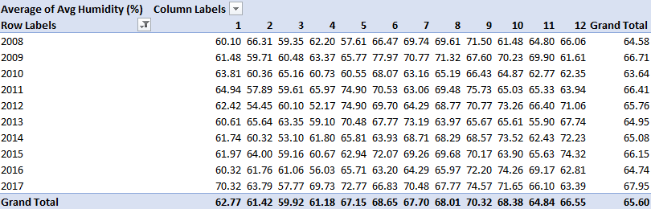
Average Humidity Yearly

Slide 12
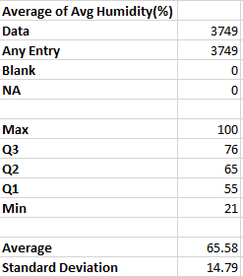
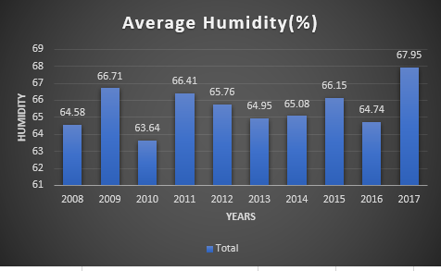
Average Humidity Yearly

Slide 13
Conclusions
Data shows that there was a .57 increase to the temperature from 2008 to 2017 and increase of 3.37 to the humidity of the same span.
Data on the ocean’s sea level remained the same even through the fluctuation over the years after the span of 9 years.

Slide 14
Future Work
In the future I would like to go before 2008 and possibly the 1990’s to find more data that could draw a definitive conclusion on the changes global warming has had on Boston.
Information before 1992 United Nations Framework Convention on Climate Change (UNFCCC) treaty could provide even more information on the trends before 2008.

Slide 15
Questions?

