Slide 1
Users and Critics in Video Games
A Study To Find a Unified or Divided Favorite Genre
Codi Uhouse
TR DSCI 101

Slide 2
Overview: Subject and Question
The subject of the study was video games.
Specifically, the relation between the genres and user / critic reviews.
Question: What genres have the highest average user and critic reviews? Do critics and users put their highest reviews on the same or different genres?
Want to focus on the genre with the greatest amount of high reviews (9 and 10).
Through an arduous process involving three years the answer was found.
Just kidding.

Slide 3
Overview: Answer
Answer (Greatest number of high reviews (9 and 10)):
Critics: Action
Users: Role-Playing
Some Definitions:
As some people in this group may not be gamers:
Action games typically involve shooters and fighting games.
Role-playing games typically involve the player making a character and going through a large, open world or at least a well designed one. (Skyrim)

Slide 4
Data Overview: File Details
Dataset came from Kaggle.com
Originally from Video Game Sales dataset.
Dataset expanded from 2016 game sales dataset.
CSV Format
16 Fields
55792 Records
~3,300KB

Slide 5
Data Overview: Data Fields
Rank
Name
Genre
ESRB Rating
Platform
Publisher
Developer
Critic Score (Ave. Reviews 0 to 10)
User Score (Ave. Reviews 0 to 10)
Total Shipped
Global Sales (Millions)
NA Sales (Millions)
PAL Sales (Millions)
JP Sales (Millions)
Other Sales (Millions)
Year

Slide 6
Problems In Data
There are thousands of blanks throughout the document and in the important fields.
Replace all blanks with “NA” so there is a reason for no data.
User and critic scores can be skewed by only one score in user and none in critic.
Data filtered so that only the games with both a critic AND user score are listed.

Slide 7
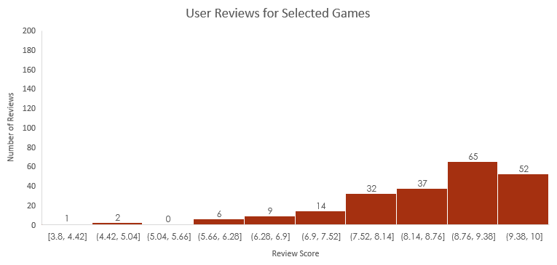
User Scores
Average user review scores for a game (0 to 10).
All Fields: 218
Numbers: 218
Blanks: 0
NA: 0
Max: 10
Q3: 9.3
Q2: 8.9
Q1: 8
Min: 3.8
Average: 8.6

Slide 8
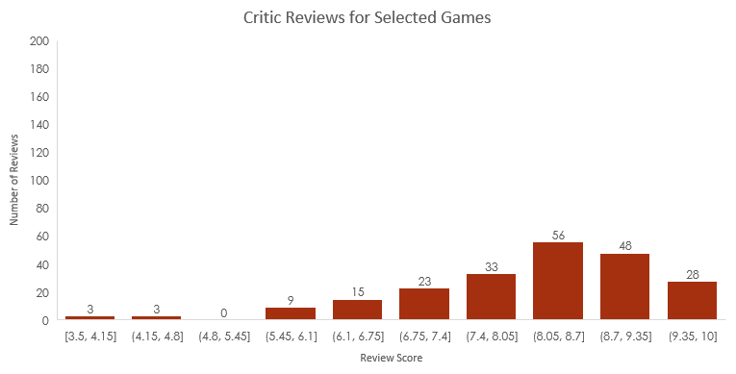
Critic Scores
Average critic review scores for a game (0 to 10).
All Fields: 218
Numbers: 218
Blanks: 0
NA: 0
Max: 10
Q3: 9.1
Q2: 8.2
Q1: 7.5
Min: 3.5
Average: 8.1

Slide 9
Genre
Genres | Count | Rank
Action | 45 | 1
Shooter | 44 | 2
Role-Playing | 41 | 3
Platform | 25 | 4
Adventure | 20 | 5
Fighting | 10 | 6
Strategy | 7 | 7
Racing | 6 | 8
Misc | 5 | 9
Action-Adventure | 5 | 9
Sports | 4 | 11
MMO | 2 | 12
Simulation | 2 | 12
Puzzle | 1 | 14
Music | 1 | 14
All Fields: 218
Numbers: 0
Blanks: 0
NA: 0

Slide 10
Top 10 Genres
The “Misc.” genre exists to define games that belong in genres that are only represented by a few games. (Wii Play)

Slide 11
Analysis Technique
To analyze the data:
Two Pivot Tables
Aesthetically look better than the mixture of both
One with User Scores vs Genres with Genres as values. Other replaces User Scores with Critic Scores
Tables sorted low to high with scores and left to right.
For both tables:
Slicers used for user and critic scores to show values between 9 and 10
Misc. category taken out of genres

Slide 12
And The Genres Are…
For critics, the genre with the greatest number of high average reviews was the action genre.
For users, the role-playing genre was found.
Tables in a second, but:
The data proved a hunch that games that have everything on the table will most likely have the highest reviews.
This information could be used to predict what genre would be liked by what group the most given the game is well made.

Slide 13
…Shown In This Table (Critics)…
Count of Genre | Column Labels
Row Labels | Action | Shooter | Role-Playing | Platform | Adventure | Fighting | Action-Adventure | Racing | MMO | Strategy | Music
10 | 1 |  |  |  | 1 |  | 1
9.9 |  |  |  |  | 1 |  | 1
9.7 |  |  |  | 2
9.6 | 1 | 4 | 1
9.5 | 3 | 2 | 2 |  | 2
9.4 |  | 2 | 1 | 1 | 1 | 1
9.3 | 5 | 1 |  | 2 |  | 2 |  |  | 1
9.2 | 3 | 1 | 1 |  |  | 1 |  | 1 | 1
9.1 | 2 | 1 | 1 | 2 | 1 |  |  | 1 |  | 1
9 | 1 | 3 | 3 | 1 | 2 |  |  |  |  |  | 1
Grand Total | 16 | 14 | 9 | 8 | 8 | 4 | 2 | 2 | 2 | 1 | 1

Slide 14
…And This One (Users)
Count of Genre | Column Labels
Row Labels | Role-Playing | Shooter | Action | Platform | Adventure | Fighting | Strategy | Racing | Action-Adventure | Simulation | Sports | Music | MMO
10 | 3 |  | 1 | 1 | 2 | 1 |  |  | 2
9.8 | 1 |  | 2 | 1 |  |  |  | 1
9.7 | 2 |  | 1 |  |  | 2 | 1 |  |  | 1
9.6 |  | 3 | 2 | 1 | 3
9.5 | 5 | 5 | 2 | 1 |  |  |  | 1 | 1
9.4 |  | 2 | 1 | 1 | 1 |  |  | 1
9.3 | 3 | 2 | 2 |  |  | 1 | 1 |  |  |  |  | 1 | 1
9.2 | 2 |  |  | 3
9.1 | 3 | 3 | 2 | 3 | 1 |  |  | 1 |  |  | 1
9 | 4 | 3 | 4 | 4 | 3 | 1 | 2
Grand Total | 23 | 18 | 17 | 15 | 10 | 5 | 4 | 4 | 3 | 1 | 1 | 1 | 1

Slide 15
Future Work
In the future:
Could allow the pivot tables to include scores between 7 and 10 to see if the genres change easily.
What genres have the highest total units shipped?
What developer / publisher has the highest users vs. critic reviews?

Slide 16
Questions?

