Slide 1
Traffic Accidents in the United States
By Bradley Peters

Slide 2

Project Overview
I performed analysis on a US Traffic accidents dataset. I set out to discover what factors affect the severity of traffic accidents.

Slide 3
Dataset Overview
I retrieved my dataset from Kaggle.com
The dataset had 2.25 million records
The dataset had 45 fields
These several fields can be broken down in a few main categories
Location
Nature/Weather
Date/Time
Attributes of the roadway

Slide 4
Cleaning the Data
To clean the data I had two main duties
Remove redundant information
Ex. Sunrise_sunset vs. civil twilight vs. nautical twilight, etc.
Trim the dataset to a reasonable size
Excel can only handle so much data before it cuts you off
45 Fields * 2,250,000 Records = 101,250,000 Data Points
Notes:
I did not have to clean any specific data points/ranges

Slide 5
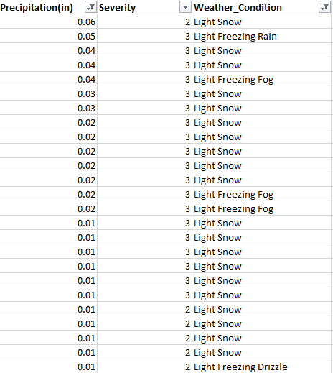
Weather Analysis
I used the following steps to analyze weather
I created a count of all of the unique weather patterns
I created a pivot table to find the most common weather patterns by severity
I created a table listing all of the data for precipitation, severity, and weather condition and used filters and sorting to discovered how increases in precipitation and different weather conditions affect severity

Slide 6
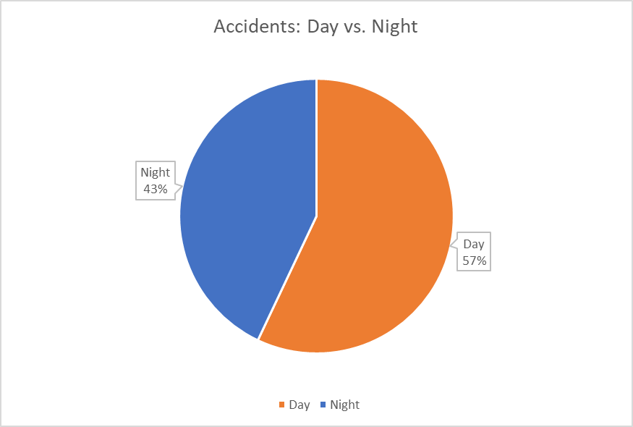
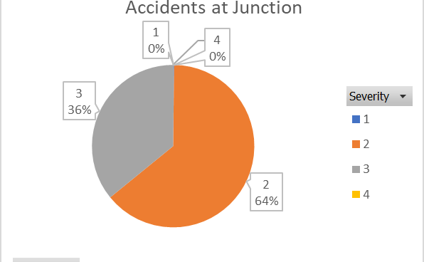
Other Analysis
To find data on accidents happening during the day or night I used a count and created a chart to demonstrate clearly which happened more often
To find information on TMC codes I isolated all the unique codes from the data and matched them to an online listing
To find

Slide 7
What I Discovered
Most Accidents occur during the day (by a margin of 14%)
More severe accidents occur at crossings, railways and junctions
Greater precipitation does not inherently make an accident more severe
Higher precipitation only makes accidents worse if it freezes
Ie snow and freezing rain

Slide 8
Conclusions I have Drawn
Most accidents occur in “safe” driving conditions (most-likely) because people are much more willing to drive in those conditions
Certain roadway properties are more likely to cause accidents

Slide 9
Future Work
Analyzing the entire dataset using more sophisticated tools
Finding other static (unchangeable) variables (like the previously mentioned structures that affect traffic accidents

