Slide 1
Pizza Prices In The US
By: Owen Luebbert

Slide 2
Introduction
Dataset obtained from Kaggle, provided by Datafiniti
4,456 KB
10,000 records with 21 fields
None of the fields were blank or missing values
Which state has the highest average pizza price?
Hypothesis: New York or Illinois

Slide 3
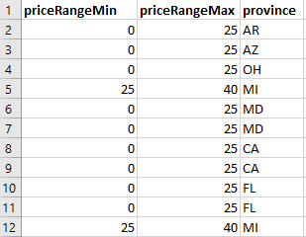
Data Overview
3 main fields
priceRangeMin, priceRangeMax, and province
priceRangeMin’s problem
8,000 entries with 0 as minimum price
Ultimately left untouched, as the average price still made sense.
Province’s problem
Some states only had a couple entries
Maine, Massachusetts, Nevada, New Hampshire, Rhode Island, and Vermont: 0 entries

Slide 4
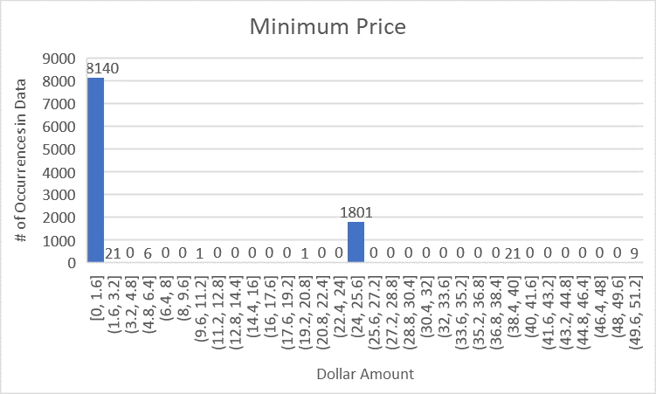
Data Analysis - priceRangeMin
Performed 5 number summary as well as average, standard deviation, and mode.
The mode was 0 with 8,007 entries
This was left unchanged in the dataset
Average minimum price came to $4.66

Slide 5
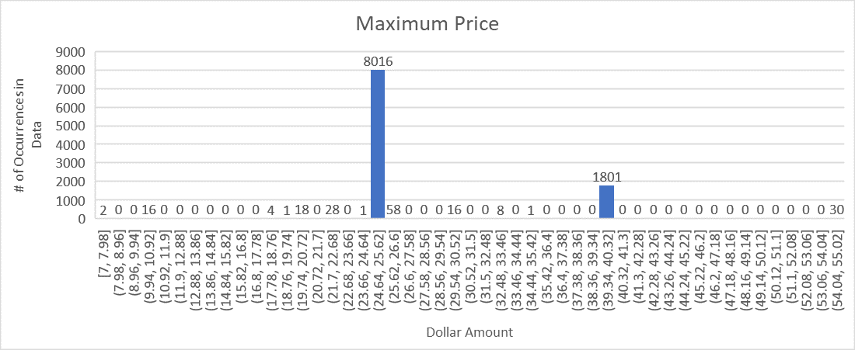
Data Analysis - priceRangeMax
Performed 5 number summary, as well as average, standard deviation, and mode.
Mode is 25 with 8,016 entries
Average is $27.77

Slide 6
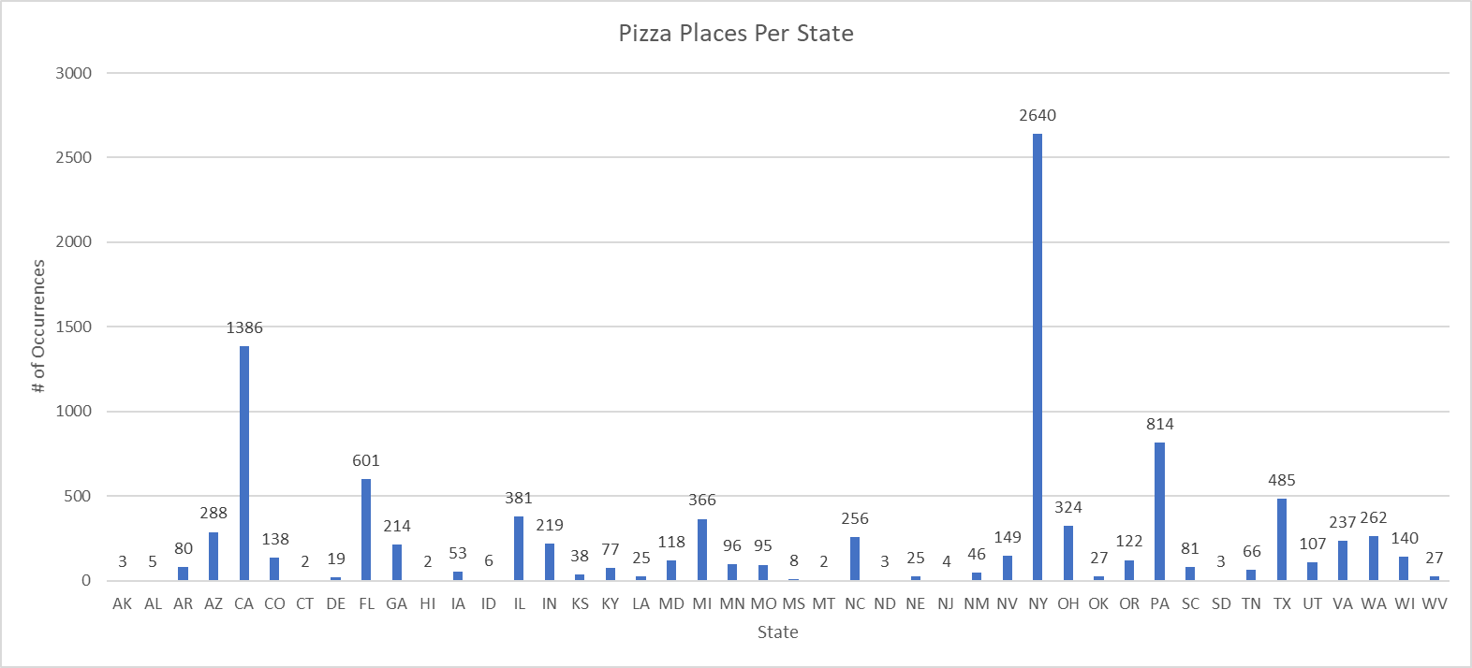
Data Analysis - province
Performed a countif for each state to see how many entries each state had.
Reordered by the greatest number of occurrences to least
Provided each state with a corresponding rank
Not all states had entries.
Maine, Massachusetts, Nevada, New Hampshire, Rhode Island, and Vermont

Slide 7
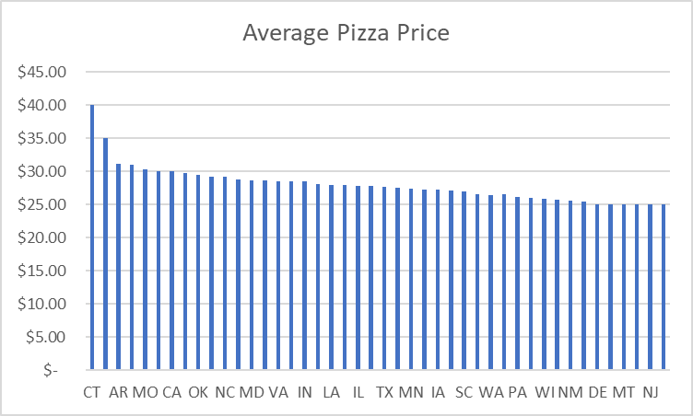
Findings
Created a pivot table with state in the rows and price in the values.
Changed the values from sum to average
Found that California is the only state with more than a few hundred entries above the average.
CA average price $29.99

Slide 8
Conclusion
The average pizza price in the US is $27.76
California has the highest pizza prices among the states.
$29.99
My hypothesis was proven to be incorrect.
New York was below the average at $27.06 and Illinois was only slight above average at $27.87
Some future work would include finding a larger dataset, to find more accurate results

