Slide 1
Military Expenditures
Joseph honeychuck

Slide 2
Overview
Military Spending from 1960-2018
Trends in spending?
Which countries spend the most?
How they changed over the years
How spending changed during times of war?

Slide 3
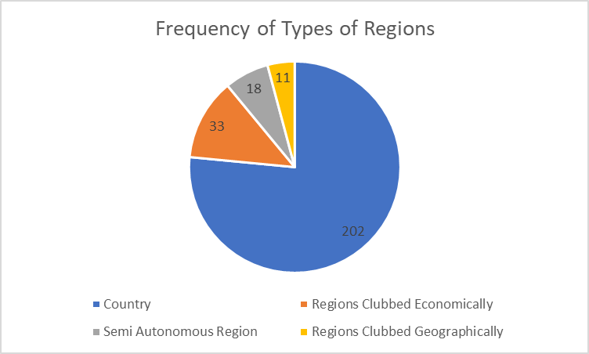
Dataset
Countries and major regions spending
Kaggle
264 rows and 62 fields
Mainly the years
10 year increments
Most recent year

Slide 4
Problems and Cleaning
Blanks
Irrelevant fields
Country bank code
Indicator type
Well organized
Relatively clean on its own

Slide 5
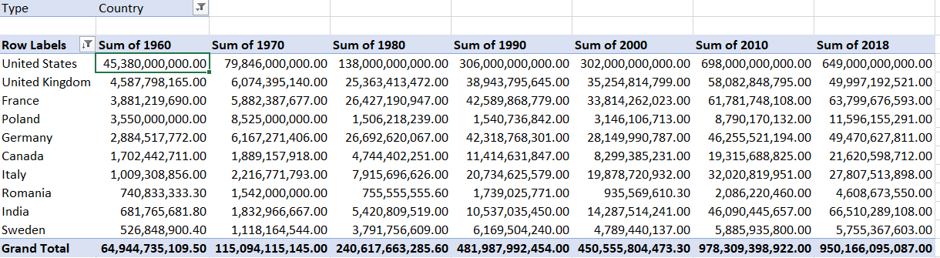
Discoveries
Graph of Top 10 from 1960
European Countries
India, Canada, USA
USA spending through the decades
9/11

Slide 6
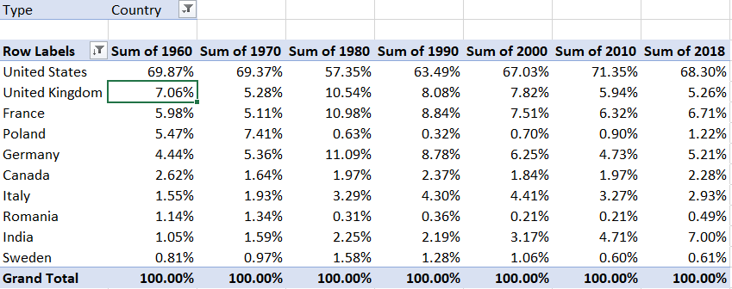
Discoveries
Graph of Top in 1960 Percentages
USA spending
Bottom 5 under 5%

Slide 7
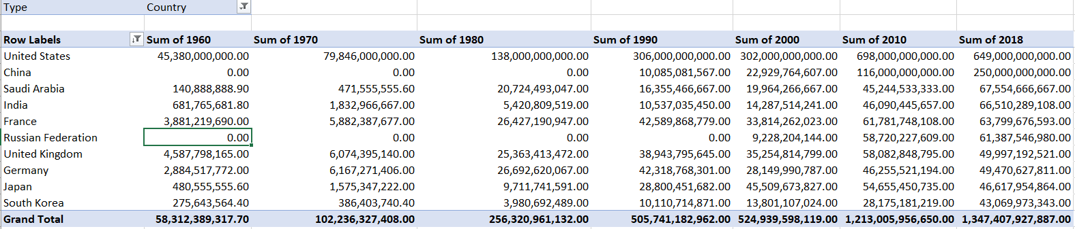
Discoveries
Top 10 Countries Spending in 2018
United States spent most by far
Asian Countries
Russia, UK, Germany, France, USA
China, Saudi Arabia, India, Japan, South Korea

Slide 8
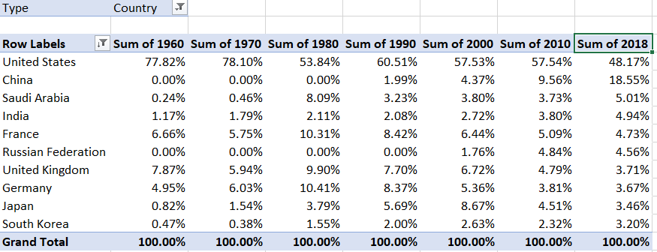
Discoveries
USA no longer spending more than all combined
China has a decent percentage of spending
Other countries spend a lot less

Slide 9
Conclusions
USA spent most
European to Asian
Most countries increased
China might surpass USA soon
9/11

Slide 10
Future Work
Other countries during war
Korean War
In depth analysis of that time period
Include countries that were involved in the war
How their spending changed
More analysis on specific regions
See what countries spent most/least
Rising countries in each region

Slide 11
Questions?

