Slide 1
World Happiness 2016
By: Cassandra Frawley

Slide 2
Project Overview
  Do the factors represented by the columns correspond with the country’s happiness rank?
  In this presentation:
    Overview of the World Happiness Report data set from 2016
    Problems with the data set
    Analysis technique
    Findings
    Future Work

Slide 3
Project Data
Found on Kaggle
  Originally collected by Gallup Incorporated
CSV Format
  155 records
  12 fields

Slide 4
Data Fields
Country
Happiness Rank
Happiness Score
Happiness Integer
Happiness Rating
Whisker High
Whisker Low
Economy GPD per Capita
Family
Health/Life Expectancy
Freedom
Generosity
Trust/Government Corruption
Dystopian Residual

Slide 5
Problems with Data
There were no problems with this data set.

Slide 6
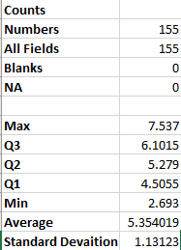
Happiness score analysis
Basic Counts
Quartiles, Average, and Standard Deviation

Slide 7
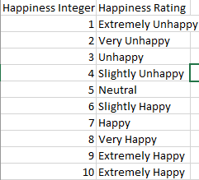
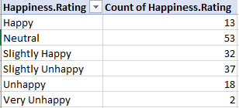
Happiness rating analysis
Happiness Integer to Happiness Rating
Pivot Table

Slide 8
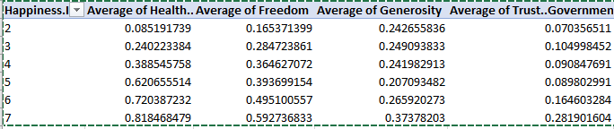
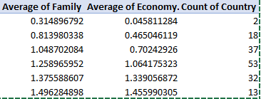
Happiness integer analysis
Pivot Table
  Using Happiness Integer
  Average of other fields

Slide 9
Findings
Average World Happiness: 5.354 (scale of 1-10)
Happiness was evenly distributed
Most other field averages corresponded with the integer
  Health
  Generosity
  Trust/Government Corruption

Slide 11
Future Work
Future years?
What determines happiness score and other fields?
United States?

