Slide 1
HONEYBEES
& NEONIC PESTICIDES
By Meghan adams
Notes:
(add bee clipart?) (more in-depth) (need screenshots from excel) (*dies*)

Slide 2
What are neonic pesticides?
Section One: information

Slide 3

Clothianidin, Imidacloprid, Thiamethoxam, Acetamiprid, and Thiacloprid
What are they?
  5 most popular insecticides/pesticides
What do they do?
  Protect crops
Why use them?
  Increased yield from crops = cheaper food at store
What’s the problem?
  Colony Collapse Disorder (CCD)

Slide 4

The Data
Where from?
  Kaggle (USDA & US Geological Survey)
Size
  1,133 Rows by 17 Columns (Original)

Slide 5
Overview of fields
  State
  Number of Colonies
  Yield per Colony
  Total Production
  Stocks
  Price per Pound
  Production Value
  Year
  Region
  One field per Neonic Pesticide
    Clothianidin
    Imidacloprid
    Thiamethoxam
    Acetamiprid
    Thiacloprid
  All Neonics

Slide 6
fixing it
Section two: Data cleaning

Slide 7
Step One:
Removing Unneeded Fields
FIPS
  No explanation
State field
  Redundancy
Hid other fields throughout analysis

Slide 8
Step Two:
Filter Out Empty Data
237 records missing any pesticide data
Find-and-Replace
  Empty fields -> “NA”
Filtered
  Eliminate all “NA”

Slide 9
basic analysis
Section three: Data summary

Slide 10
States
8 States not included in data
Unknown why
Count
Non-empty | 895
Numeric | 0
Blank | 0
NA | 0
Maryland
Oklahoma
South Carolina

Slide 11
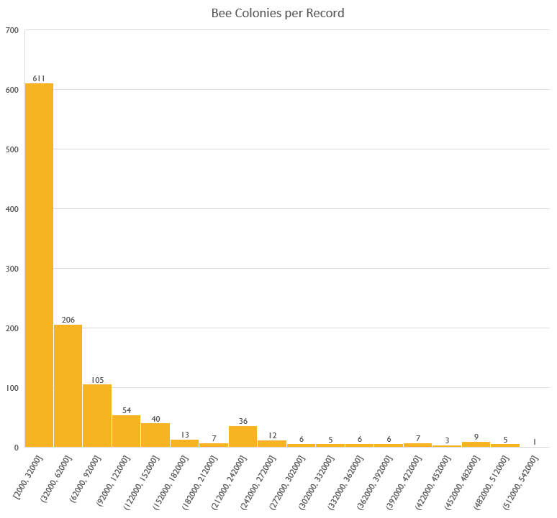
Colonies
Count
Non-empty | 895
Numeric | 895
Blank | 0
NA | 0
Max | 510000
Q3 | 67500
Q2 | 28000
Q1 | 9000
Min | 2000

Slide 12
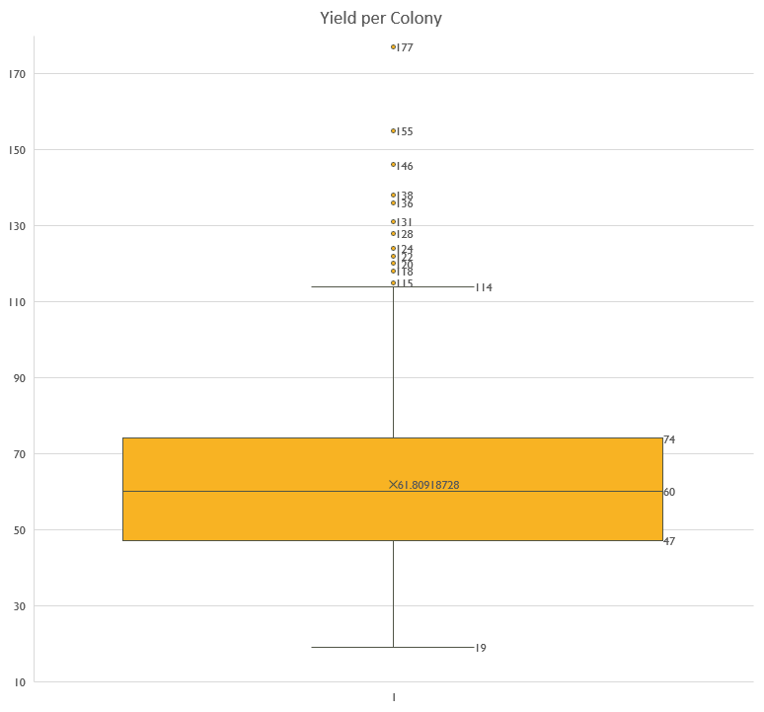
Colony Production
Count
Non-empty | 895
Numeric | 895
Blank | 0
NA | 0
Max | 128
Q3 | 72
Q2 | 59
Q1 | 47
Min | 19

Slide 13
Price per Pound
Does not account for regional inflation (EG in New York)
Count
Non-empty | 895
Numeric | 895
Blank | 0
NA | 0
Max | 7.09
Q3 | 1.96
Q2 | 1.39
Q1 | 0.895
Min | 0.47

Slide 14
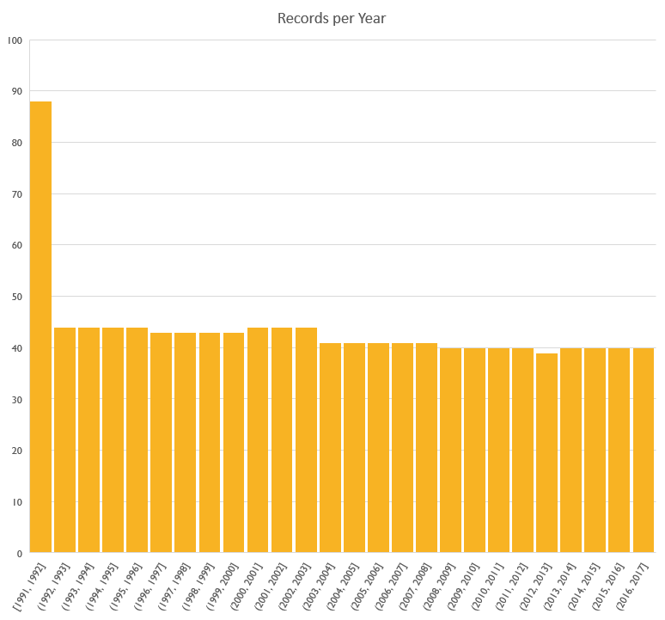
Year
Double amount first year
Non-empty | 895
Numeric | 895
Blank | 0
NA | 0
Max | 2016
Q3 | 2011
Q2 | 2005
Q1 | 2000
Min | 1994

Slide 15
Clothianidin
Non-empty | 895
Numeric | 895
Blank | 0
NA | 0
Max | 278498.8
Q3 | 4345.15
Q2 | 33.4
Q1 | 0
Min | 0

Slide 16
Imidacloprid
Non-empty | 895
Numeric | 895
Blank | 0
NA | 0
Max | 150569.3
Q3 | 9373.4
Q2 | 3186.6
Q1 | 617.25
Min | 0

Slide 17
Thiamethoxam
Non-empty | 895
Numeric | 895
Blank | 0
NA | 0
Max | 64834.6
Q3 | 5724
Q2 | 463.2
Q1 | 0
Min | 0

Slide 18
Acetamiprid
Non-empty | 895
Numeric | 895
Blank | 0
NA | 0
Max | 36480.3
Q3 | 202.6
Q2 | 0
Q1 | 0
Min | 0

Slide 19
Thiacloprid
Non-empty | 895
Numeric | 895
Blank | 0
NA | 0
Max | 4273.2
Q3 | 0
Q2 | 0
Q1 | 0
Min | 0

Slide 20
All Neonics
Non-empty | 895
Numeric | 895
Blank | 0
NA | 0
Max | 403011.6
Q3 | 26130.9
Q2 | 5151.4
Q1 | 923.45
Min | 0

Slide 21
Combined data analysis
Section four: data manipulation

Slide 22
Production by Year & Region
Only pivot table
Data mostly inconclusive
Interesting still
  Distribution of production across years
Average of yieldpercol | Column Labels
Row Labels | 1994 | 1995 | 1996 | 1997 | 1998 | 1999 | 2000 | 2001 | 2002 | 2003 | 2004 | 2005 | 2006 | 2007 | 2008 | 2009 | 2010 | 2011 | 2012 | 2013 | 2014 | 2015 | 2016
Midwest | 0% | 115% | 112% | 109% | 119% | 121% | 123% | 108% | 106% | 109% | 112% | 116% | 107% | 105% | 115% | 103% | 103% | 106% | 113% | 102% | 113% | 104% | 113%
Northeast | 0% | 82% | 82% | 71% | 83% | 80% | 72% | 82% | 100% | 84% | 77% | 89% | 72% | 84% | 88% | 89% | 87% | 79% | 87% | 89% | 84% | 89% | 83%
South | 122% | 103% | 103% | 103% | 96% | 98% | 98% | 105% | 105% | 97% | 101% | 102% | 110% | 113% | 106% | 109% | 109% | 108% | 111% | 112% | 108% | 107% | 100%
West | 93% | 89% | 92% | 99% | 93% | 89% | 90% | 93% | 87% | 102% | 97% | 86% | 95% | 87% | 82% | 91% | 91% | 93% | 78% | 88% | 81% | 92% | 88%

Slide 23
Clothianidin
High levels not attached to price
Highest levels more recent
Wildly different colony numbers
  Potential contributor to CCD?
numcol | yieldpercol | priceperlb | year | Region | nCLOTHIANIDIN
8000 | 49 | 4.11 | 2014 | Midwest | 278498.8
35000 | 43 | 2.41 | 2014 | Midwest | 256886.6
7000 | 48 | 4.19 | 2013 | Midwest | 222432.9
39000 | 48 | 2.45 | 2013 | Midwest | 214836
7000 | 61 | 3.55 | 2012 | Midwest | 212756.9
132000 | 60 | 2.06 | 2014 | Midwest | 192952.2
37000 | 61 | 2.17 | 2012 | Midwest | 168229.2
5000 | 62 | 3.19 | 2014 | Midwest | 149287.3
275000 | 30 | 2.03 | 2015 | West | 143619.6
125000 | 67 | 1.92 | 2012 | Midwest | 135044.1

Slide 24

Imidacloprid
Higher levels, lower prices
Wide range of yield per colony
High colony numbers
Not CCD, but potentially affecting quantity/quality
numcol | yieldpercol | priceperlb | year | Region | nIMIDACLOPRID
275000 | 30 | 2.03 | 2015 | West | 150569.3
320000 | 39 | 2.06 | 2014 | West | 134904.2
330000 | 33 | 2.11 | 2013 | West | 130277
330000 | 35 | 1.94 | 2012 | West | 112795.9
370000 | 48 | 1.65 | 2011 | West | 112450.6
340000 | 40 | 1.04 | 2007 | West | 112185.1
410000 | 67 | 1.55 | 2010 | West | 93949.9
8000 | 49 | 4.11 | 2014 | Midwest | 85852.3
7000 | 48 | 4.19 | 2013 | Midwest | 79582.5
420000 | 75 | 0.7 | 1997 | West | 76719.6

Slide 25
Thiamethoxam
Low prices
Mid-to-high colony production
Mid-to-high colony numbers
No CCD, potential quality/quantity issue
numcol | yieldpercol | priceperlb | year | Region | nTHIAMETHOXAM
35000 | 43 | 2.41 | 2014 | Midwest | 64834.6
37000 | 61 | 2.17 | 2012 | Midwest | 59286.2
25000 | 62 | 1.96 | 2011 | Midwest | 56816.9
26000 | 42 | 1.6 | 2009 | Midwest | 52617.1
92000 | 52 | 2 | 2012 | South | 51258.9
50000 | 75 | 2.04 | 2014 | Midwest | 51112.9
39000 | 48 | 2.45 | 2013 | Midwest | 49952.7
46000 | 60 | 2.07 | 2013 | Midwest | 49819.9
27000 | 49 | 1.92 | 2010 | Midwest | 48152.2
43000 | 65 | 1.93 | 2012 | Midwest | 47666.3

Slide 26
Acetamiprid
Very low prices
Mid-to-high colony production
High colony numbers
No CCD, potential quality/quantity issue
numcol | yieldpercol | priceperlb | year | Region | nACETAMIPRID
360000 | 51 | 1.39 | 2008 | West | 36480.3
275000 | 30 | 2.03 | 2015 | West | 22852.8
320000 | 39 | 2.06 | 2014 | West | 20154.2
330000 | 33 | 2.11 | 2013 | West | 18075.6
330000 | 35 | 1.94 | 2012 | West | 17423
390000 | 45 | 1.05 | 2004 | West | 15984.1
370000 | 48 | 1.65 | 2011 | West | 15457
4.00E+05 | 75 | 0.86 | 2005 | West | 13997.2
380000 | 52 | 0.97 | 2006 | West | 13963.7
480000 | 67 | 1.39 | 2003 | West | 12293

Slide 27
Thiacloprid
Mid-price
Mid-to-high colony production
High colony numbers
No CCD, potentially no affect on quality/quantity
Low amounts of Thiacloprid make analysis
difficult
numcol | yieldpercol | priceperlb | year | Region | nTHIACLOPRID
69000 | 39 | 2.3 | 2013 | West | 4273.2
55000 | 48 | 2.12 | 2013 | Northeast | 3885.8
45000 | 65 | 1.93 | 2009 | Northeast | 3734.7
45000 | 64 | 1.96 | 2010 | Northeast | 3655
60000 | 55 | 2.83 | 2014 | Northeast | 3482.3
64000 | 57 | 3.19 | 2016 | Northeast | 2904.2
28000 | 40 | 1.63 | 2006 | Northeast | 2556.7
49000 | 56 | 1.96 | 2011 | Northeast | 2439.6
71000 | 37 | 1.57 | 2010 | West | 2398.2
51000 | 51 | 2.23 | 2012 | Northeast | 2385.5

Slide 28
All Neonics
Mid-to-high colony production & price
Wide range of colony numbers
  Type of neonic definitely affects colony numbers
Highest almost all in Midwest
numcol | yieldpercol | priceperlb | year | Region | nAllNeonic
8000 | 49 | 4.11 | 2014 | Midwest | 403011.6
35000 | 43 | 2.41 | 2014 | Midwest | 375671.1
39000 | 48 | 2.45 | 2013 | Midwest | 335529.9
275000 | 30 | 2.03 | 2015 | West | 334951.8
7000 | 48 | 4.19 | 2013 | Midwest | 333325.6
7000 | 61 | 3.55 | 2012 | Midwest | 309854
37000 | 61 | 2.17 | 2012 | Midwest | 276854.7
132000 | 60 | 2.06 | 2014 | Midwest | 266271.3
5000 | 62 | 3.19 | 2014 | Midwest | 234848.3
7000 | 50 | 3.9 | 2011 | Midwest | 227276.1

Slide 29
What we’ve learned
Section five: conclusions

Slide 30
Conclusion One:
Pesticide Usage
Thiacloprid least common pesticide
  Max 5,000
Clothianidin most common
  Max over 278,000.
Lack of Thiacloprid use
  Low toxicity level?
  Low effectiveness?
  Low cost-effectiveness?
numcol | yieldpercol | priceperlb | year | Region | nTHIACLOPRID
69000 | 39 | 2.3 | 2013 | West | 4273.2
numcol | yieldpercol | priceperlb | year | Region | nCLOTHIANIDIN
8000 | 49 | 4.11 | 2014 | Midwest | 278498.8
Notes:
(add table)

Slide 31
Conclusion Two:
Pesticide Effects
Certain pesticides may affect honey quality/production rates
  Acetamiprid
  Thiamethoxam
  Thiacloprid
numcol | yieldpercol | priceperlb | year | Region | nACETAMIPRID
360000 | 51 | 1.39 | 2008 | West | 36480.3
275000 | 30 | 2.03 | 2015 | West | 22852.8
320000 | 39 | 2.06 | 2014 | West | 20154.2
330000 | 33 | 2.11 | 2013 | West | 18075.6
numcol | yieldpercol | priceperlb | year | Region | nTHIAMETHOXAM
35000 | 43 | 2.41 | 2014 | Midwest | 64834.6
37000 | 61 | 2.17 | 2012 | Midwest | 59286.2
25000 | 62 | 1.96 | 2011 | Midwest | 56816.9
26000 | 42 | 1.6 | 2009 | Midwest | 52617.1
numcol | yieldpercol | priceperlb | year | Region | nTHIACLOPRID
69000 | 39 | 2.3 | 2013 | West | 4273.2
55000 | 48 | 2.12 | 2013 | Northeast | 3885.8
45000 | 65 | 1.93 | 2009 | Northeast | 3734.7
45000 | 64 | 1.96 | 2010 | Northeast | 3655
Notes:
(screenshots of tables?)

Slide 32
If there was more time
Section six: further analysis

Slide 33
Extra Analyses
More Data
  Gaps in data combined with lack of essential fields
More Analysis
  Look at other fields
    All Neonics vs. Colony Population
Do Differently
  More mathematic/statistic analysis of fields

Slide 34
Any
Questions?

