Slide 1
Civil War fractures of the Humerus and Femur
Kayla Weber
DSCI 101

Slide 2
Overview/Introduction
The data is from Dr. Barbian’s work with the National Health and Medicine Museum.
The data set includes 296 records with 15 fields
    Catalogue Number
    Anatomical area
    Notes of specific area
    Date of injury, treatment and death
The data wasn’t in the best shape. I cleaned fields but deleted some that were just bad data.
Fractures are bullet wounds….I know confusing

Slide 3
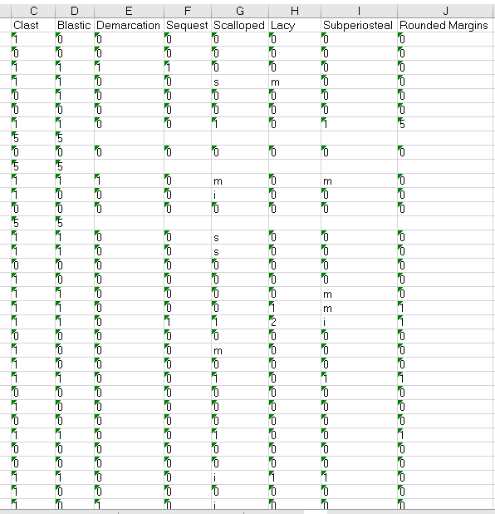
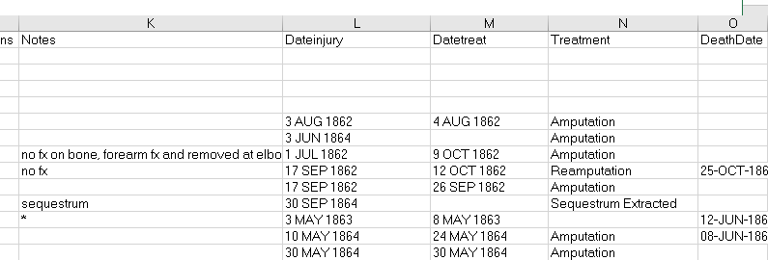
Problems with the data
Some problems I had was with this section of the data. In the data dictionary Dr. Barbian gave me it said that these were only supposed to contain “0” or “1” and these contained letters and “5”.
Another problem was with blank spaces so I added “NA” in.

Slide 4
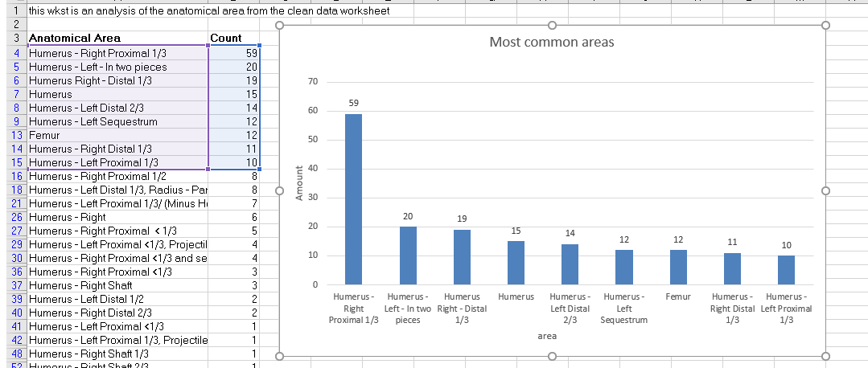
Discoveries:
I discovered that the Humerus was the body part that got hurt the most overall. Especially the Right Proximal
I figured this out by Copying over all the anatomical areas and then selecting the unique records only. I then counted these with =Countif(). I took the top 10 and put them into the chart.

Slide 5
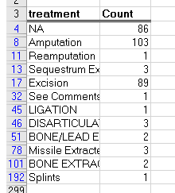
Discoveries:
Another Discovery was that Amputation or excision was the most common treatment of the fractures.

Slide 6
Conclusions
Fractures are most common in the humerus
Most common treatment is amputation or excision
Most injuries happened on May 3.
Multiple battles happening near the Battle of Chancellorsville.

Slide 7
Future Work:
Make the date fields, date fields
Figure out how long between injury, treatment and death
Figure out the fields I had deleted

