Slide 1
Debitage Data
By: Ayden Schweter

Slide 2
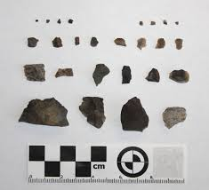
What is Debitage?
Debitage is the scraps that were left over from ancient stone tool making. They usually consist of flakes that are sharp edged, and they can range from small to large.

Slide 3
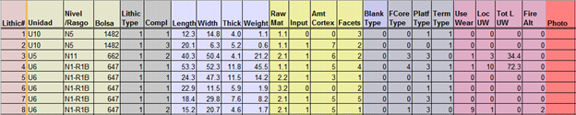
The Data Set
Provided by Dr. Stacy Dunn of the Anthropology department.
Consists of... 83 columns, 756 records, 198 KB.
Also provided a document showing what each row title meant.

Slide 4
My Question
What I wanted to find using this data was how big the pieces of debitage were that came from one certain location, that location being U10 location (Unidad 10), and to see just how large the biggest piece of debitage was.

Slide 5
Cleaning
Not much cleaning needed. Removed things I didn't think were necessary to answer my question.

Slide 6
Failures
Only one problem, VLOOKUP doesn't work, similarly to Nathan's Data set.

Slide 7
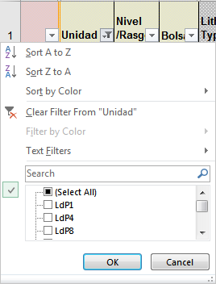
Analysis
Set up a filter to see only U10 location.
Found that 33 records came from U10.
After finding records from U10, set filters for the length, width, thickness, and weight categories so they appear from smallest to largest.

Slide 8




Analysis cont.
With other filters I found that the largest piece of debitage was 28.0 cm long, 32.0 cm wide, 9.9 cm thick, and 7.9 grams.

Slide 9
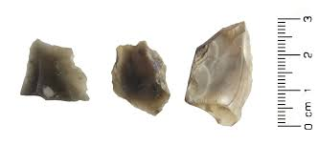
Conclusion
In conclusion, I found that a total of 33 records were stored under the U10 location. The largest piece of debitage from U10 was 28.0 cm long, 37.0 cm wide, 9.9 cm thick, and it weighed 7.9 grams, which is actually very small compared to other pieces of debitage from different areas.

Slide 10
Future Work
Could possibly use the data set to find out which location produces the biggest pieces of debitage data.
Could als0 be used to see where the smallest debitage came from.

