Slide 1
Police shootings
Dylan Binda
DSCI MWF
12/3/2019

Slide 2
Data Overview
Kaggle
Shows civilians shot and killed by on duty police officers
2015 to the present day
Updated in 2017
Data
2356 Records
12 fields

Slide 3
Fields
Name
Age
Race
Gender
City
State
Manor of death
Threat level
Armed
Sign of mental illness
Fleeing
Body camera

Slide 4
Problems
Race Field
A, W, B, H, N, and O
Did some research to find out
A- Asian
W- White
B- Black
H- Hispanic
N- Native American
O- Unknown
Find and replace to fix it

Slide 5
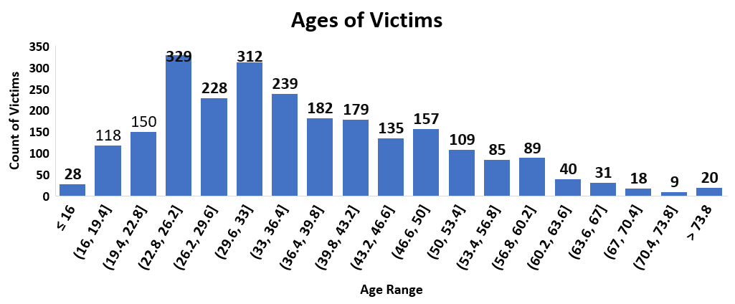
Age Field

Slide 6
Age Field
max | 91
Q3 | 45
Q2 | 34
Q1 | 26
min | 6
5 Number summary
Lead me to find some interesting Points
Frank Wratney (8/3/17)
91 years old, armed with a gun,
Union Township Pa
Jeremy Mardis (3/11/15)
6 years old, parents were fleeing in car,
Marksville La

Slide 8
Weapons Used

Slide 9
Future Work
Look more in depth at the fields and try to find a relationship between some of them
Obviously, there is a relationship between the person being armed and that’s why they were shot
Id like to do more research on whether the shooting was justified and/or what happened to the officer

