Slide 1
PowerPoint
A Few Thoughts

Slide 2
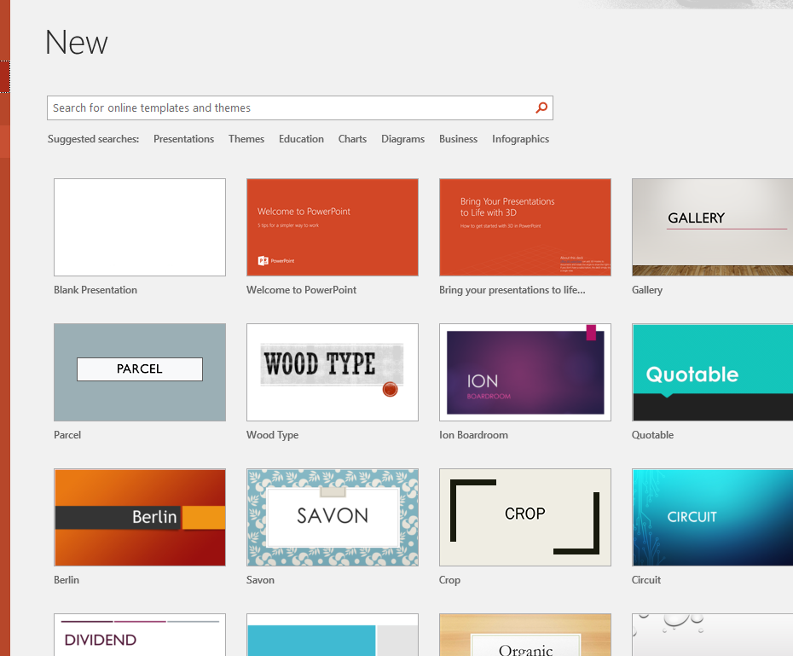
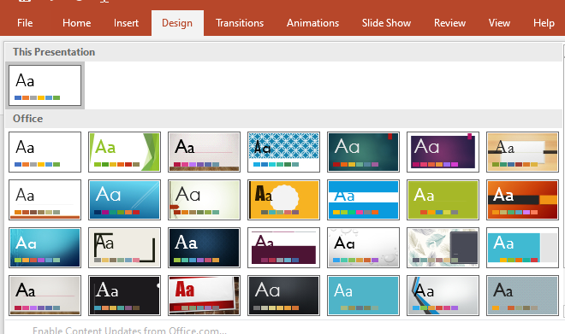
Theme
Select at the start
Select from the Design tab
Build your own

Slide 3
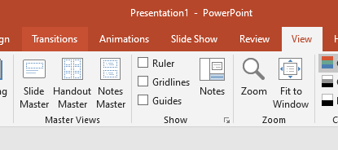
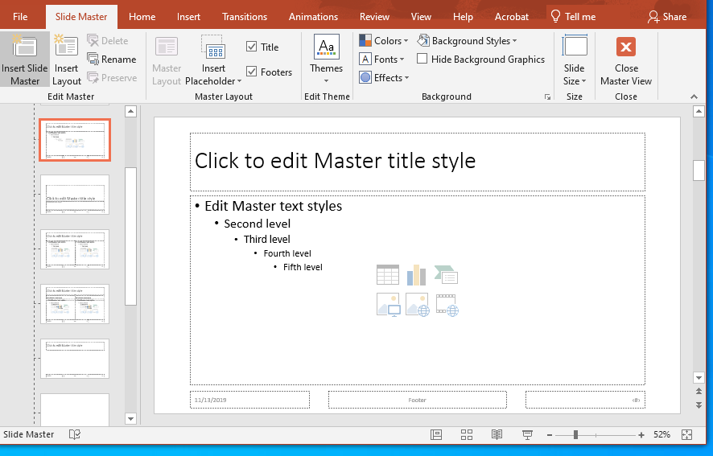
Build your own
View Tab
Master Views command group
Slide Master

Slide 4
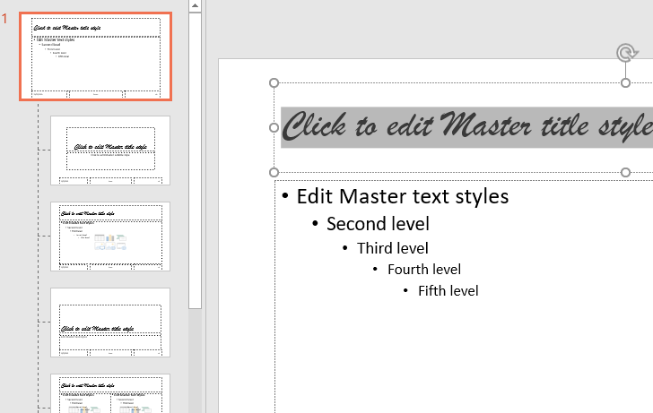
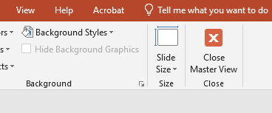
Editing the Master
Page 580 of your book.
I only do this for small fixes.
But if you are artistic, go for it.
Note:
Slide Master tab
Work on the top master applies to all children
Close Master View
Let’s give it a try.

Slide 5
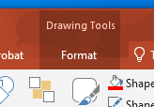
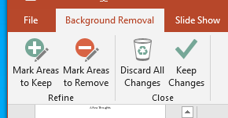
Removing Background of an Image
Insert an image.
Click on the Drawing Tools Format tab
Select Remove Background
Use the tools to remove the background.

Slide 6
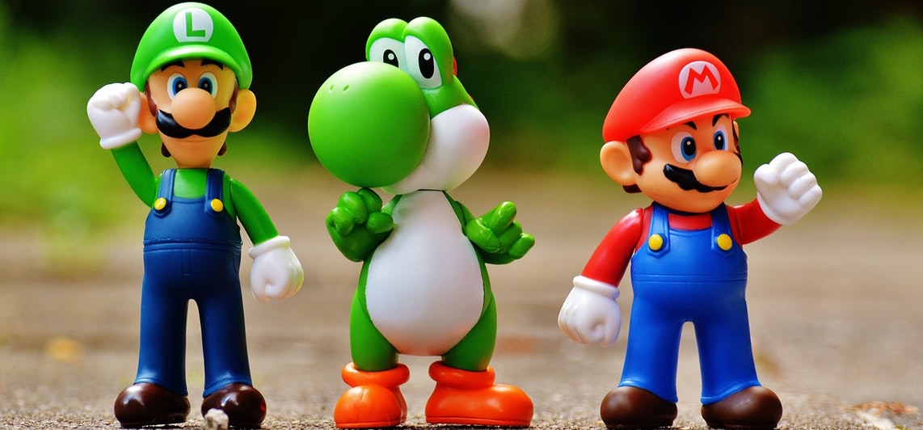
Try It

Slide 7
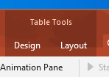
Inserting a Table
Hair Color | Bad | Good | Neutral
Black | 30% | 64% | 6%
No Hair | 48% | 49% | 3%
Brown | 32% | 62% | 6%
White | 47% | 41% | 6%
Blond | 12% | 82% | 2%
Red | 15% | 80% | 5%
Insert the table
Use the Table Tools
Fix the formatting
Don’t’ forget about the font size.
Hair Color | Bad | Good | Neutral
Black | 30% | 64% | 6%
No Hair | 48% | 49% | 3%
Brown | 32% | 62% | 6%
White | 47% | 41% | 6%
Blond | 12% | 82% | 2%
Red | 15% | 80% | 5%

Slide 8
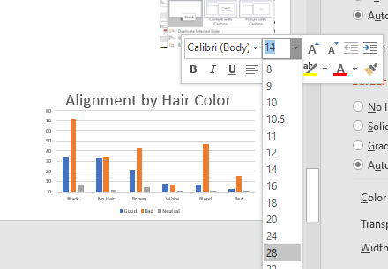
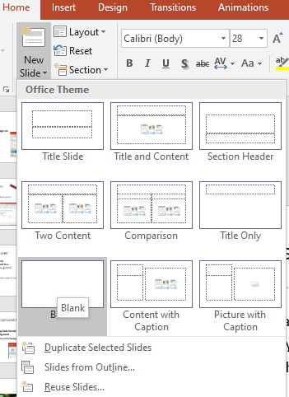
Usable Charts
Insert them.
Then make them readable.
Perhaps on a slide by themselves
Don’t forget about the blank slide

Slide 10
Don’t Do This
Hair Color | Bad | Good | NA | Neutral
Yellow |  | 2
No Hair | 35 | 37 |  | 3
White | 10 | 10 | 1 | 2
Strawberry Blond | 3 | 4
Silver |  | 3 | 1
Red / White |  | 1
Red / Orange | 1
Red / Grey | 1
Red | 9 | 40 |  | 2
Purple | 3 | 1 |  | 1
Pink |  | 1
Orange / White |  | 1
Orange |  | 2
NA | 53 | 114 | 3 | 2
Magenta |  | 1
Indigo |  | 1
Grey | 3 | 2
Green | 1 | 7
Gold | 1
Brownn | 1
Brown / White |  | 4
Brown / Black |  | 1
Brown | 27 | 55 |  | 4
Blue | 1 | 1 |  | 1
Blond | 12 | 87 | 2 | 1
Black / Blue | 1
Black | 42 | 111 |  | 8
Auburn | 3 | 10

Slide 11
Or This

Slide 12
Use Shapes to Emphasize Items
Add the chart or table.
Insert a Shape to highlight important elements
Grouping elements makes it easier!
50% Bad

Slide 13
Animations
Text item 1
Text item 2
Text item 3
Mark Pictures
Reorder as needed
SHIFT-F5 to preview

