Slide 1
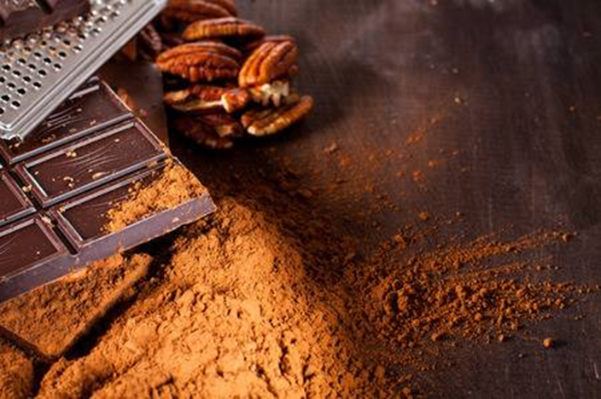
Flavors of Cacao
Nationwide Chocolate Ratings
Tori Unger
DSCI 101
Fall 2018
Notes:
Cacao: a bean that is fermented, dried, and grinded to make ingredients (cocoa) for chocolate

Slide 2
Reviews of Chocolate Flavors
Which country sells the best tasting chocolate?
What makes chocolate tasty?
10 Fields investigated
Company (Maker-if known)
Specific Bean Origin or Bar Name
REF
Review Date
Cocoa Percent
Company Location
Rating
Bean Type
Broad Bean Origin
Rating Description

Slide 3
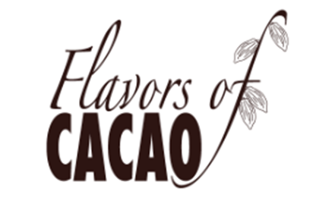
My Data
Flavors of Cacao dataset from Kaggle.com
Originally from Flavors of Cacao database
Compressed CSV file
30 kB
125 kB

Slide 4

Cleaning the Data

Slide 5
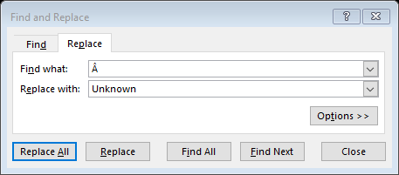
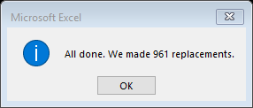
Cleaning Methods
Simple formatting
Fixing spaces
Â’s everywhere
CompanyÂ (Maker-if known) | Specific Bean Origin or Bar Name | REF | Review Date | Cocoa Percent | Company Location | Rating | Bean Type | Broad Bean Origin
Askinosie | San Jose del Tambo | 175 | 2007 | 0.7 | U.S.A. | 3 | Forastero (Arriba) | Ecuador
Bahen & Co. | Houseblend | 1474 | 2015 | 0.8 | Australia | 3.25 | Â | Â
Bahen & Co. | Papua New Guinea | 1474 | 2015 | 0.7 | Australia | 3.5 | Â | Papua New Guinea
Bahen & Co. | Sambirano | 995 | 2012 | 0.7 | Australia | 3 | Trinitario | Madagascar

Slide 6
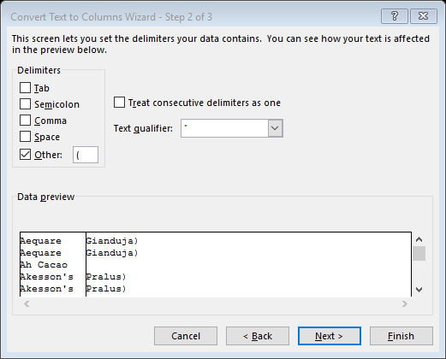
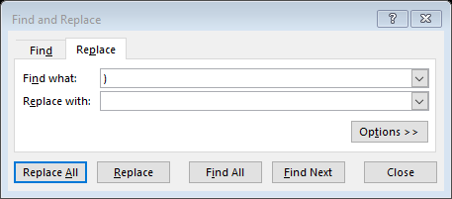

Cleaning Methods
Splitting cells
Consistency issues

Slide 7
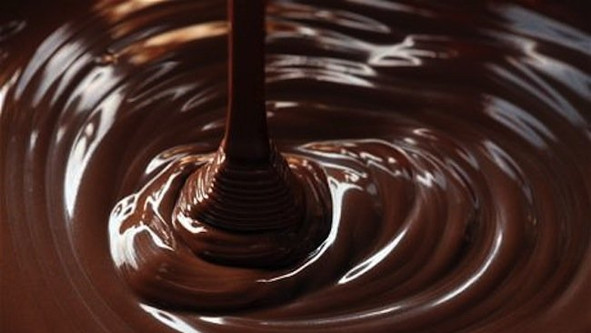
Analyzing the Fields
This Photo by Unknown Author is licensed under CC BY-NC

Slide 8
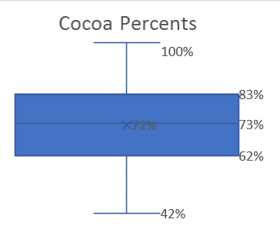
Native Fields
Company
Text
Amedei
Review Date
Integer
2007
Cocoa Percent
Percent
70%

Slide 9
Native Fields
Company Location
Text
Italy
Rating
Based on flavor, texture, after melt, and overall opinion
Decimal
3.75

Slide 10
Native Fields
Average of Rating | Column Labels
Row Labels |  | Amazon mix | Beniano | Blend | Criollo | Criollo, Trinitario | Forastero | Forastero (Arriba) | Forastero (Nacional) | Forastero (Parazinho) | Trinitario
Belize |  |  |  |  |  |  |  |  |  |  | 4.00
Bolivia |  |  | 4.00
Brazil |  |  |  |  |  |  |  |  |  | 4.00
Colombia |  |  |  |  |  |  |  |  | 4.00
Costa Rica |  | 4.00
Dom. Rep., Madagascar |  |  |  | 4.00
Dominican Republic
Ecuador |  |  |  |  | 4.00 | 4.00 |  | 4.00 |  |  | 4.00
Ghana |  |  |  |  |  |  | 4.00
Gre., PNG, Haw., Haiti, Mad |  |  |  | 4.00
Guat., D.R., Peru, Mad., PNG
Guatemala |  |  |  |  | 4.00
Haiti
Indonesia |  |  |  |  |  |  |  |  |  |  | 4.00
Jamaica |  |  |  |  |  |  |  |  |  |  | 4.00
Madagascar |  |  |  |  | 4.00 | 4.00 |  |  |  |  | 4.00
Mexico |  |  |  |  | 4.00
Nicaragua |  |  |  |  |  | 4.00
Papua New Guinea |  |  |  |  |  |  |  |  |  |  | 4.00
Peru |  |  |  |  | 4.00 |  |  |  | 4.00 |  | 4.00
Peru, Dom. Rep
Sao Tome |  |  |  |  |  |  | 4.00
Sao Tome & Principe |  |  |  |  |  |  | 4.00
South America |  |  |  |  |  | 4.00
St. Lucia |  |  |  |  |  |  |  |  |  |  | 4.00
Tobago |  |  |  |  |  |  |  |  |  |  | 4.00
Unknown |  |  |  | 4.33
Ven, Bolivia, D.R. | 4.00
Venezuela |  |  |  |  | 4.00 |  |  |  |  |  | 4.17
Venezuela, Java |  |  |  | 4.00
Vietnam |  |  |  |  |  |  |  |  |  |  | 4.00
Bean Type
Text
Trinitario
Broad Bean Origin
Text
Venezuela

Slide 11
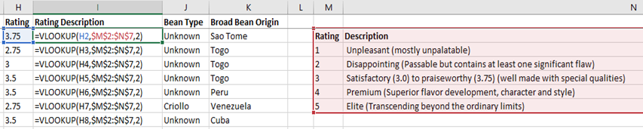
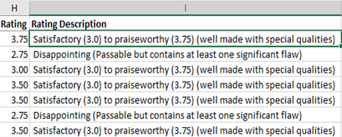
Derived Fields
Rating Description

Slide 12
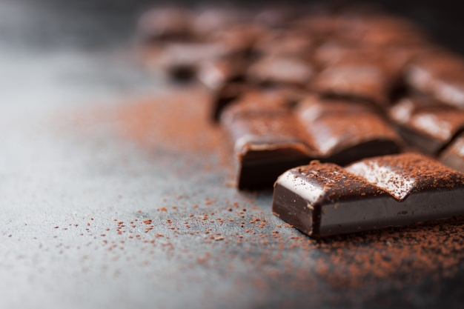
Conclusions

Slide 13
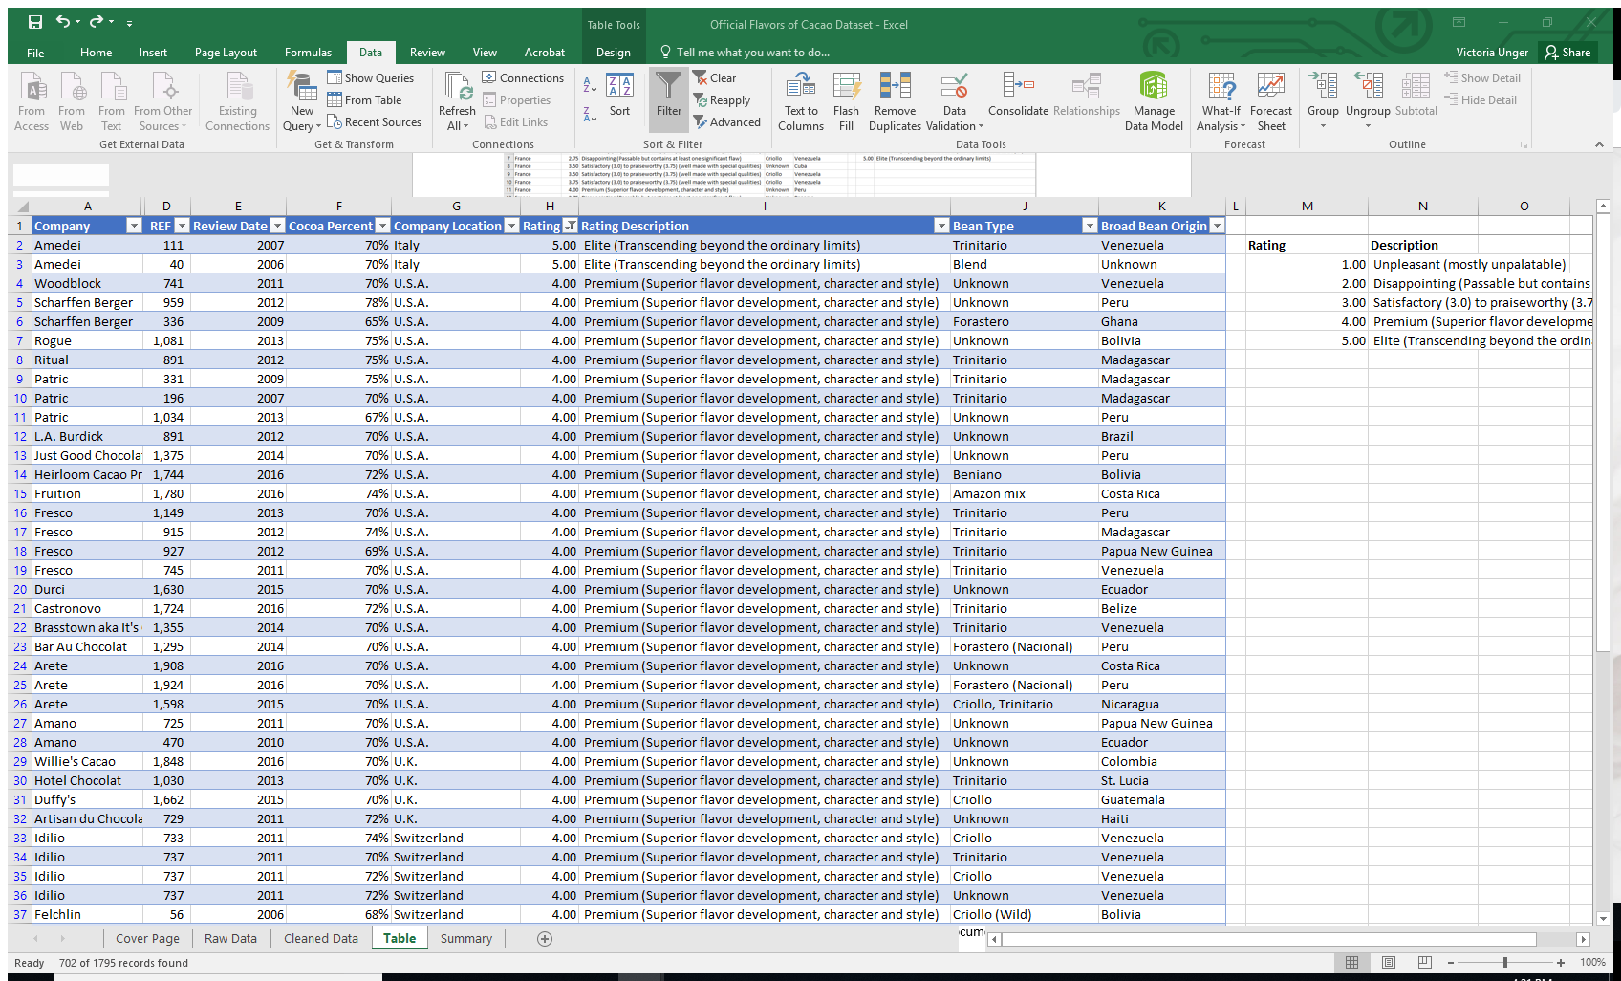
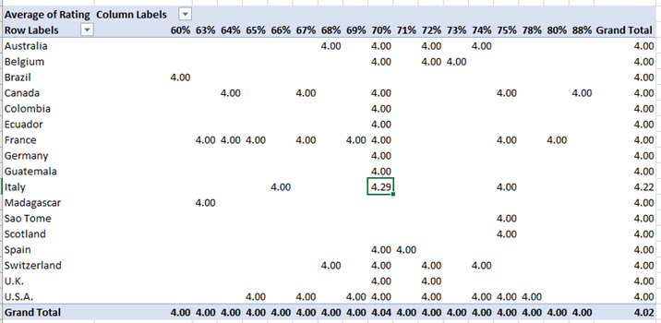
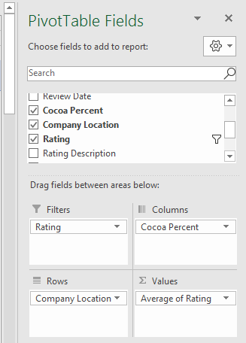
Where is the Highest Rated Chocolate?
Amedei company in Italy

Slide 14
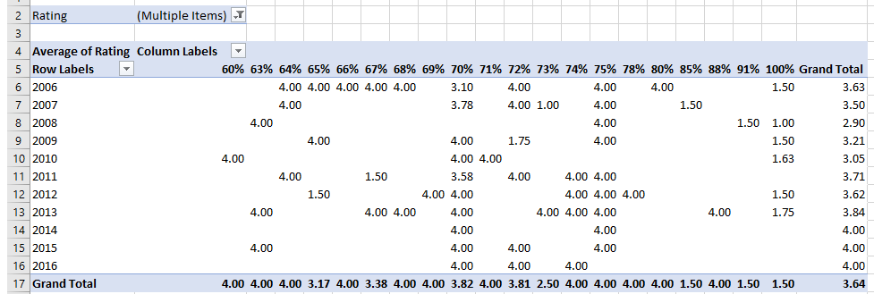
What Factors Contribute to the Tastiest Chocolate?
Cocoa Percent

Slide 15
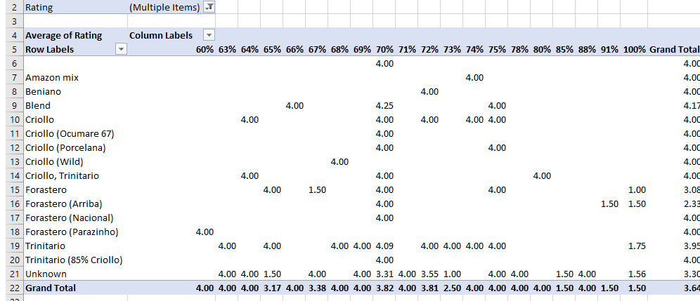
What Factors Contribute to the Tastiest Chocolate?
Type of Bean

Slide 16
Future Work
Fix the Specific Bean Origin or Bar Name
Names of chocolate bars
Impacts on ratings
Reviewers
Same people?
Why significant drop in 2017?

Slide 17


Questions or Comments?
Thank you for your time!

