Slide 1
Where it Pays to Attend College
Sally Sterkel
DSCI 101
Fall 2018
An Investigation on the Best College Degrees

Slide 2
Introduction
College degrees (undergraduate majors)
Type of college
Region the school is located
What combination of these factors will result in the highest salaries?
Is it possible to estimate a future salary based on where you attend college?

Slide 3
My Data
Obtained from kaggle.com
Posted in the Wall Street Journal in 2017
  Based on data collected from Payscale, Inc.
  No information on how Payscale, Inc. collected the data

Slide 4
My Data
3 Excel files
  degrees-that-pay-back
    5KB
    51 different degrees that people graduated with and the salaries associated with that degree
  salaries-by-college-type
    31KB
    270 colleges and the salaries of graduates
  salaries-by-region
    38KB
    321 colleges and the salaries of graduates based on the region where the school is located

Slide 5
The Dataset
Undergraduate Major
School Type
  Engineering
  Party
  Liberal Arts
  Ivy League
  State
Region
  California
  Western
  Midwestern
  Southern
  Northeastern
  Mid-Career Median Salary
    Used to produce my results
  Mid-Career Percentile Salaries
    10th
    25th
    75th
    90th

Slide 6
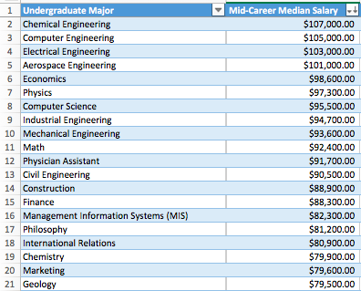
Degrees That Pay Back
Created table to see which careers had the highest mid-career median salary
  Descending order based on Mid-Career Median Salary
All Engineering majors are in the top 13

Slide 7
Salaries by Region
I wanted to see which regions produced the highest average salaries
AVERAGE function
Average Mid-Career Median Salary By Region
California | =AVERAGE(D2:D29)
Western | =AVERAGE(D30:D71)
Midwestern | =AVERAGE(D72:D142)
Southern | =AVERAGE(D143:D221)
Northeastern | =AVERAGE(D222:D321)
Average Mid-Career Median Salary By Region
California | $93,132.14
Western | $78,200.00
Midwestern | $78,180.28
Southern | $79,505.06
Northeastern | $91,352.00

Slide 8
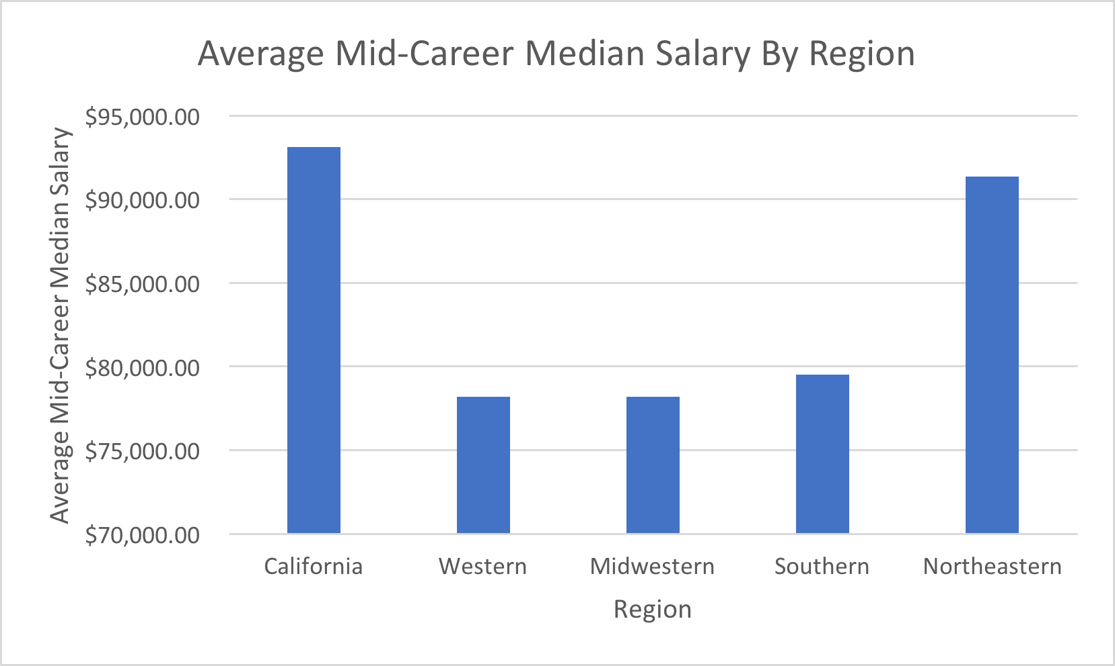
Salaries by Region
Used that data
to build a bar graph
California and
Northeastern
schools have
graduates earning
the most

Slide 9
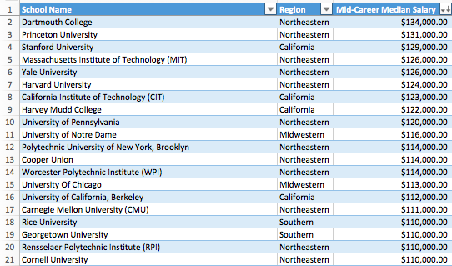
Salaries by Region
Which schools in
particular?
Built another table
Almost all NE and
California schools
  Ivy League

Slide 10
Salaries by School Type
I wanted to see which type of school produced the highest average salaries
AVERAGE function
Average Mid-Career Median Salary Based on School Type
Engineering | =AVERAGE(D2:D20)
Party | =AVERAGE(D21:D40)
Liberal Arts | =AVERAGE(D41:D87)
Ivy League | =AVERAGE(D88:D95)
State | =AVERAGE(D96:D270)
Average Mid-Career Median Salary Based on School Type
Engineering | $103,842.11
Party | $84,685.00
Liberal Arts | $89,378.72
Ivy League | $120,125.00
State | $78,567.43

Slide 11
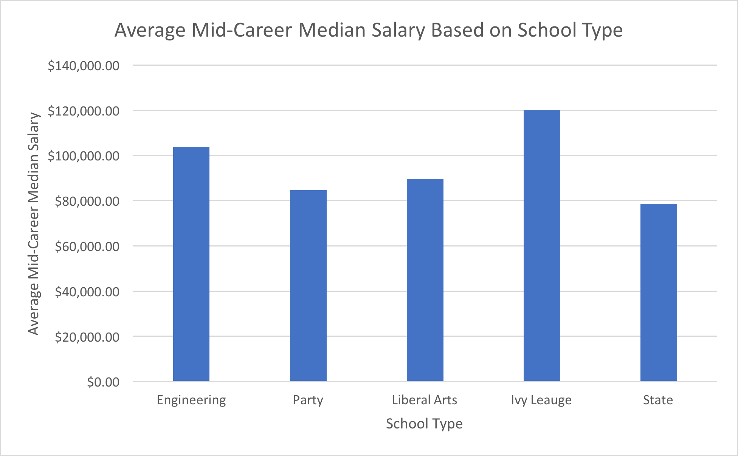
Salaries by School Type
Bar graph
Ivy League
Engineering

Slide 12
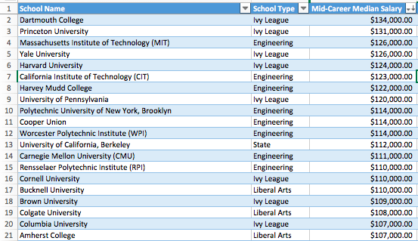
Salaries by School Type
Built table to
identify which
schools in particular
Only 1 state school
All Ivy Leagues
Engineering

Slide 13
Ivy League
Wondered if the Ivy League schools were skewing our data for the Northeast region
Copied worksheet and deleted the Ivy Leagues
Found the averages again for mid-career median salary based on region, this time without the 8 Ivy League schools included
Average Mid-Career Median Salary By Region
California | $93,132.14
Western | $78,200.00
Midwestern | $78,180.28
Southern | $79,505.06
Northeastern | $88,850.00

Slide 14
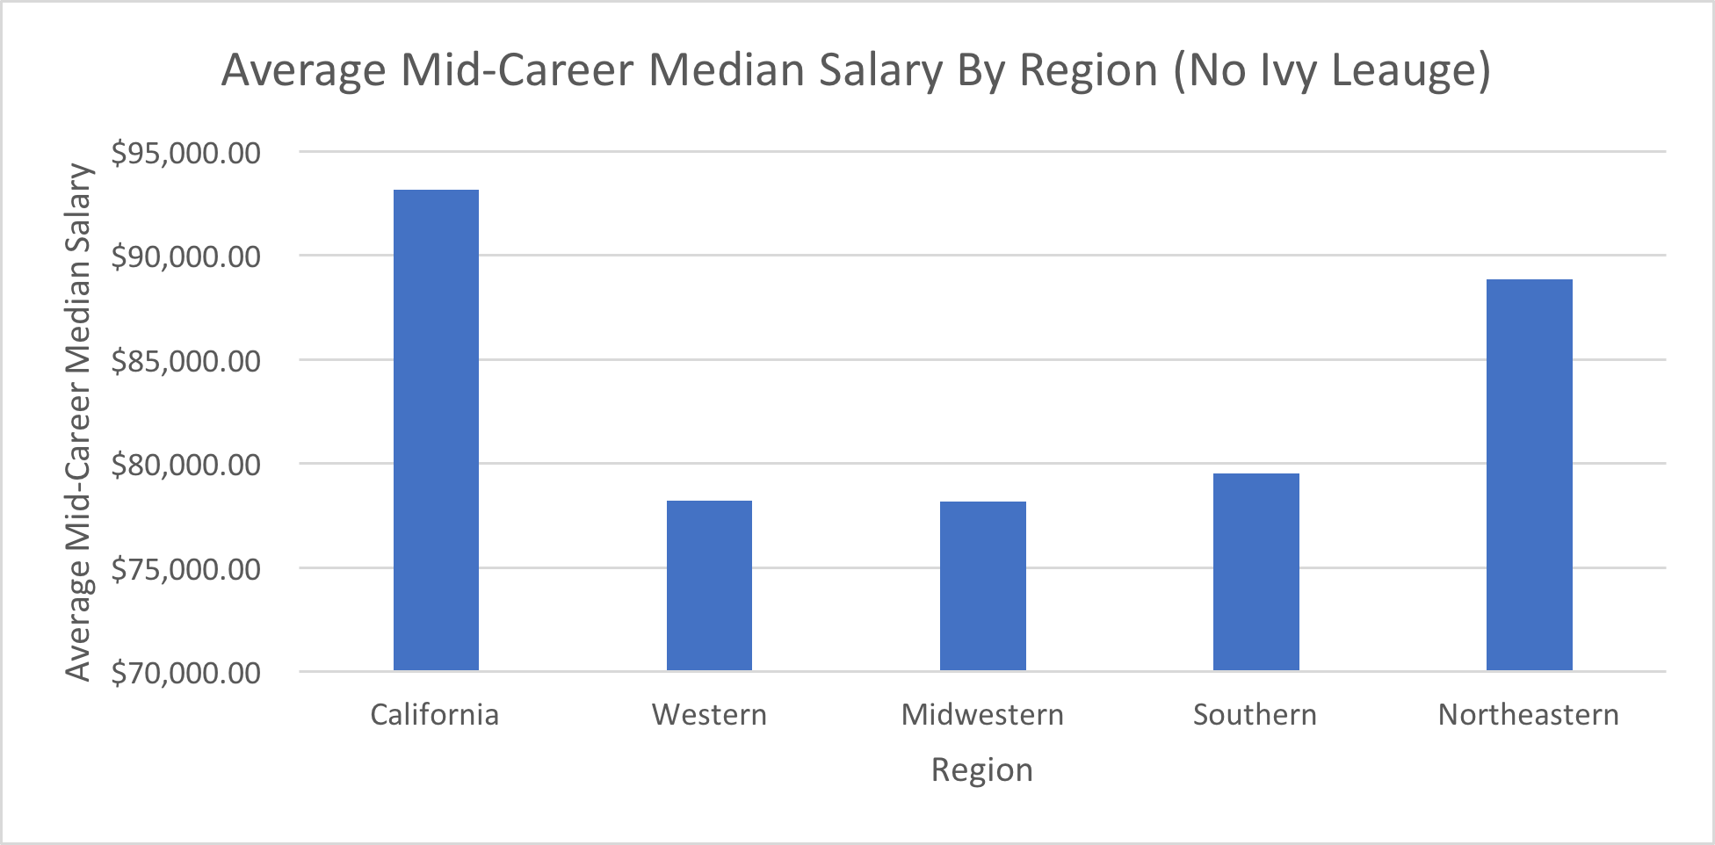
Ivy League

Slide 15
Ivy League
The Northeastern average originally $91,352.00.
Without Ivy League schools it lowered to $88,850.00.
Although it did lower, the Northeastern region still has higher mid-career earnings than the Western, Midwestern, and Southern regions.
The Ivy League schools did not impact it as much as I thought they might

Slide 16
Conclusions
Dartmouth appeared first in both the region and school type categories.
The schools located in the Northeastern or California regions tend to produce graduates who make more money mid-way through their careers than the Western, Midwestern, or Southern regions.
Ivy League and Engineering schools are at the top for school type.
State, liberal arts, and party schools were spread throughout the rest of the list.
Engineering majors appeared the most for the best degrees.

Slide 17
Conclusions
What combination of these factors will result in the highest salaries?
The best combination of all 3 categories based on my findings:
  Undergraduate major = Chemical Engineering
  School type = Ivy League (specifically Dartmouth)
  Region = Northeastern region

Slide 18
Conclusions
Is it possible to estimate a future salary based on where you attend college?
Although you cannot predict the future, this project could help someone make a decision about the college they are thinking of attending or a possible career path.

Slide 19
Problems & Future Work
I experienced no problems with this data.
Future work and questions:
  More schools could be added to the data
  Worksheet that deals with how much you earn based on your college GPA
  I am also wondering if the region you get a job in, not necessarily where you went to school, would be a major factor in determining salary.

