Slide 1
2017 Book Dataset
By Alexander Sankey

Slide 2
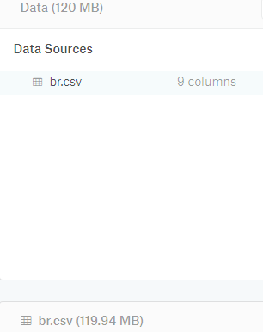
Introduction
2017 Book Data
Secondary Source: Kaggle
Primary Source: Goodreads
Originally a CVS file that I converted to an Excel Worksheet

Slide 3
Goals
What was the most popular book in 2017
I wanted to figure out the correlation between ratings and reviewer rankings
if certain authors received a higher amount of ratings compared to the other authors
Which author has the highest amount of ratings
What was the highest rated book in 2017

Slide 4
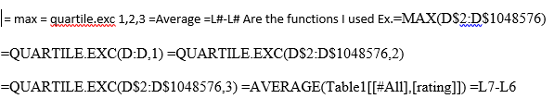
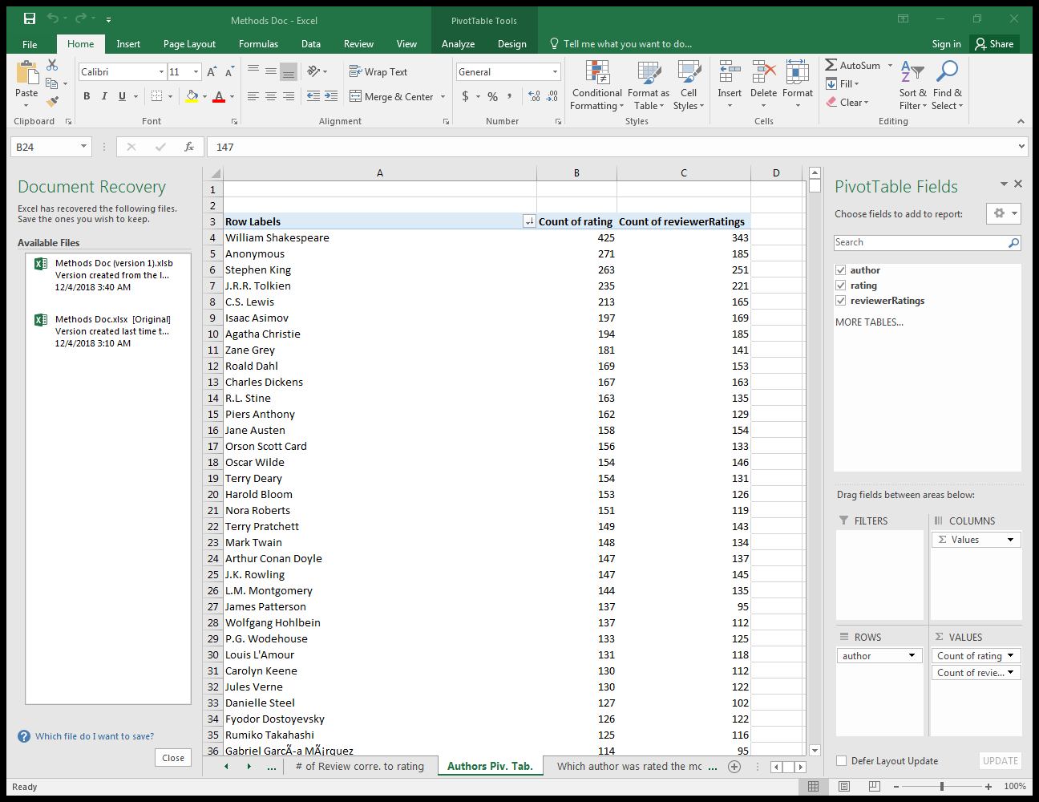
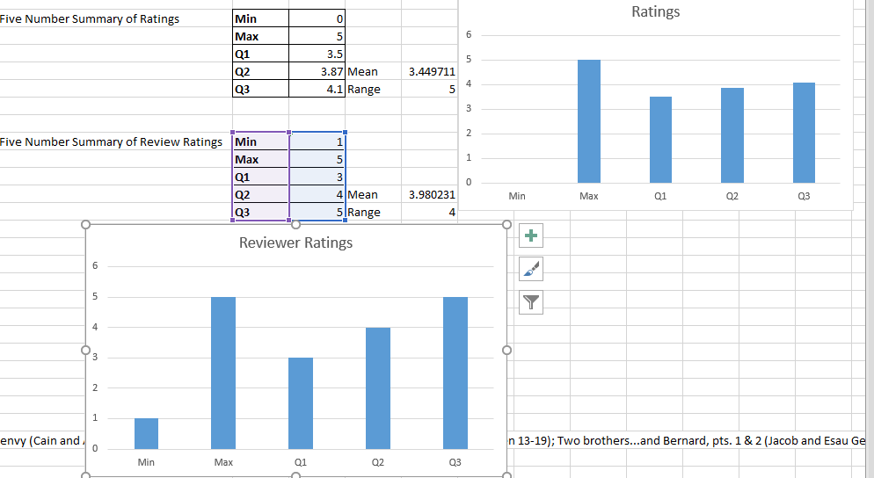
Data Cleaning
Pivot Table for Author
Five Number Summary For ratings and Reviewer Rankings
Mean and Range
Pivot Table for Amount of ratings to determine the most popular book of 2017
I got rid of the Book ID as it was useless information

Slide 5
Summary/Findings
Highest Rated Author: William Shakespeare
Most Popular Book: Harry Potter and the Sorcerer's Stone (Harry Potter, #1)
Top 25 Authors all have best sellers and most have movies based on their books Ex. #25 J.K. Rowling
Correlation between rating and reviewer rating
highest rated book: Harry Potter y la piedra filosofal (Harry Potter, #1)

Slide 6
Future work/Errors
Pivot Table
Length of Time the book had been published
Page count correlation to rating
Highest selling book

Slide 7


Slide 8
Questions?

