Slide 1
Most Popular Lego Color
Zack Patz
Dsci 101
Section 007

Slide 2
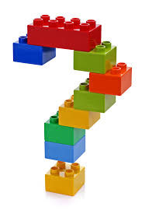
Different colors in Legos
In the data set there is 76 recorded colors for all the sets

Slide 3
My data set
The data consisted of 3 fields
RGB
Color
Number of how many times the color appeared in different sets

Slide 4
Problems with data
There were no problems with the data
All fields were present
All data appeared to be clean

Slide 5
My data
I received the data from Rickvenadata, a user on Kaggle.com
The file is 1.87 KB and consists of 3 columns

Slide 6
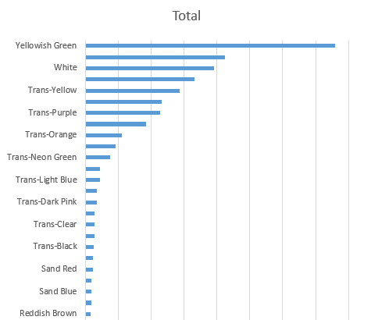
Discoveries
Looking through the data the most popular color found was Yellowish Green

Slide 7
Future work
Try to figure out the most common set ever sold
Figuring out what pieces are the most popular

