Slide 1
NFL Rushing Stats
(2002-2017)
Jesse Ohmer
DSCI 101
Section 2

Slide 2
NFL Rushing Stats for each Team
What team has had the best run game in the NFL since 2002?

Slide 3
My Data
The data set NFL Team Season Stats - Rushing
This dataset was obtained from kaggle.com
Contains data on 35 teams
  from 2002-2017
CSV file
  24.32KB

Slide 4
The Dataset
Consists of 13 fields
  YEAR
  Team
  GP
  Att
  Yds
  Avg
  Yds/G
  TD
  Big
  Fum
  FumL
  Stuff
  Yds

Slide 5
Data Cleaning Process
In my spreadsheet “Stuff” was changed to runs for loss
the second “yds” field was changed to “Negative yds” to keep the two “yds” fields separate
LA teams data was replaced with NA

Slide 6
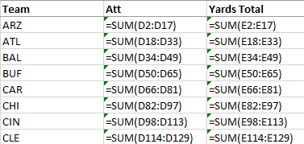
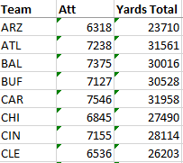
Methods
A new sheet containing each individual team’s attempts and yards total for the years recorded was made.

Slide 7
Methods
Graph of team totals

Slide 8
Methods
Five Number Summaries

Slide 9
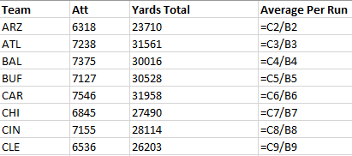
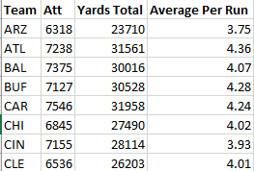
Methods
Next I found the average amount of yardage each team got through the fifteen-year span

Slide 10
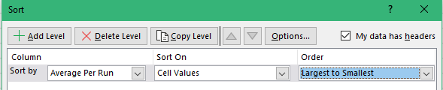
Methods
I then sorted the table on the Average Per Run column from largest to smallest

Slide 11
Methods
Graph of average yards

Slide 12
Conclusion
The Minnesota Vikings have had the best run game since 2002.

Slide 13
Future work
Perform the same analysis for passing stats in the NFL
Find which division has the best run game during the data period

Slide 14
Question?
Thank you for listening.

