Slide 1
Arrests in the NFL
Ishra Musa
DSCI 101

Slide 2
Arrests in the nfl
Dataset was obtained from Kaggle, originally from USA Today
  Kaggle user Patrick Murphy
The data contains the arrest records for NFL Players from January 2000 to March 2017.
    This set only includes crimes that are more serious than a traffic violation
86K CSV File
Notes:
The data contains the arrest records for NFL Players from January 2000 to March 2017.
This set only includes crimes that are more serious than a traffic violation
86K CSV File

Slide 3
The Dataset
11 Fields
  Date, team, name, position, case, category, description, and outcome
  All text fields except for “date”
Got rid of date, team, description, and outcome
  The only useful fields were position, case, and category

Slide 4
Notes:
This is a bit of the original data…the description column is really interesting. When you get toward the bottom, towards around 2006, they get really weird. The most recent ones are just a lot of DUI’s and crimes involving drugs.

Slide 5
Data Dictionary
Date – exact day in where the player was arrested
Team – which team the player plays for
Name – their name
Position – what position they play
Case – what their case was classified as (arrested, charged, cited etc.)
Category – why they were brought in (DUI, theft, domestic violence etc.)
Notes:
The date field in the spreadsheet gives us the exact day in which the player was arrested on said charge.
The team field in the spreadsheet gives us which team the player plays for.
The name field in the spreadsheet gives the name of the player.
The position field in the spreadsheet gives us the position in which the player plays.
What the arrest was classified as. In our case, it is either arrested, charged, cited, indicted, surrendered, died, or summoned.
This field gives us why they were brought in for, which could be for drugs, a DUI or even theft.

Slide 6
Data cleaning & Pivot Table
My dataset was clean for the most part
  However I did have to get rid of the fields that didn’t provide me with the necessary information
To analyze my data, I used a Pivot Table
  A pivot table is useful when you want to analyze a set of information
My Question: which position gets arrested the most for domestic violence?
  Different categories of domestic violence (i.e. with gun, rape, or alcohol

Slide 7
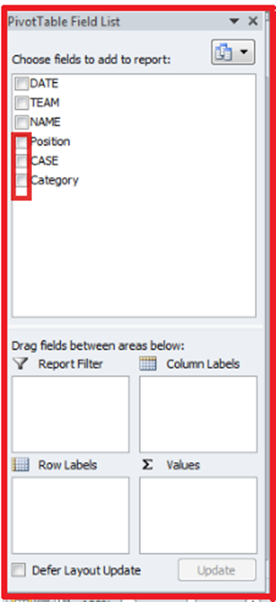
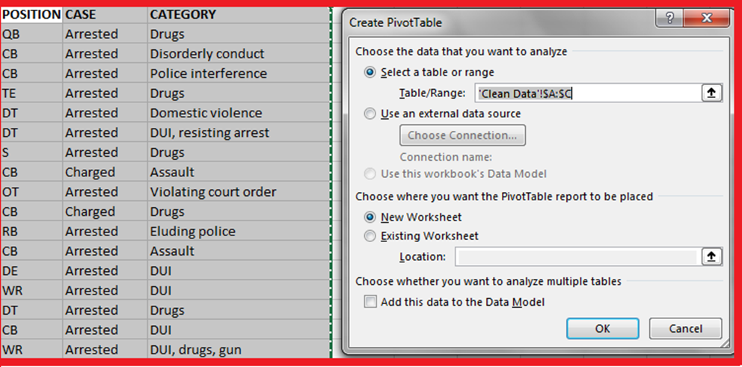
Pivot Table
Inserted a Pivot Table to a new worksheet
Position field in “Row Labels”
Case field in “Values”
Category field in “Column Labels”

Slide 8
results
Notes:
From the pivot table, we can see that Running Backs are arrested the most for domestic violence. They were arrested a total of 17 times. Others that were arrested for domestic violence were Linebackers (arrested 14 times), Wide Receivers, Cornerbacks, and Linemen were all tied at 10 for times arrested for domestic violence. In my data, there are sections in domestic violence broken down to alcohol, gun, and rape as I mentioned before. There was only 1 Tight End who was arrested for domestic violence involving alcohol. Furthermore, there was only 1 Running Back and Cornerback arrested for domestic violence involving a gun and 1 Linebacker arrested for domestic violence involving rape.
--
Before I messed with the row labels and changed it to Domestic Violence, I looked at animal cruelty field involving alcohol, and apparently QB’s are big in those fields. I don’t know what that says about them, but… And while QB’s were only arrested once in this dataset, they have a ton of other citations in disorderly conduct and DUI’s.

Slide 9
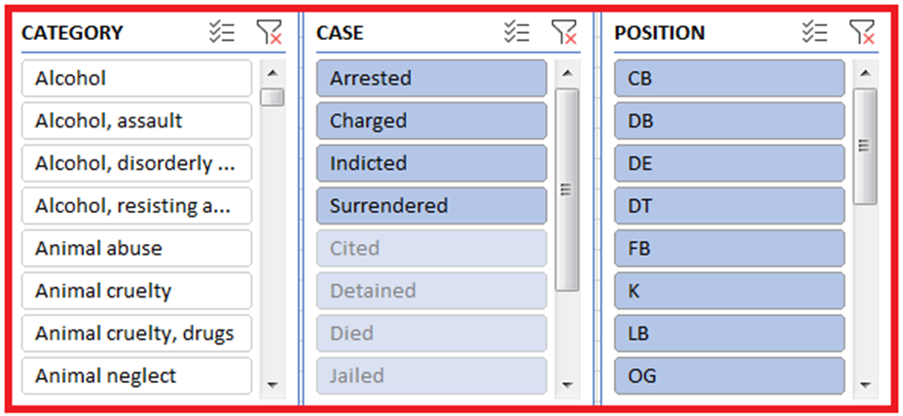
Slicers
Notes:
I added in slicers so I could switch back and forth between the category, case, and position fields. This really helped when I wanted to determine what RB’s were arrested for the most besides domestic violence….which *hint* was a field also involving assault.

Slide 10
Future Work
Offensive Vs. Defensive Players
Outcome Field
Notes:
For future work I could definitely make a correlation between offensive and defensive linemen and see which one’s were arrested the most for a specific case. I could also try to do something with the outcome columns and see which one’s were guilty (or not) of the charges and see if the charges actually held up. So there are a few more things I could do with this dataset.

Slide 11
Questions?

