Slide 1

National Football League Passers 1996-2016
Halie Lewis
Wikipedia

Slide 2
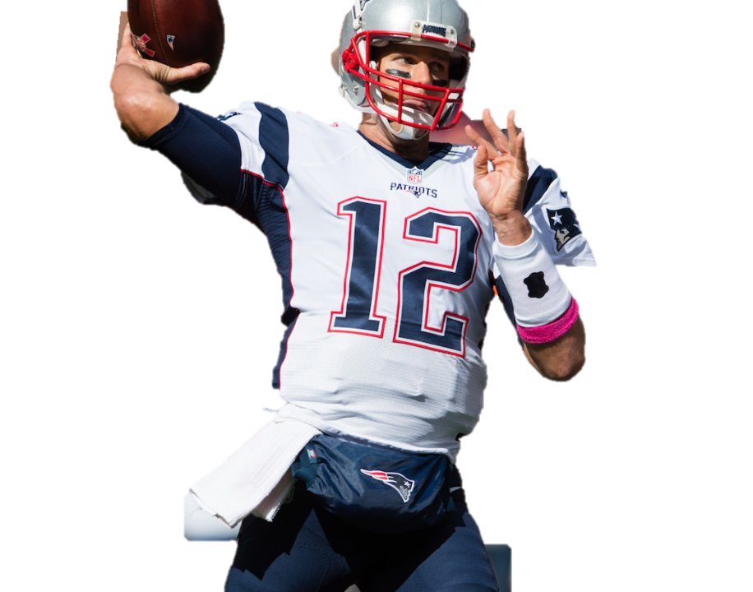
Overview
When are quarterbacks (QBs) the best?
Best recent QB
Pro Football Focus
Notes:
Define what a QB is/ Does

Slide 3
The Dataset
Kaggle - CSV file
  The Football Database
Regular Season 1996-2016
13,189 records, 14 columns
Non-Quarterbacks
Notes:
Converted to excel workbook file
Each record was information from single game for a single player

Slide 4
Cleaning the data
QB column
  Sort
5 full regular seasons ~ 80 games
  Eliminates non-passers, backups, and limited experienced players
  53 QBs

Slide 5


Are Quarterbacks Better As They Gain Experience?
Pivot Table and Slicers
New sheet with both halves
Box-and- whiskers
  Average Pass Attempts
  Average Pass Completions
  Average Yards Per Game
  Average Yards Per Attempt
  Average Number of Touchdowns
  Average Number of Interceptions
  Average Game Points
  Average Passer Rating
St Francis Xavier School
Oystermouth Parish
Notes:
Slicers on last name and year. Most of pivot tables were average calculations. This was in case a qb had odd number of playing seasons the more seasons went with the first half.
Talk about what some of those things mean in terms of football
Some of these stats were very close. I will feature those that are notable.

Slide 6

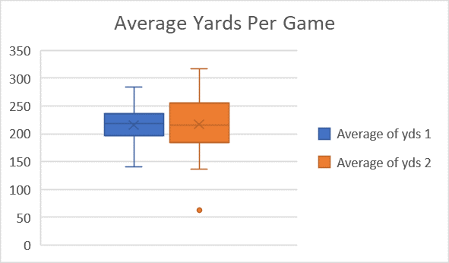

Slide 7
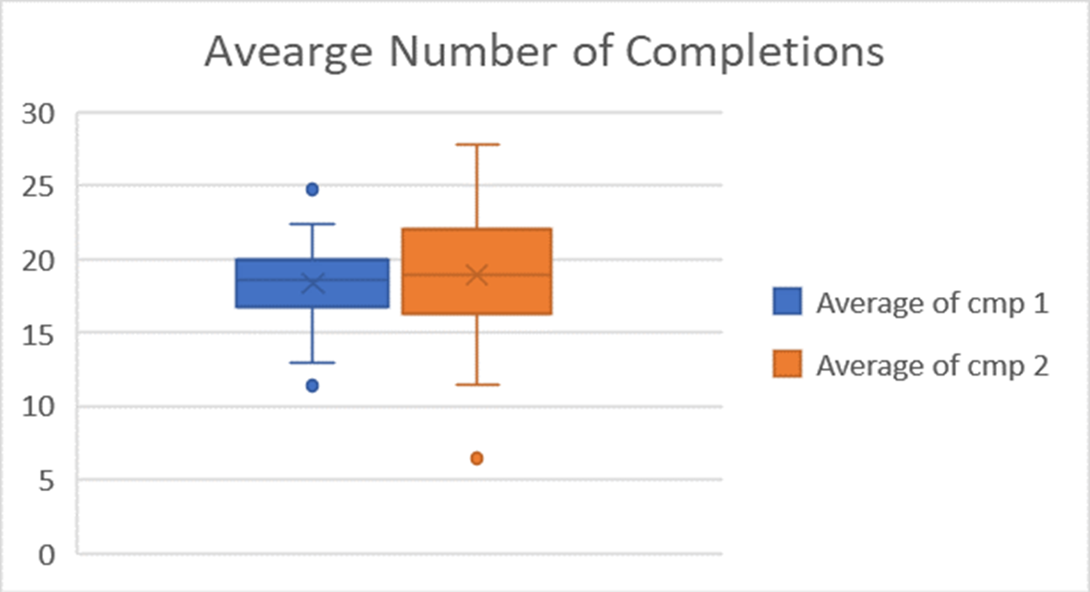

Slide 8
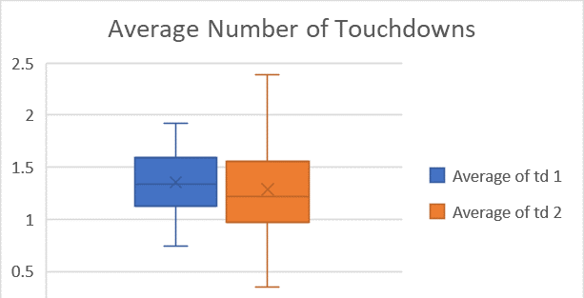

Slide 9
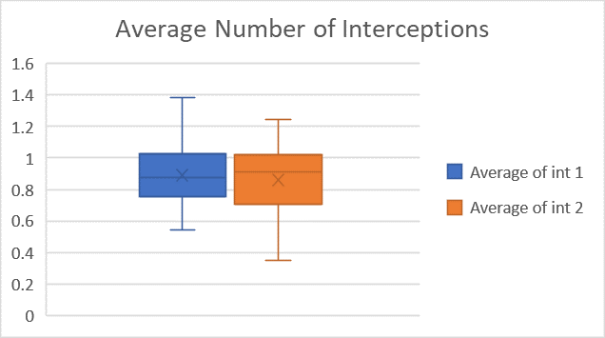

Slide 10
Better Second or First Half of Career
Data close in many areas
Better with Experience

Slide 11
Who is the Best Recent Quarterback
Same pivot table and slicers
  Recent QBs with Passer Rating around upper 80s or higher
Compared 10 QBs
  Line graphs
  Close results
Notes:
Recent meaning currently playing or recently retired

Slide 12
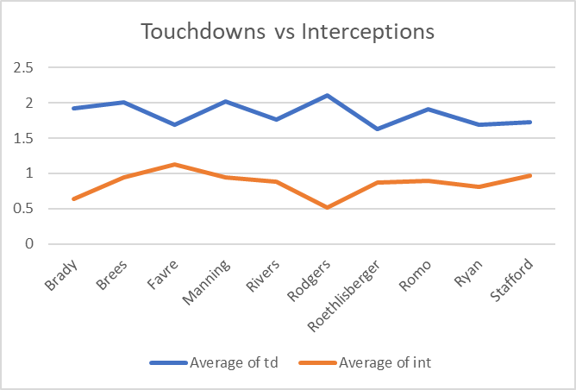

Slide 13
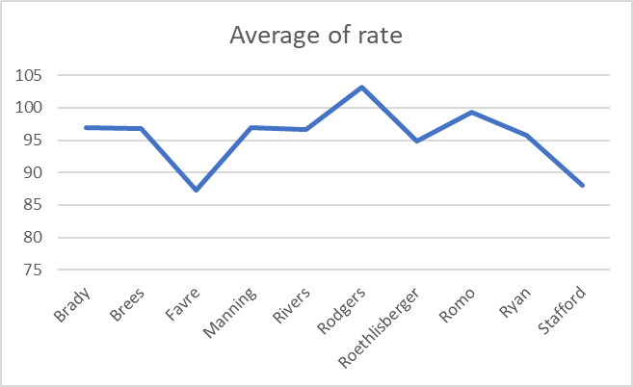

Slide 14
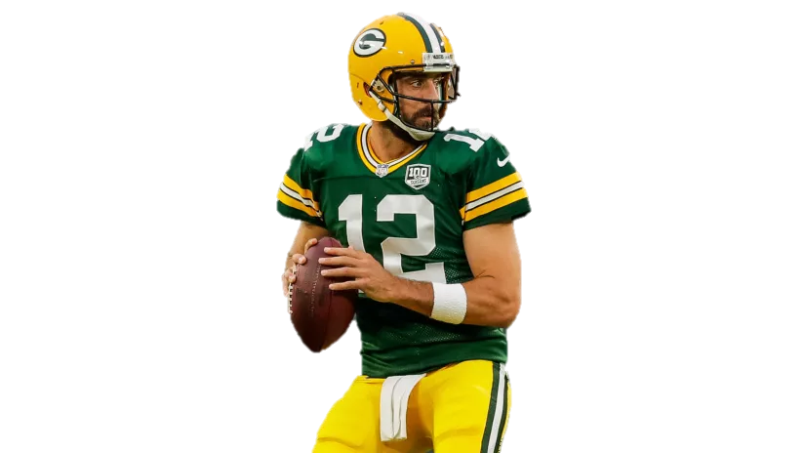
Who is the Best
Other factors involved
Based on this Data
Green Bay Packers
Notes:
Rodgers Based on this data

Slide 15
Conclusion
QBs better in second half
Aaron Rodgers

Slide 16
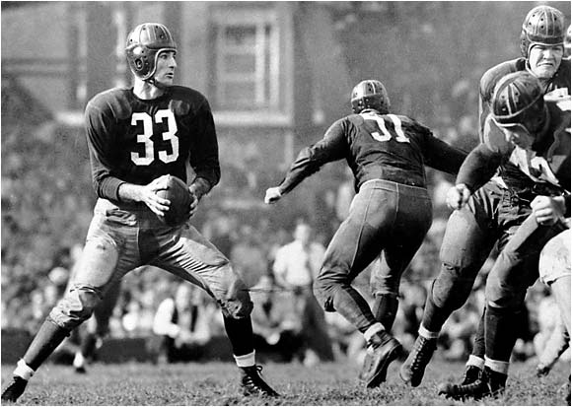
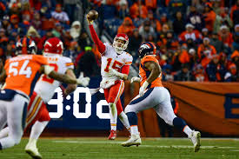
Future Work
The Grid Fe
Extend to more current seasons
More in depth comparisons
  Gather more data
Game Development
Time
Notes:
Gather more data such as wins, teams, coaching staff

Slide 17

Questions
EvolveFISH

