Slide 1
Crime in erie, pa
By: Jazzmine Harris
DSCI 101

Slide 2

Project Overview
My data set includes homicide for Erie area from 2000-2016
The question I asked was, what weapon was used mostly by male and what weapon was used mostly by female?

Slide 3
My dataset
The PA Uniform Crime Reporting System
Was modified (excel file)
16 columns including Race, Gender, Age, etc.

Slide 4
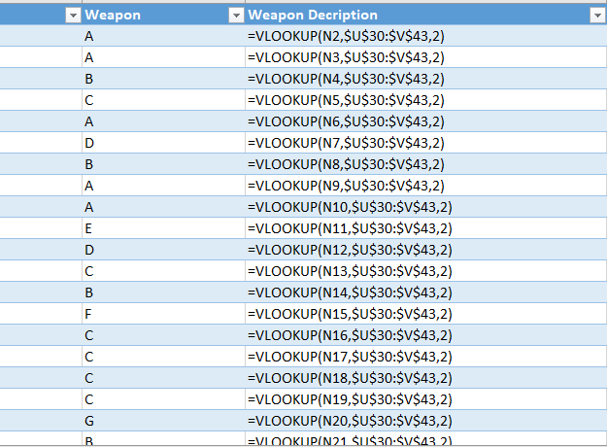
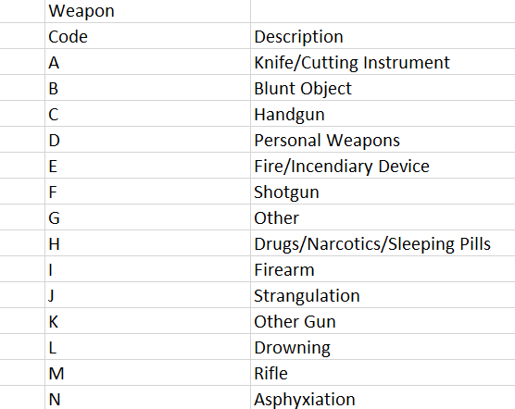
Cleaning the data
The raw worksheet of my data was coded, so I had to do =vlookup to clean the data.

Slide 5
Problems with the data
There are multiple weapons that could all fit under the same category.
There are a few things wrong with the ages in both the Victim Age and Offender Age fields.

Slide 6
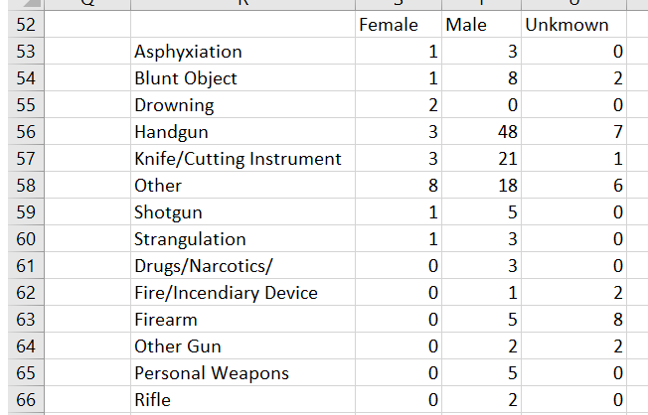
Discoveries in my data
Males seem to use Guns over any other weapon although knives are up there as well.
There are not as many female offenders as male, but they seem to fall under the category of “other” in the weapons column.

Slide 7
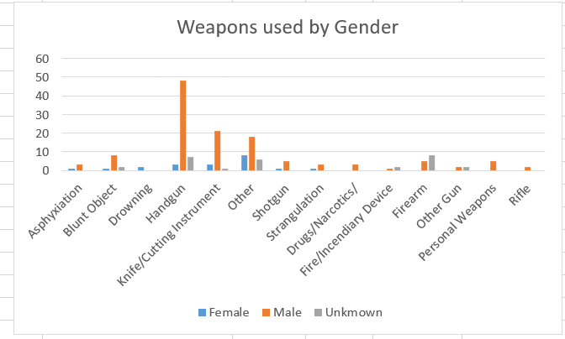
Weapon used by gender

Slide 8
Conclusion
There are more male offenders than female offenders
I also believe this dataset is very well put together… with a little bit of cleaning.

Slide 9
Future Work
I would like to compare the relationship between the offender and victim
I would also like to compare the ages of offender and victim

Slide 10
Works Sited
http://www.paucrs.pa.gov/UCR/ComMain.asp
https://www.google.com/search?q=erie+pa&source=lnms&tbm=isch&sa=X&ved=0ahUKEwjY9MCvp4LfAhXMLVAKHcZ0CRwQ_AUIECgD&biw=1821&bih=876#imgrc=3uJh2SEG_89g8M:
http://mirkwood.cs.edinboro.edu/~bennett/class/dsci101/fall2018/hw/nine/

