Slide 1
Google Play Store Apps
A data science presentation by Jacob Haibach

Slide 2
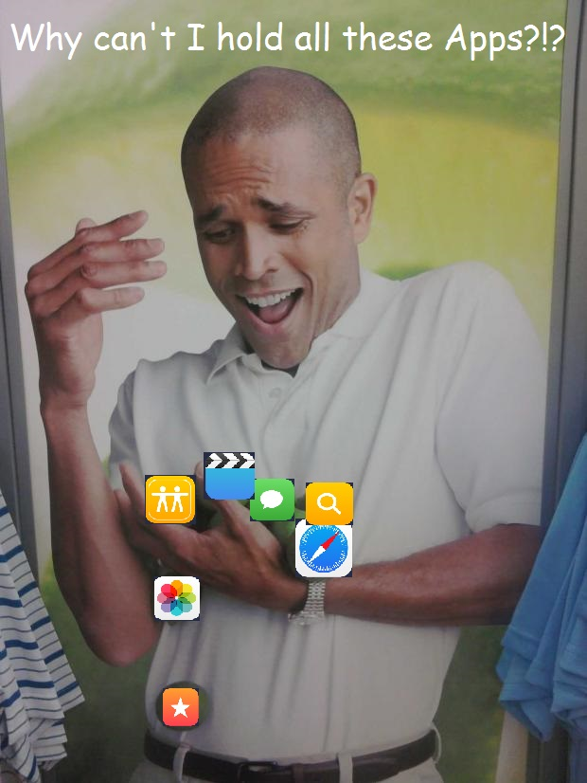
Project Overview
The Google Play Store is very crowded
High ratings increase visibility
What gets an app a high rating?

Slide 3
Data Overview
10,841 total records with 13 fields
Fields include: App name, rating, reviews, installs, price, etc.
Data was originally obtained by scraping it from the Google Play Store
The condition of the data was good.

Slide 4
Problems with the Data
1474 apps with a rating listed as NaN, 1 with a rating of 19
Free apps had price of 0, but paid apps had prices formatted as dollars
Installs included a plus after the number of installs

Slide 5
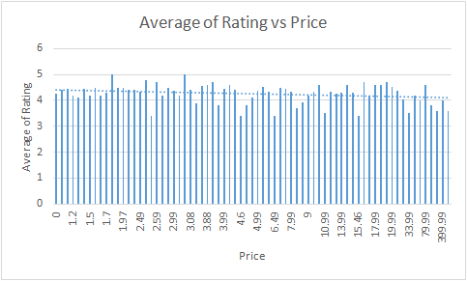
Data Analysis Technique
Created a pivot table to compare average rating to price
Made a chart and added the trend line
The trend line was nearly horizontal

Slide 6
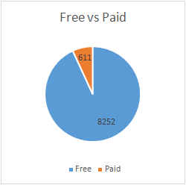
Findings
The vast majority of apps are free
The majority of apps are well rated
Paid apps were rated slightly higher than free apps

Slide 7
Conclusion/Future Work
None of the investigated fields had a significant impact on ratings
The impact of some fields on rating was not investigated
One could investigate this data set from a different perspective

