Slide 1
The Search for the Highest Point Difference
Enrique Cornejo
DSCI 101
Section 002

Slide 2
My Topic
When you think of the NBA finals you probably think of the best two teams, the best in the West and the best in the East.
Well one question I have always had is what is the highest point difference in an NBA finals game.
So with that said I decided to make it my project to find the answer

Slide 3
Data Description
Originally this data was 36KB EXL file, but with adding all the data sets together and cleaning up some questionable data it is now 96KB. Also containing data from what team was home, and what team scored the most, what was their three-point percentage, etc.

Slide 4
Data Dictionary
The original data had more than five data sets the most important I think are
Game: What game it was played (1-7)
If the game was home or away
Points
Rebounds
Three-points taken
Field goals made

Slide 5
Data Cleaning
This data was honestly very clean
I did not do anything to the data other than arrange them into the individual series for each year.
I also put the data into a table, so it was a little easier to filter through.

Slide 6
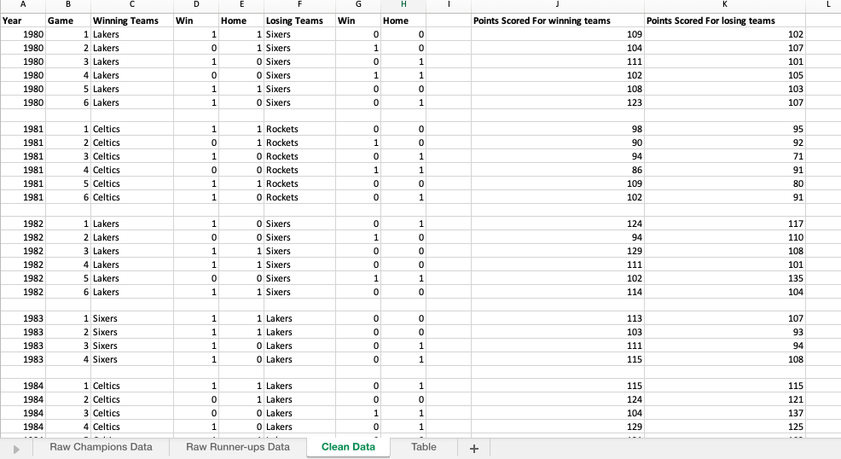
Summary Description
I decided to move the following data fields: Year, game, home, winning team, losing team, and points scored. Into the clean sheet and just separate them

Slide 7

Summary cont.
Following that I then decided to take all the points and find the difference.

Slide 8
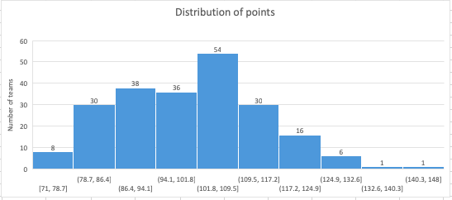
Summary cont.
I also made a distribution chart for the points and the games.

Slide 9

Summary cont.
I then decided to find the five-number summary for the point differences.

Slide 10
Conclusion
With the help of the five-number summery it was very easy to find that the highest point difference in an NBA finals game was 42 points.

Slide 11
Future Work
There is so much one can do with a data set so huge.
I could have done a chart of all the three pointers taken in a single game and see which team was known for the most threes.
I also could have seen what points were scored more in the paint or beyond the line.

