Slide 1
Creating a Smarter Video Game Companion
Nicole Segal

Slide 2
What exactly?
NPC companion
Trainable
Proto-RPG
Items with attributes

Slide 3
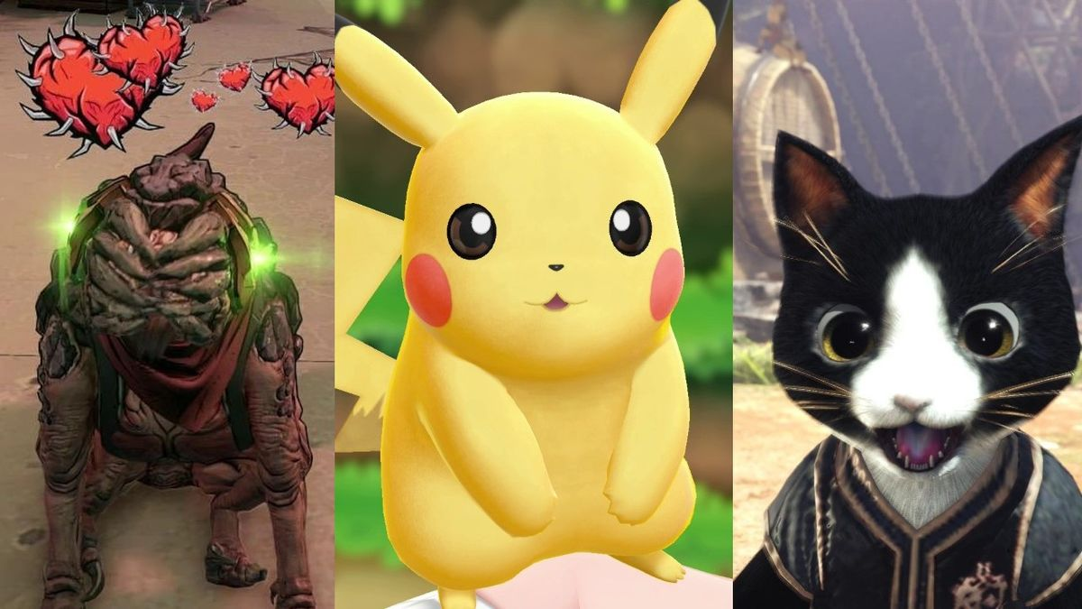
Why?
Individualized experience
Game Flow
Current AI limitations
Current Research
Enemies
FPS

Slide 4
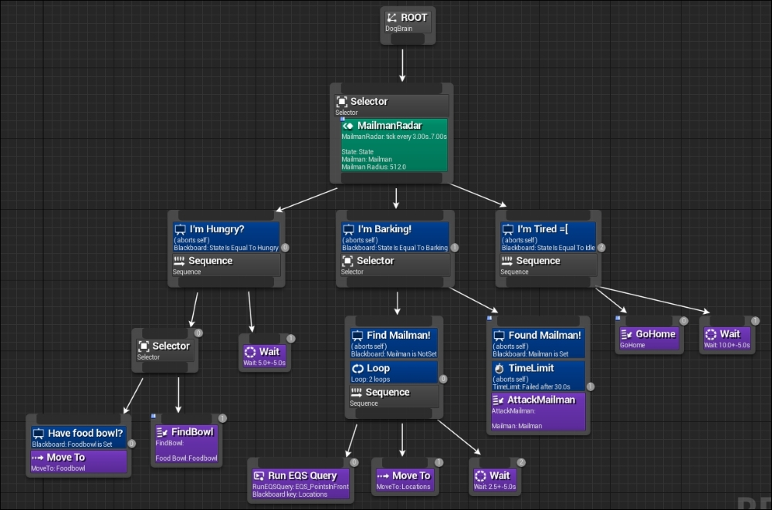
Some Basics
Current NPC behavior
Behavior trees
Unreal Engine
Blueprints
Artificial Neural Network

Slide 5
ANNs
Based on real brains
Intelligent or not?
Store information

Slide 6
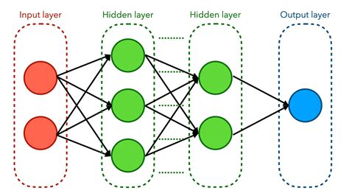
How ANNs work
Inputs
Hidden Layers
Activation functions
Weights
Outputs

Slide 7
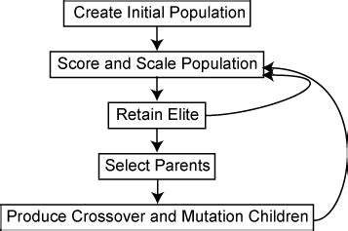
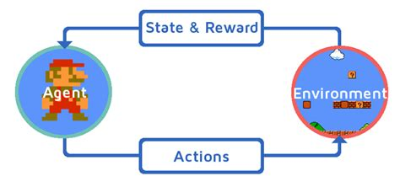
ANN Approaches
Genetic Algorithm
Reinforcement Learning

Slide 8
Limitations
Unsupervised learning
Accounting for all inputs
Memory

Slide 9
Further Work
Expansion of learning capabilities
Fighting
Gather resources for building
Using better ANN

Slide 10
Questions?
[1] R. A. Boyd, "Implementing Reinforcement Learning in Unreal Engine 4 with Blueprint," Honors College of Middle Tennessee State University, Murfreesboro, 2017.
[2] Z. K. Shovon, K. Ahamed, T. A. Khan and S. Z. Hasan, "Implementation of neural network in game engine to create smart bot and behavior analysis," BRAC University, 2018.
[3] J. Tremblay and C. Verbrugge, "Adaptive companions in FPS games," FDG, vol. 13, pp. 229-236, 2013.
[4] M. Weeks, D. Binnion, A. C. Randall and V. Patel, "Adventure game with a neural network controlled non-playing character," 2017 16th IEEE International Conference on Machine Learning and Applications (ICMLA), pp. 396--401, 2017.
[5] D. Johnson and J. Wiles, "Computer games with intelligence," 10th IEEE International Conference on Fuzzy Systems, vol. 3, pp. 1355--1358, 2001.
[6] S. Shanmuganathan, Artificial neural network modelling: An introduction, Springer, 2016.

