Slide 1
Group Project Idea CSCI 340
Mason Biggie

Slide 2
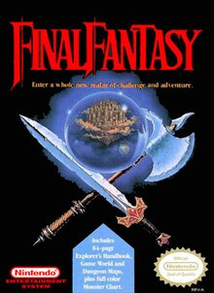
Have you played/seen Final Fantasy?
NES (1987)
Traditional Turn-Based Role Playing Game (RPG)
Let’s talk about the opening portion of this game

Slide 3
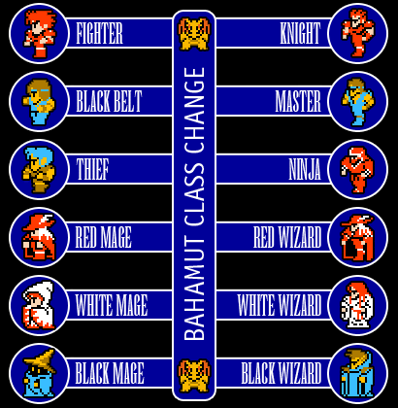
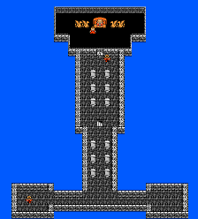
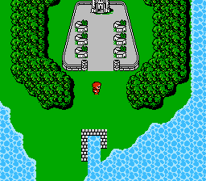
The Setup/Goal
You start by making a team of four characters with different classes
You appear near Castle Cornelia
You find out the princess has been kidnapped
Leave to the northwest to find/save her

Slide 4
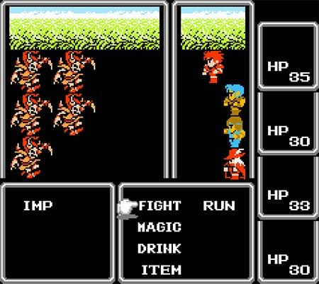
Gameplay
While walking on the overworld, you run into random battles
You select the actions each of your characters make(Attack, Use Magic, Use Item, etc.)
Once the enemies are defeated, each character gets experience points and levels up after enough points are earned

Slide 5
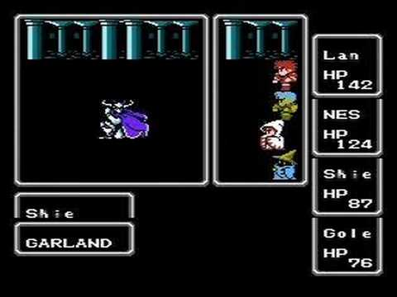
End of the Beginning
Once you get to the ruined castle, you fight Garland who kidnapped the princess.
After fighting him, the princess would be saved, the king would repair the northern bridge, and you could continue the game.

Slide 6
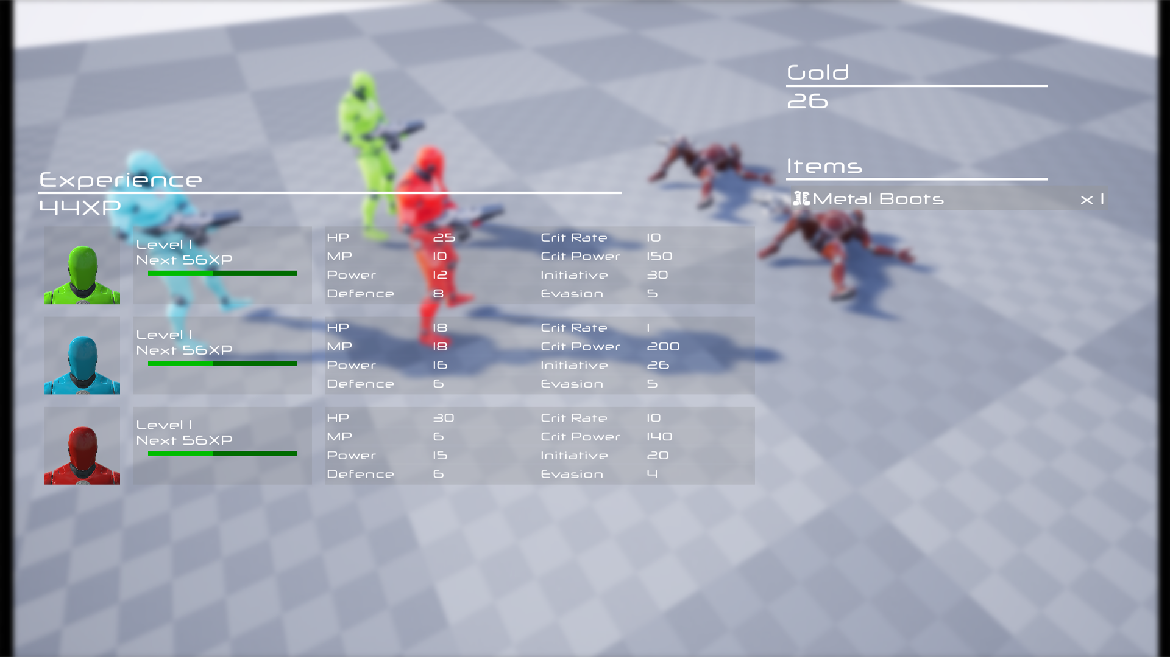
Now for the project idea…
Creating something along the lines of the Final Fantasy 1 opening
Not expecting anything huge of course
Mainly want to try for a turn based battle system

Slide 7
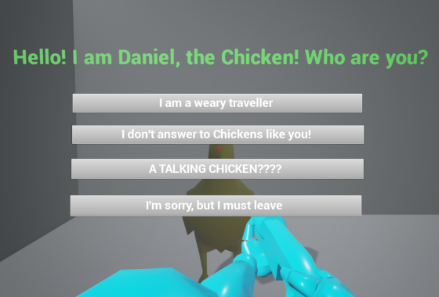
Main Game Plan
Player will start the game with a basic weapon such as a sword
A main quest will be given (doesn’t have to be a damsel in distress)
Player will then travel to a castle/dungeon and fight enemies on the way

Slide 8
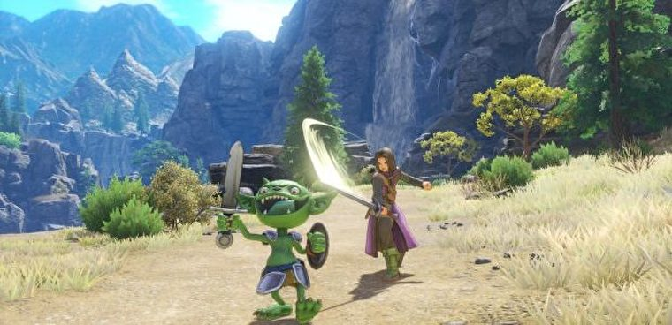
Main Game Plan cont.
No random battles, something like Dragon Quest 11 where enemies can be found in the world
Player gains experience to level up (player has various stats like attack and defense)
After going through the small dungeon, the player will fight a boss enemy and beat the game

Slide 9
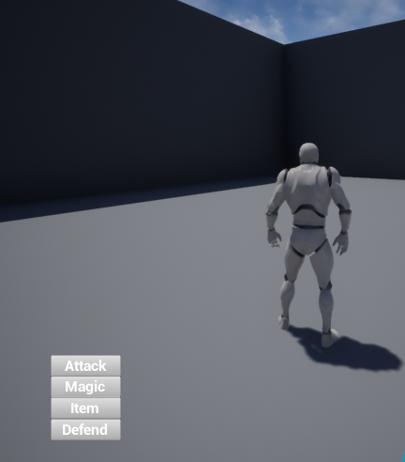
Controlling UMG Menus
I made a real quick, extremely basic command menu for a battle system
My goal would be to allow buttons to be clicked on screen to execute a certain battle command
A player’s stats in battle would help them take down the boss at the end

Slide 10
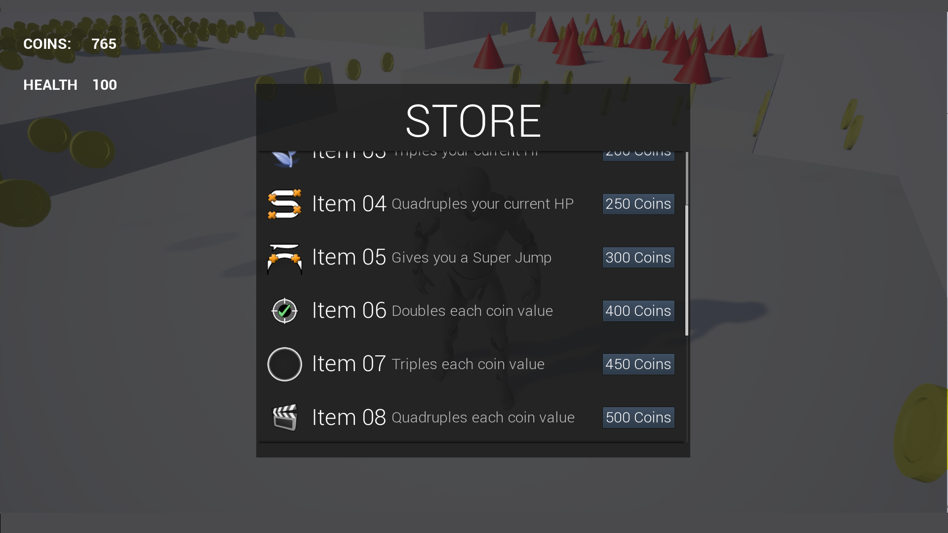
Potential extra ideas to add
Implementing a gold/money system; Fighting enemies gets money you can use to buy new weapons or items
A “Limit Break” system; if player takes a lot of damage in battle, they can use a super move/attack
A few side quests/NPCs to talk to

