Slide 1
Possession and Camera
Jozef Jankowiak

Slide 2
Possession
Usable in level bp or gamemode
“Target” should be relevant controller
“In pawn” should be the pawn to be controlled by the target controller

Slide 3
Possession

Slide 4
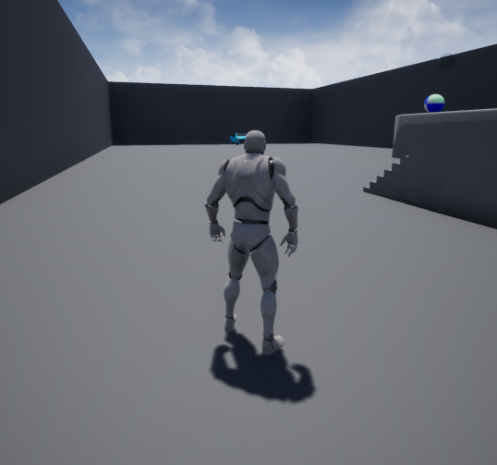
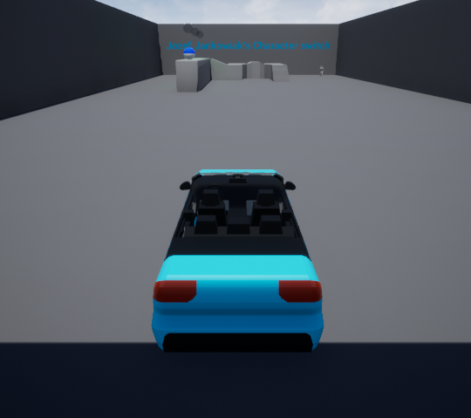
Possession

Slide 5
possession
Handles shifting camera automatically
Can be disabled using “take camera control when possessed”
If there is no camera component will put viewport in the middle of pawn
Input mapping is turned into on list that the controller pulls from and pass to pawn

Slide 6
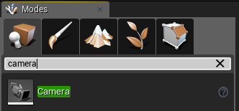
Camera
Starts with a camera object that is premade

Slide 7
Camera
Post process
Can affect:
Color
Lens flare
Etc
Used to create effects like black and white or sepiatone

Slide 8
CAMERA
Possess automatically changes active camera
“set view target with blend” can change camera without changing controlled pawn
Blend amount causes a slow pan from old camera to new camera

Slide 9
Camera
When a camera is attached to a actor
By default
the camera has no axis control
Camera has no collision
Add a camera boom
Acts like a physical attachment to actor
Can enable collusion for camera

Slide 10
camera
When a camera is NOT attached to an actor
It can still be viewed through
Will not affect the way a character moves in terms of the “front” of an actor

Slide 11
camera
Activate and deactivate can be used to switch between views
A property called auto-activate can determine which camera to use by default when a actor is created or possessed with need for additional nodes

Slide 12
Sources
https://docs.unrealengine.com/en-US/Gameplay/HowTo/UsingCameras/index.html
https://docs.unrealengine.com/en-US/Gameplay/Framework/Camera/index.html
https://docs.unrealengine.com/en-US/Gameplay/HowTo/UsingCameras/Blueprints/index.html
https://docs.unrealengine.com/en-US/Engine/Components/Camera/index.html

