Slide 1
Level Loading and Streaming
Gabe Dayton

Slide 2
Outline
Slide 3: Level Loading basics
Slide 4: Level loading Open level
Slide 5: Level Streaming Volumes
Slide 6: Level Streaming blueprints
Slide 7: Extras
Slide 8 - 9: Useful Links

Slide 3
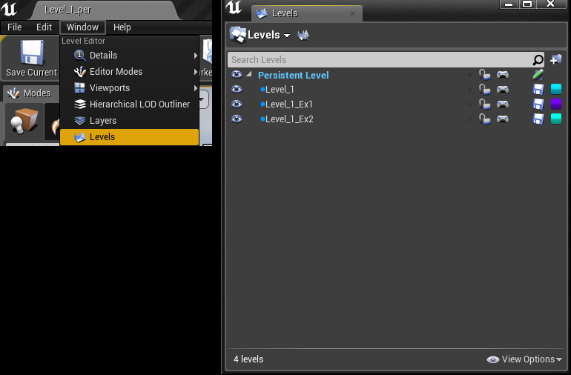
Level Loading basics
Methods
Open Level
Level Streaming volumes
Level Streaming blueprints
Levels Menu
Window - Levels

Slide 4
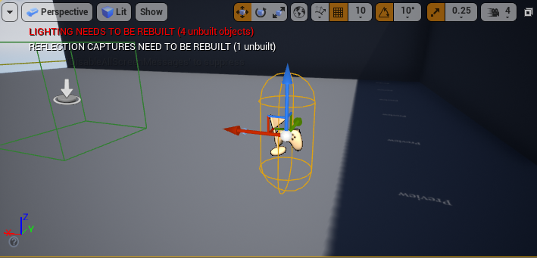
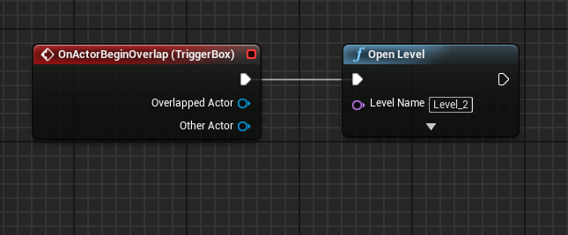
Open Level
Easiest way to load levels.
Just one function and teleports you to the new level.
New levels need a player start for open level to work.
Level names are case sensitive

Slide 5
Streaming Volumes
Levels have volumes you set so the engine can determine if a level need to be loaded.
“Each frame, the engine iterates over each Level
and checks to see if the player's viewpoint is inside any of the Level Streaming Volumes associated with that Level.”
“the volume that most recently contained a player is cached.
This cached volume is checked first, so that Levels a player is in or returns to are quickly accepted ”
A bit costly , but might be useful for multiplayer games or small games.
You can disable the volumes so you don’t have to remove a level just to not have it load

Slide 6
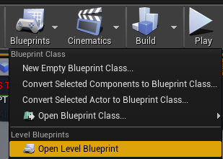
Level Streaming with blueprints
Persistent level
Contains the player and player start
Has any lighting that can be seen through multiple levels
Shouldn’t contain much because it will never be unloaded
Load earlier so the player doesn't see the loading
Loading should be handled in the level blueprint.
Blueprints - Open level blueprint

Slide 7
Extras
Saving data
Loading a new level does not save changes to the original level
Game Instances
Allows the player to have data carry over from one level to another

Slide 8
Useful Links
General Hub for level streaming documentation
https://docs.unrealengine.com/en-US/Engine/LevelStreaming/index.html?fbclid=IwAR3XREzEhGrjSCNF3m4kiYtXiPeC-ipNbX3EaprCxARv6GRw0fyeZM5sR18
Level Streaming : Volumes
https://docs.unrealengine.com/en-US/Engine/LevelStreaming/StreamingVolumes/index.html
Level Streaming : Blueprints
https://docs.unrealengine.com/en-US/Engine/LevelStreaming/HowTo/StreamWithBlueprints/index.html

Slide 9
Useful Links
Level Streaming Video : https://www.youtube.com/watch?v=XE2x4TZHxHg&list=WL&index=126&t=141s
Saving Variable When loading maps:
https://www.youtube.com/watch?v=XjPdyoy7ySo&list=WL&index=128&t=0s
Saving multiple objects:
https://www.youtube.com/watch?v=YrdEha-Ogc8&t=532s
or
https://www.youtube.com/watch?v=MLqypbTyZG8&t=17s
Both are 20+ mins

