Slide 1
Projectiles in Unreal Engine 4
Adam Zidek

Slide 2
Key Elements for a projectile
Built off Actor Class
Collision Volume
  Block all Dynamic
Static Mesh
Particle System(If Desired)
Rotating Movement Component(If Desired)
*Projectile Movement Component
More complex projectiles will take advantage of Line Tracing and the Hit Result Struct, which we will get into

Slide 3
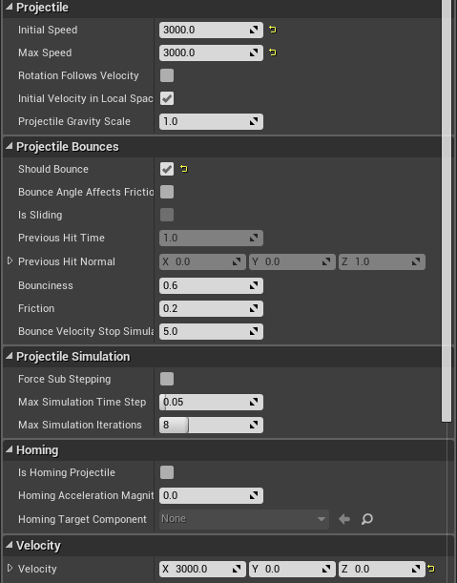
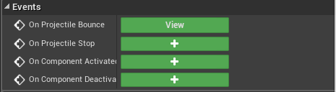
Projectile Movement Component
Takes care of basic projectile functionality
Also gives us events to build upon our projectile
I am using the bounce event in my more advanced projectile

Slide 4
Should Bounce
If set to true, projectile will not interact with physics objects
If set to false, projectiles will interact with physics objects, but stop on impact
Fixed by adding impulse at hit location
  Default FP projectile takes care of this
(Default behavior of FP projectile is to have bounce enabled and add impulse at hit location)

Slide 5
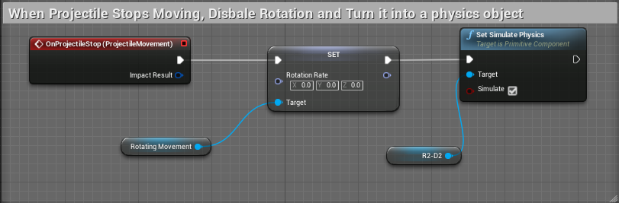
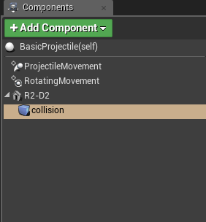
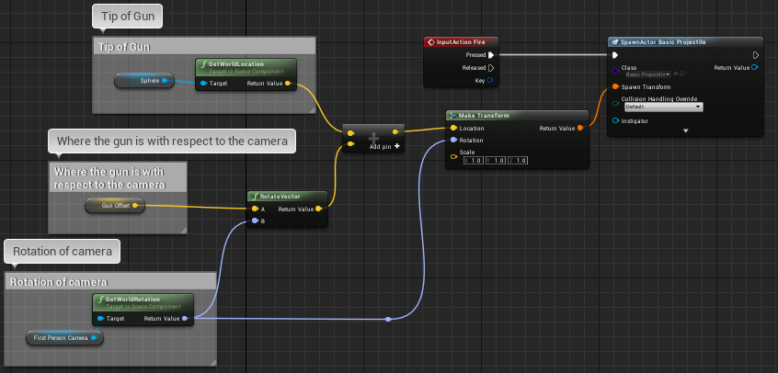
Basic Projectile To Build From
Character Blueprint

Slide 6
Tracing
In a nutshell, checks to see if something was hit between a start and end location.
  Returns hit result struct if there was a hit
Channel Trace vs Object Trace
  Channel is not very specific
  Object for example allows you to specify only physics objects
Multi Traces, Shape Traces

Slide 7
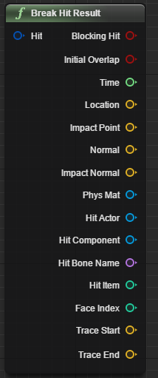
Hit Result Structure
Collection of variables that tell us everything we need to know about trace hit result
https://www.youtube.com/watch?v=vje9S5aj15k
  YouTube video that describes what each variable is much better than I can

Slide 8
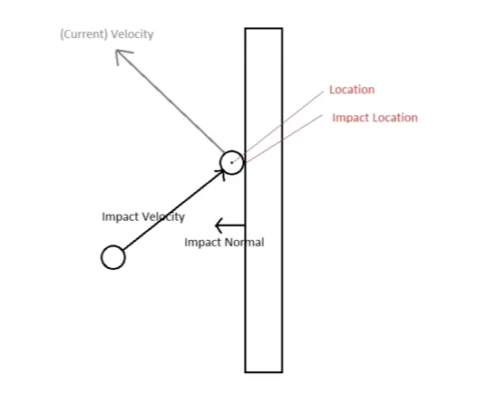
Important Variables to Note from Hit Result
Location - refers to the position the projectile must be in order to collide with an object but not penetrate
Impact Location – Exact point where projectile and object contact
  These will be the same if Trace Complex is false
Normal – direction of the target objects center point towards projectiles center point
  For line tests this will always equal impact normal
Impact Normal – normal of the surface where the impact happened
Image from YouTube Tutorial

Slide 9
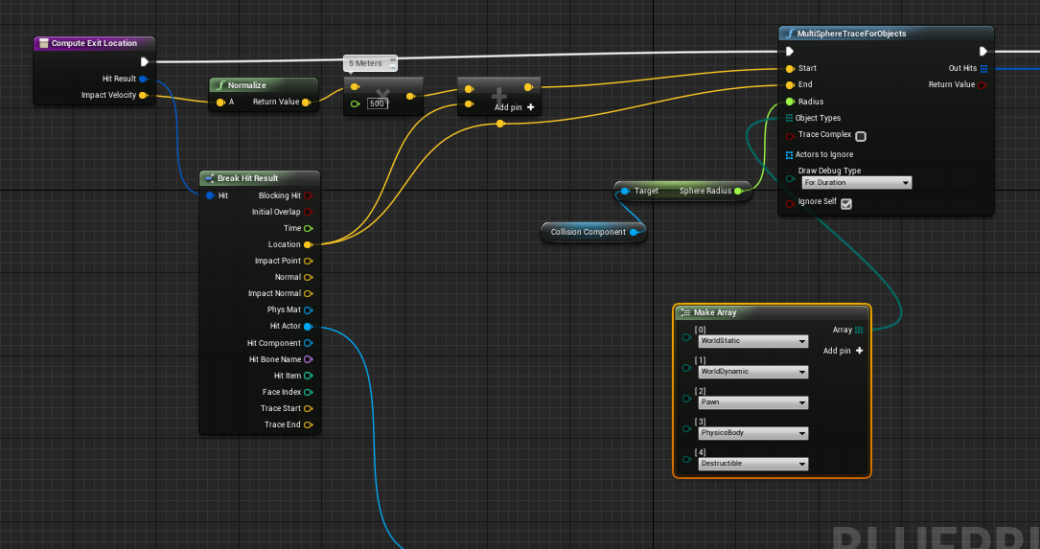
Compute Exit Location(Pic 1)

Slide 10
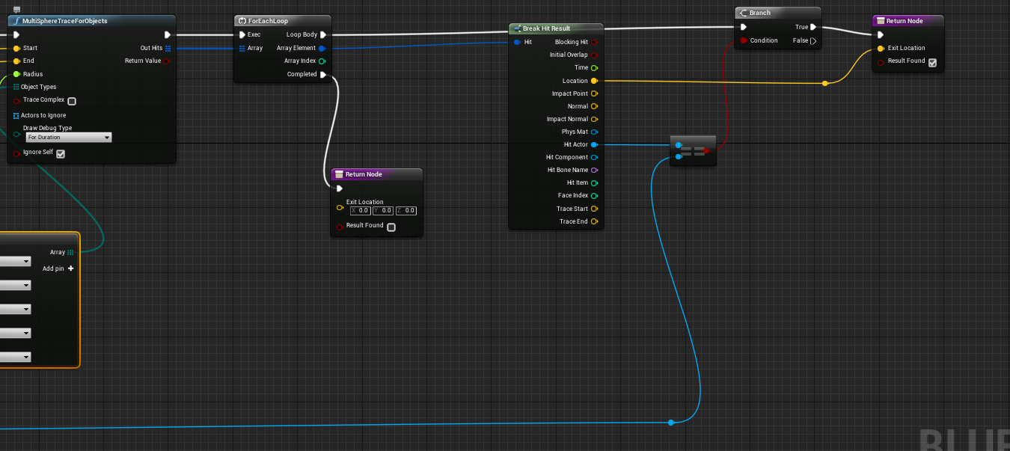
Compute Exit Location(Pic 2)

Slide 11
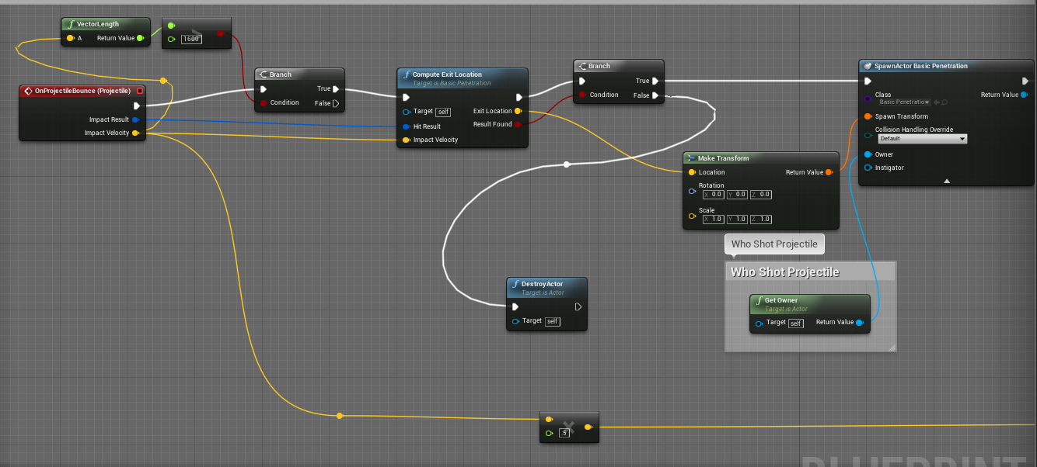
Bullet Penetration Event Graph(Pic 1)

Slide 12
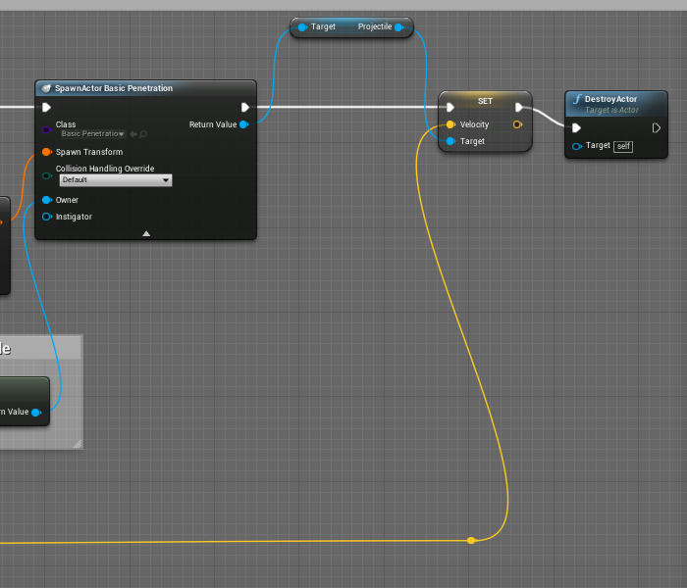
Bullet Penetration Event Graph(Pic 2)

Slide 13
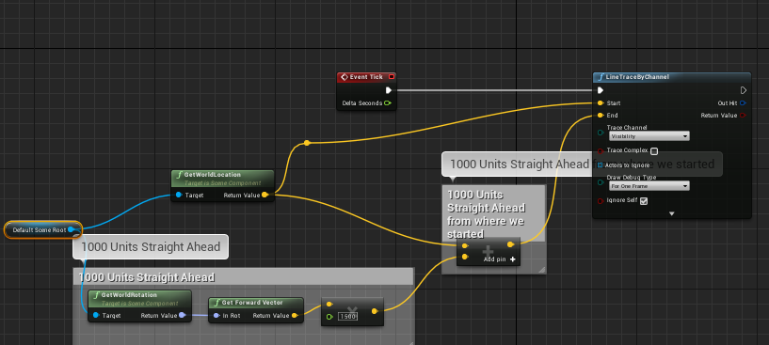
Line Tracing Object

Slide 14
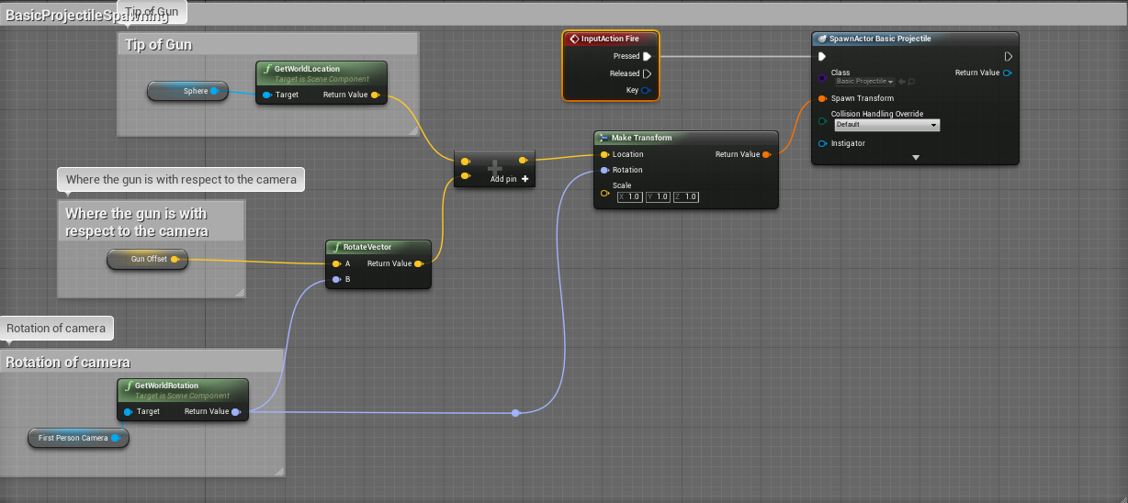
Basic Projectile Spawning from Gun(No animations)

Slide 15
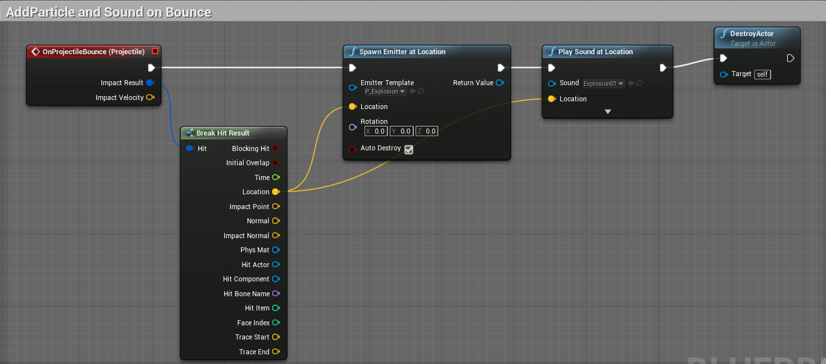
BasicEmitter Projectile

Slide 16
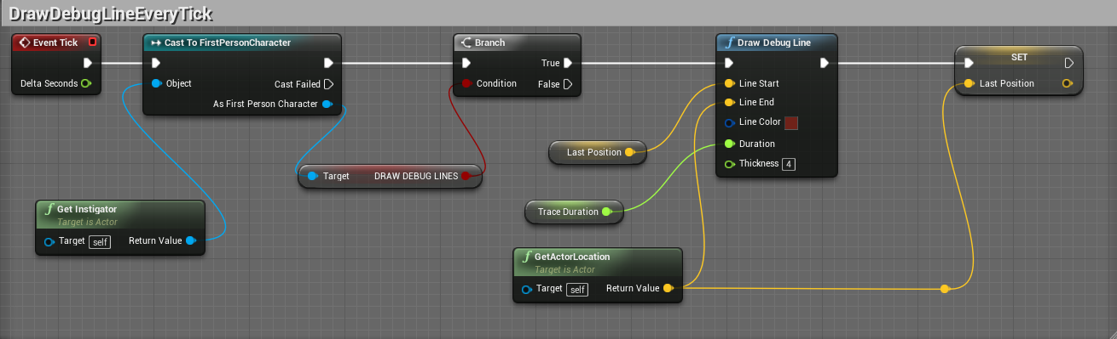
Debug Lines

Slide 17
USEFUL LINKS
Bullet Penetration Tutorial Part 1
  https://www.youtube.com/watch?v=jNVEimfgvm4
Intro to Line Tracing
  https://www.youtube.com/watch?v=yo9VrxFgUJY
UE4 Documentation on Hit Result Struct
  https://docs.unrealengine.com/latest/INT/BlueprintAPI/Collision/BreakHitResult/index.html
UE4 Forum Discussion about Hit Result Struct
  https://forums.unrealengine.com/showthread.php?72466-Break-Hit-Result-explained

