Slide 1
Large Collaboration and GitHub in Unreal
Jacob William Poteet

Slide 2
Downward Spiral Design and Implementation

Slide 3
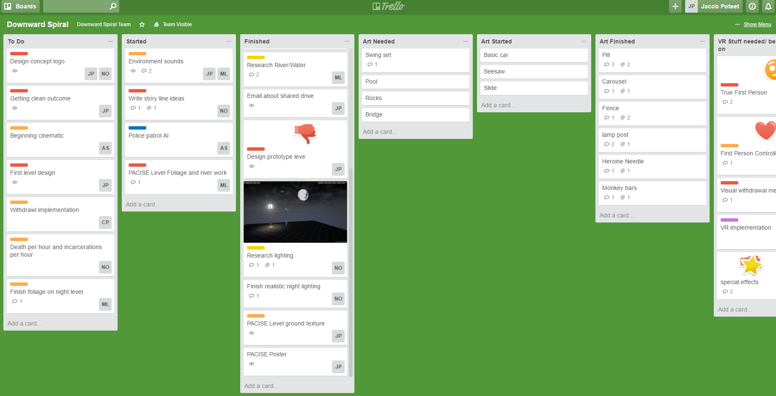
Trello

Slide 4
Filestore
Problems
Only one person can access the whole project at once
Once accessible on the Ross computers
Save Errors
Verification Errors

Slide 5
Investigation

Slide 6
5 Questions
What was the hardest part of starting your project?
What was an unexpected problem that you found that involved file sharing?
From my experience, whenever we are working on our game on a shared network drive we must make sure no one else is working on it at the same time. How did you solve this problem?
When starting out, how would you organize what each person would work on while avoiding idle time for other’s assets.
In your experiences, what were the best and worst experiences you had in a group collaboration?

Slide 7
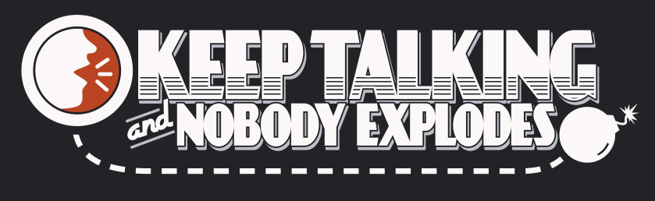







Who do I ask?

Slide 8
Who responded?

Slide 9


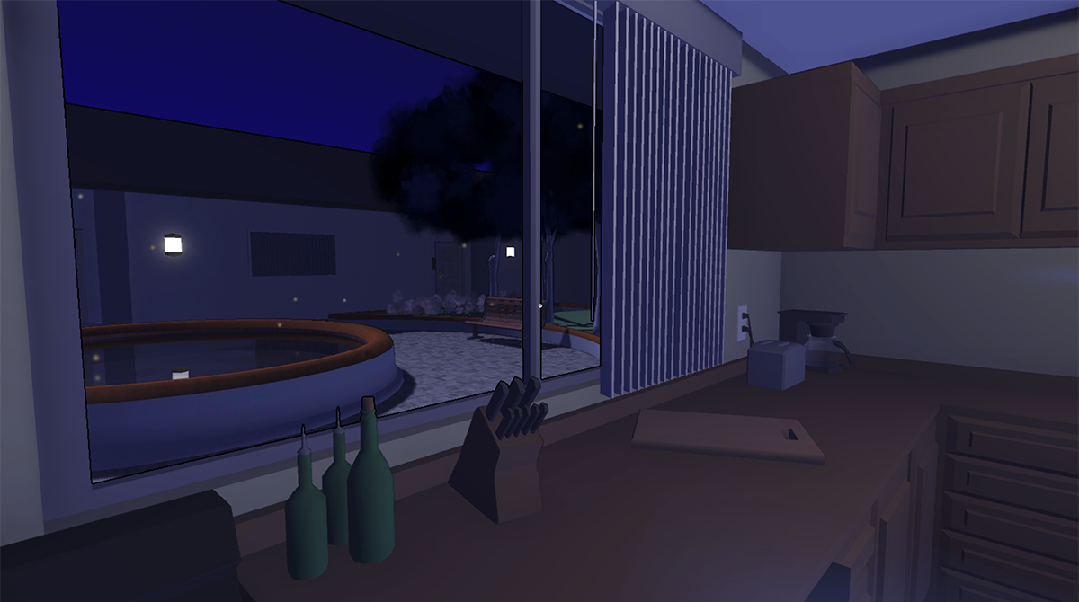
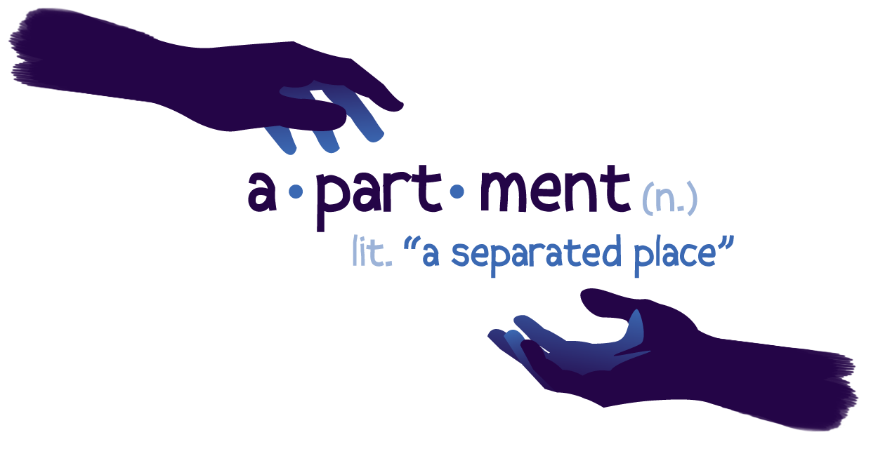


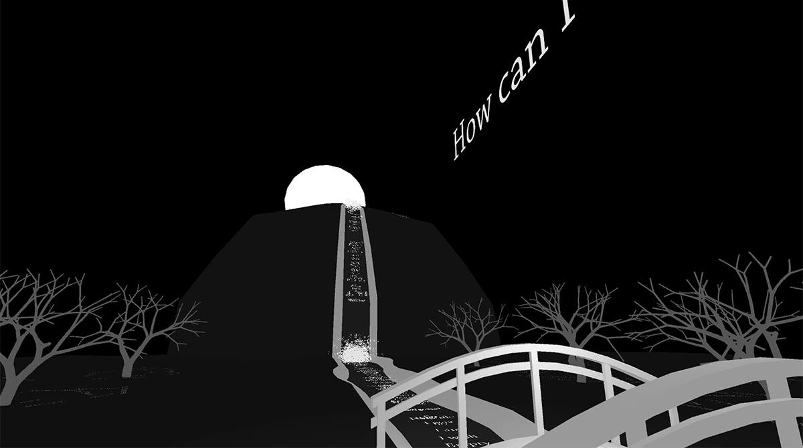


Slide 10
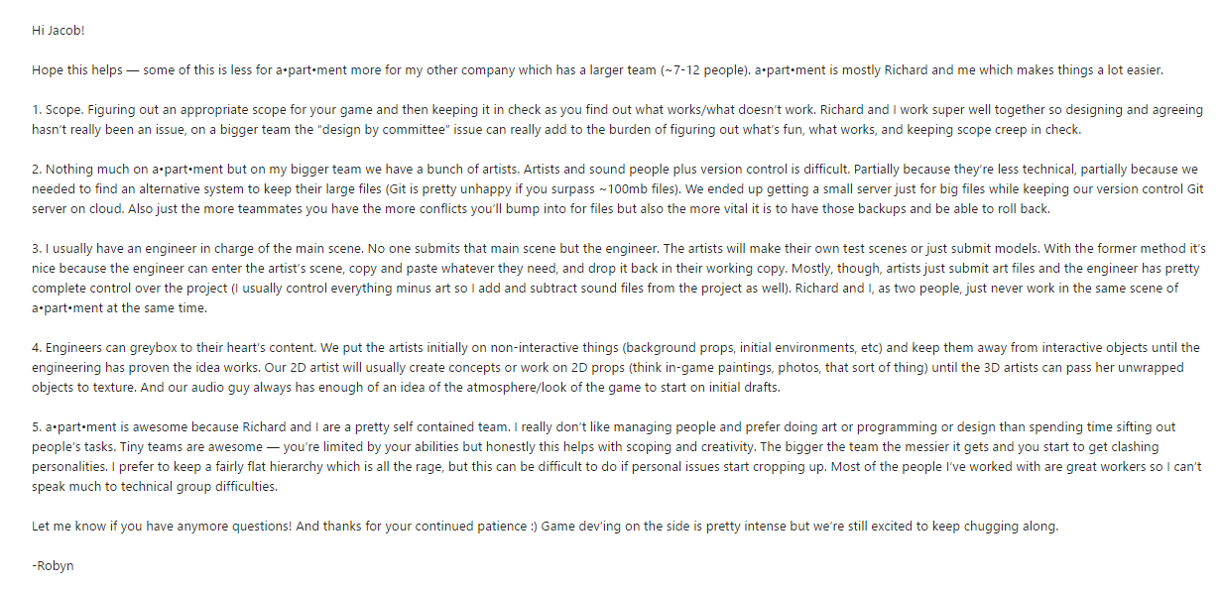
Answers

Slide 11
Answers

Slide 12





Slide 13
Answers
3

Slide 14
Answers
3

Slide 15
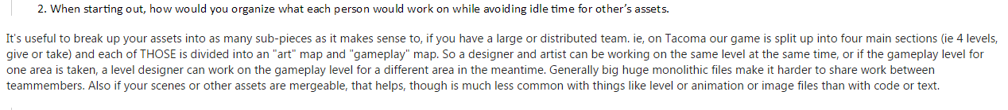
Answers
4

Slide 16
Answers
4

Slide 17

Perforce

Slide 18
Filestore
Problems
Solutions
Only one person can access the whole project at once
Once accessible on the Ross computers
Save Errors
Verification Errors
Exclusive Checkout
Still has to be connected to the server
Automatic backups
Integration

Slide 19
GitHub

Slide 20
GitHub Background
Founded in 2008
Git repository hosting service
“A code hosting platform for version control and collaboration. It lets you and others work together on projects from anywhere” –Github.com

Slide 21
Git

Slide 22
Git Background
Definition - “ A version control system (VCS) for tracking changes in computer files and coordinating work on those files among multiple people.” – Wikipedia
Linus Torvalds (original author) described the tool as "the stupid content tracker“ when he wrote the very first version
Distributed version control
Source code management

Slide 23
GitHub Background
Founded in 2008
Git repository hosting service
“A code hosting platform for version control and collaboration. It lets you and others work together on projects from anywhere” –Github.com
Access control
Bug tracking
Feature requests
Task management

Slide 24
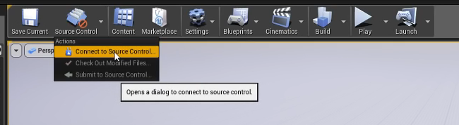
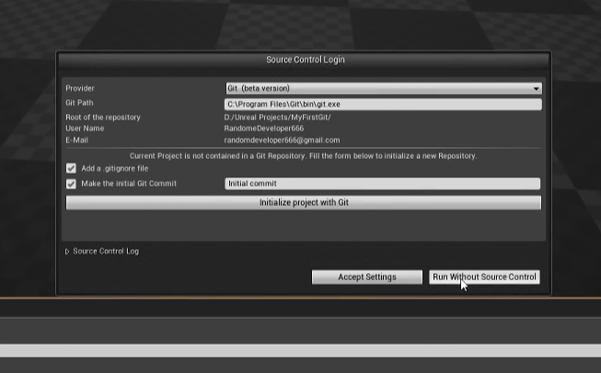

Slide 25
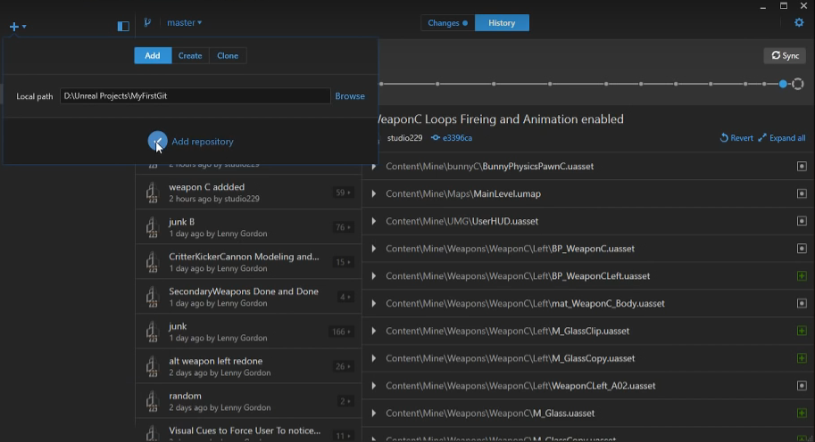
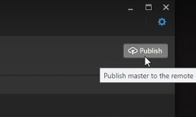

Slide 26
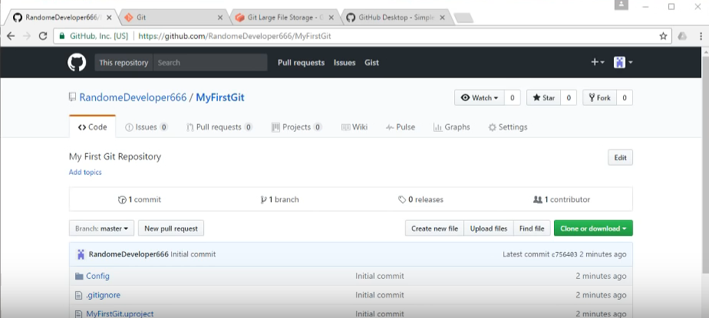

Slide 27
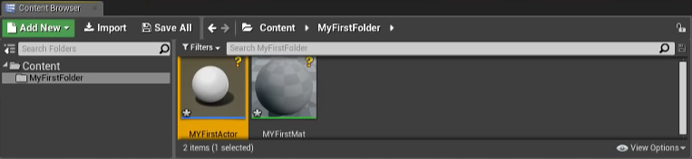
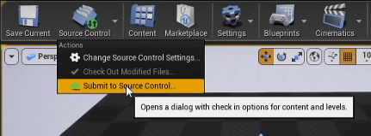
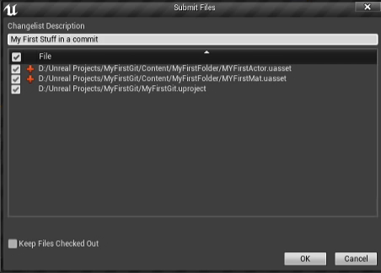

Slide 28
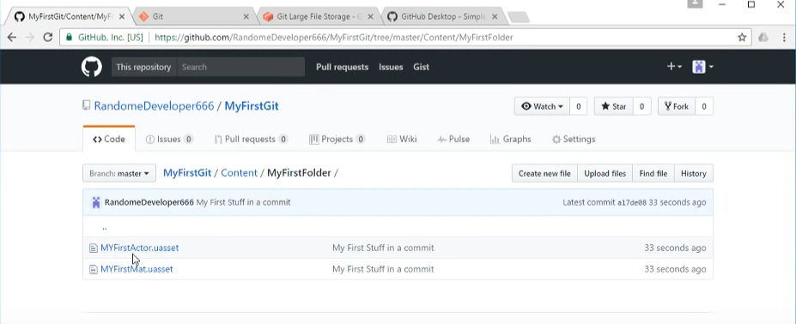

Slide 29
Sources
Steve Gaynor
Robyn Gray
https://en.wikipedia.org/wiki/GitHub
https://en.wikipedia.org/wiki/Git
https://www.youtube.com/watch?v=Hv_v3tPuNj4

