Slide 1

Sound
Anthony Wagner

Slide 2
Importing sound Files
Unreal Engine 4 supports importing uncompressed 16 bit wave files at any sample rate
Once the file is imported, it becomes a Sound Wave asset
Can be directly placed into the level
Or used to create a Sound Cue
Two ways to import:
Use the Import button and choose the .WAV file you want
Click and drag the file from your File Explorer into the Content Browser

Slide 3
Importing (cont)
Sounds can be Stereo or Mono
Multichannel, Surround sounds are also possible, just make sure the file name has a special extension before the .wav
_fl for Front Left
_fr for Front Right
_fc for Front Center
_lf for Low Frequency
_sl for Side Left
_sr for Side Right
_bl for Back Left
_br for Back Right

Slide 4
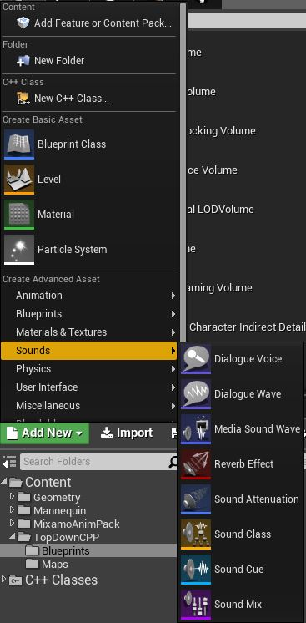
Sound Assets
Using the Add New button from the Content Browser, there is a whole section dedicated to Sounds
Dialogue Voice
Dialogue Wave
Media Sound Wave
Reverb Effect
Sound Attenuation
Sound Class
Sound Cue
Sound Mix

Slide 5
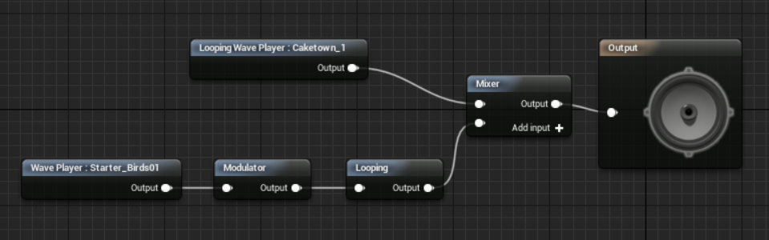
Sound Cue
“Composite sounds that allow you to modify the behavior of audio playback, combine audio effects, and apply audio modifiers with Sound Nodes to alter the final output”
Has its own Sound Cue Editor
Has an Output node with a volume and pitch multiplier
Place sound waves and nodes to create and modify mixtures of them that will be played in the final cue

Slide 6
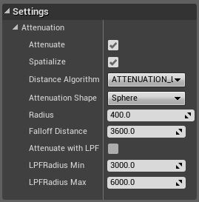
Sound Attenuation
Defines a specific set of attenuation settings and properties that can be used by one or more different sound assets
Attenuation
The ability of a sound to lower in volume as the player moves away from it
Works using a MinRadius and a MaxRadius
Rate of fade determined by a Distance Algorithm
Linear, Logarithmic, LogReverse, Inverse, NaturalSound, or Custom
Attenuation Shapes specify the shape of the Attenuation Volume
Sphere, Capsule, Box, or Cone

Slide 7
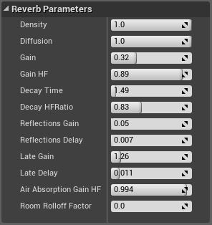
Reverb Effects
Defines several properties that can be applied to any Audio Volume in the level
Adds a reverb/echo effect based on the settings to the sound it is applied to

Slide 8
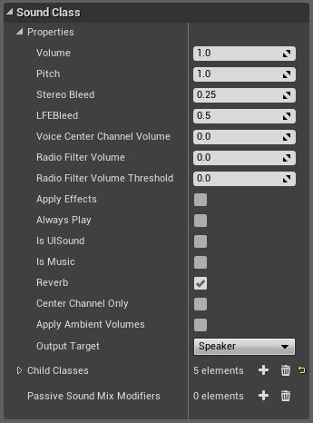
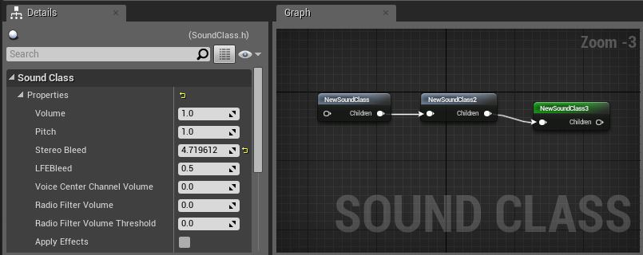
Sound Classes
Collections of properties that can be applied to sound assets and will act as multipliers to the existing values of the sounds that have them
Allows for hierarchies, parent-child relationships determined through the Sound Class Editor
Passive Sound Mixes can be added to a class and they automatically activate when the class is played

Slide 9
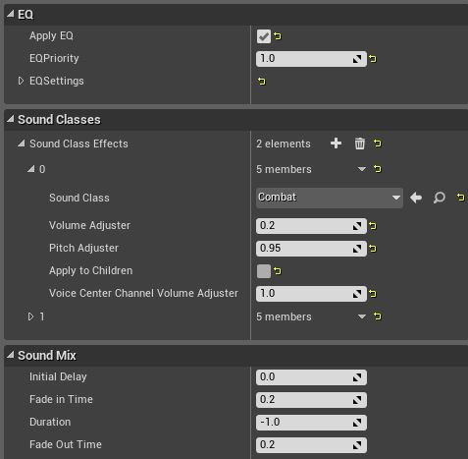
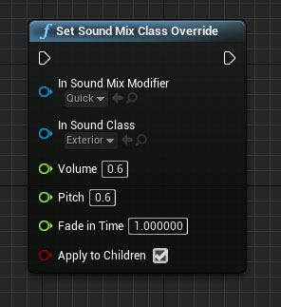
Sound mix
Allow EQ (Equalizer) settings to be set and can modify the Volume and Pitch of Sound Classes
Can Push(Activate) and Pop(Deactivate) mixes directly in a Blueprint with the respective nodes, or activate them passively in a Sound Class
Or, use the Set and Clear Sound Mix Class Override nodes

Slide 10
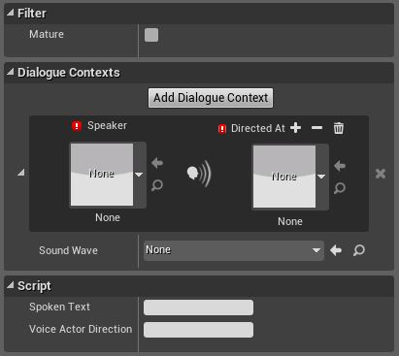
Dialogue Voice & Wave
The Dialogue Voice just simply sets the gender and plurality of a voice actor
The Dialogue Wave provides the setup for the sound file, subtitles, and the context for the dialogue

Slide 11
Sources
https://docs.unrealengine.com/latest/INT/Engine/Audio/Overview/index.html
https://docs.unrealengine.com/latest/INT/Engine/Audio/WAV/index.html
https://docs.unrealengine.com/latest/INT/Engine/Audio/SoundCues/Editor/index.html
https://docs.unrealengine.com/latest/INT/Engine/Audio/DistanceModelAttenuation/index.html

