Slide 1
Lighting
Nick O’Black

Slide 2
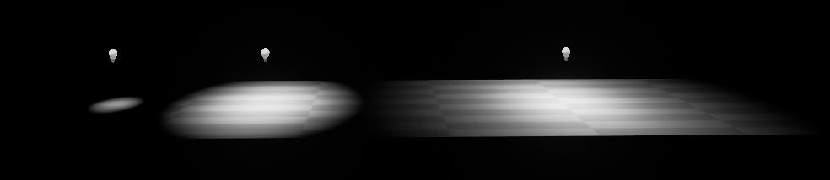
Lighting Basics
Intensity – total energy the light emits
Light Color - color the light emits
Casts Shadows – whether or not the light casts shadows
Shadow Bias – Controls how accurate the shadows from the light are
Attenuation Radius
Sets the reach of the light
Defines what objects it will affect
Outer bounds for calculating falloff of the light
200, 400, 800

Slide 3
Types of Lights
Unreal has four light types
Directional Lights
Point Lights
Spot Lights
Sky Lights
There is a sky light as well as a directional light provided when creating a default level
Directional light is linked to skysphere by default and it used to adjust the sun’s light

Slide 4
Mobility
When placing a light it can be set to 1 of 3 mobility settings
Static – Light can not be changed whatsoever in game, fastest rendering.
Stationary – Light can change color and intensity in game, however the light can not be moved
Moveable – Totally dynamic, has all properties of stationary with the added property of it being able to move

Slide 5
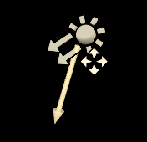
Directional Lights
Used as your primary outdoor light or any light that needs to appear as if its casting light from extreme or near infinite distances.
Ideal choice for simulating sunlight
When placing a light it can be set to 1 of 3 mobility settings
Static – Light can not be changed whatsoever in game, fastest rendering.
Stationary – Light can change color and intensity in game, however the light can not be move
Moveable – Totally dynamic, has all properties of stationary with the added property of it being able to move

Slide 6
Point Lights
Work much like a real world light bulb
Emits light equally in all directions from a single point in space
Have the same mobility settings as the directional lights

Slide 7
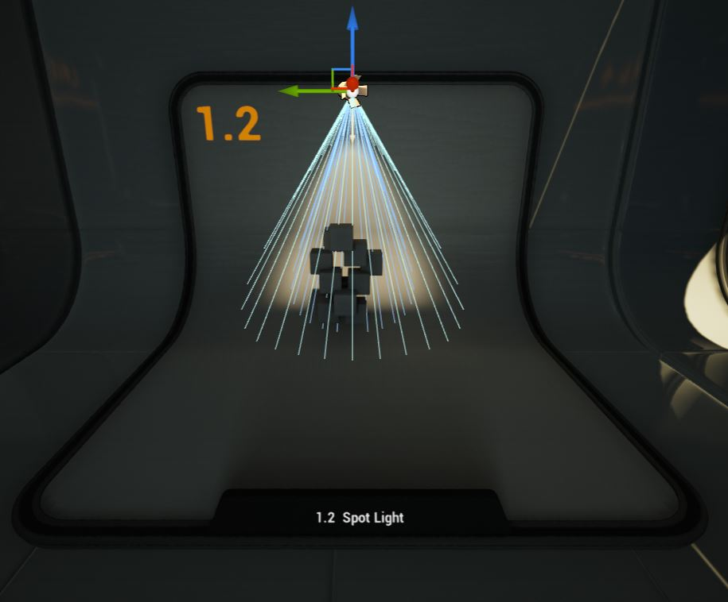
Spot Lights
Emits light from a single point in a cone shape
Two cones used to shape the light
Inner Cone Angle – where light achieves full brightness
Outer Cone Angle – where falloff takes place

Slide 8
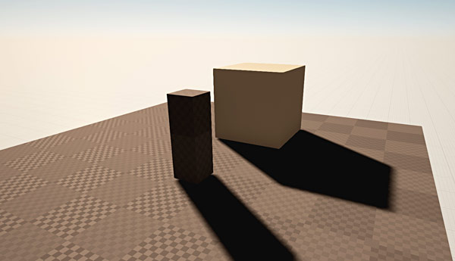
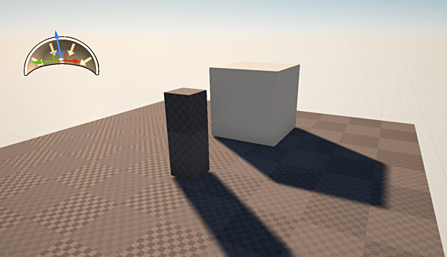
Sky Light
SkyLight is an additional light actor that illuminates indirectly lit areas or areas that aren't being reached and lit by Directional Light.
Scene without skylight with skylight

Slide 9
IES lighting profiles
IES stands for Illuminating Engineering Society
Light industry standard method of diagramming the brightness and falloff of light as it exists in a particular real world light fixture
Used in the CGI industry for many years
Unreal 4 can use IES profiles to get realistic light results based on profiles directly from light manufacturers
IES profiles render very fast and do not have a significant effect on performance, making them a more ideal option for shaping your light than using a Light Function
Profiles of various fixtures can be downloaded from light manufacturer websites.

Slide 10
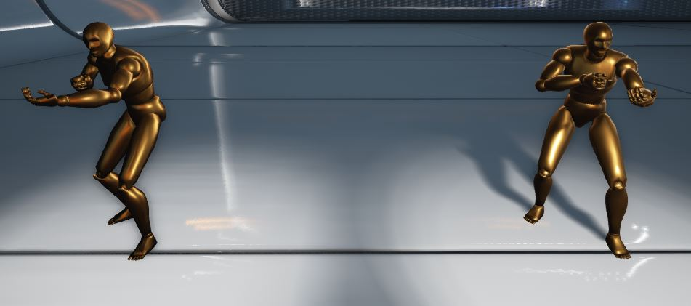
Shadows
Shadows make objects feel grounded in the world and give the viewer a sense of depth and space
Static shadows are free as far as rendering goes, but dynamic shadows can be one of the biggest drains on performance
Static lights cast completely static shadows and light, meaning they will have no direct effect on dynamic objects

Slide 11
Shadows
Directional Stationary Lights are special because they support whole scene shadows through Cascaded Shadow Maps at the same time as static shadowing.
This is very useful in levels with a lot of animating foliage; you want to have moving shadows around the player but do not want to pay the cost of having many cascades to cover a large view range.
The dynamic shadows are faded into static shadows over distance, such that the transition is often indistinguishable
Dynamic Shadow Distance StationaryLight – property to change within the Directional stationary light in order to set this range

Slide 12
Shadows
Each movable object creates two dynamic shadows from a stationary light: a shadow to handle the static world casting onto the object, and a shadow to handle the object casting onto the world
With this setup, the only shadowing cost for stationary lights comes from dynamic objects that it affects
This means the cost can vary from very little to a large amount, depending on how many dynamic objects there are. With enough dynamic objects, it is more efficient to use a Movable light instead.

Slide 13
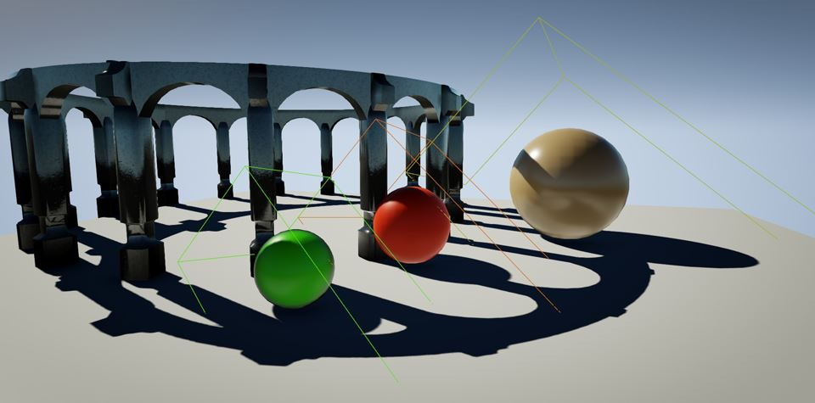
Shadows
In the scene below, the spheres are all movable, and they all receive shadows from the static world and cast their own shadows, which merge with the distance field shadows

Slide 14
Shadows
Movable lights cast completely dynamic shadows (and light) on everything
None of its light data will get baked into the light maps and it will be free to cast dynamic shadows on everything
When editing a Stationary or Static Light in such a way that the lighting becomes un-built, Preview Shadowing is enabled to give you an idea of what the shadows will look like when lighting is rebuilt
When editing a Stationary or Static Light in such a way that the lighting becomes un-built, Preview Shadowing is enabled to give you an idea of what the shadows will look like when lighting is rebuilt
Unreal wrapping up shadow documentation:
“When all the shadows are brought together, each bringing their strengths to make up for the weakness of the others, impressive and rapidly rendered visuals can be brought to life.”

Slide 15
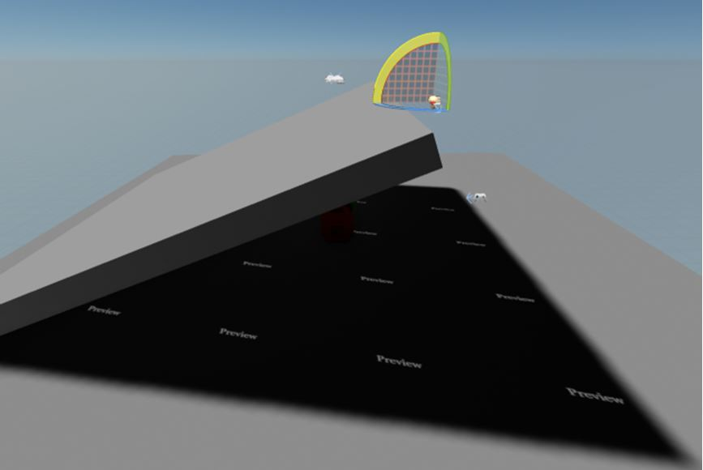
Previewing Shadows

Slide 16
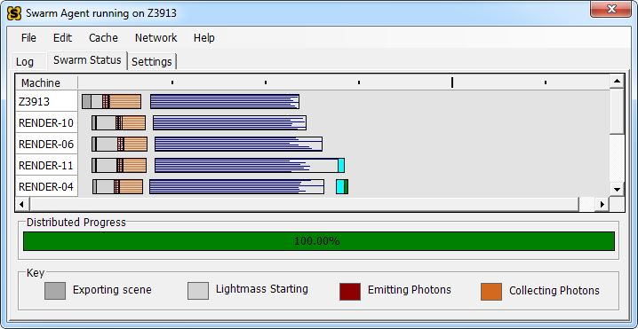
Lightmass Global Illumination
Lightmass creates lightmaps with complex light interactions like area shadowing
It is used to precompute portions of the lighting contribution of lights with stationary and static mobility
Communication between the editor and Lightmass is handled by the Swarm Agent, which manages the lighting build locally and can also distribute the lighting build to remote machines. The Swarm Agent, which opens minimized by default, also tracks lighting build progress and keeps you up to date with which machines are working for you, what they are working on, and how many threads each one is using.

Slide 17
Diffuse Interreflection
the most visually important global illumination lighting effect
Light bounces by default with Lightmass
BaseColor of your material controls how much light (and what color) bounces in all directions.
This effect is sometimes called Color Bleeding
not affected by the viewing direction or position.

Slide 18
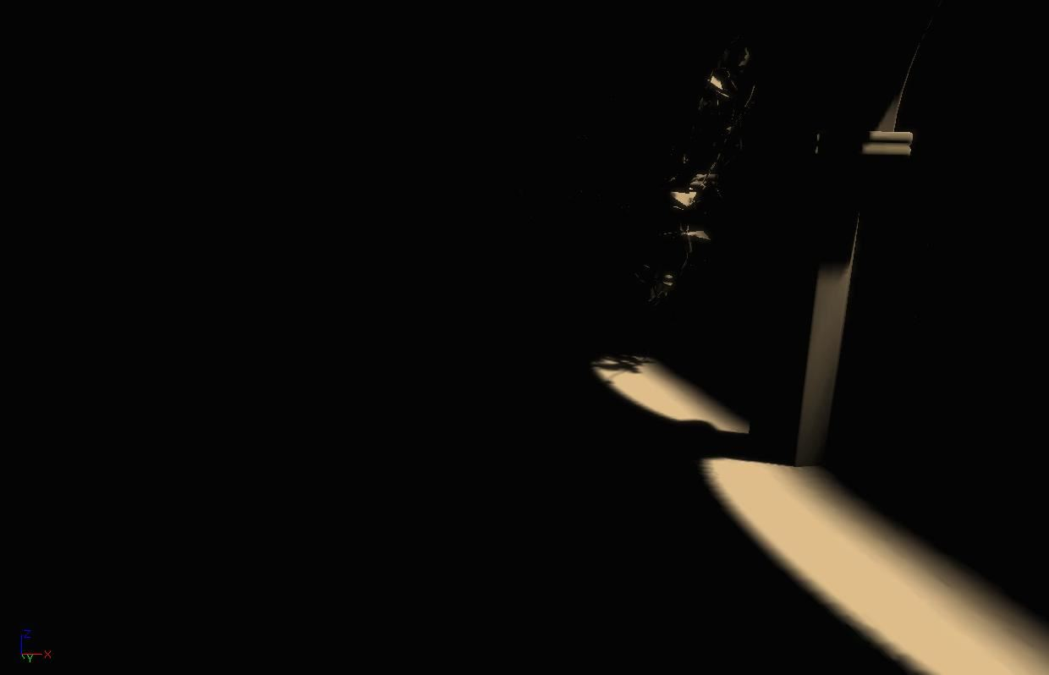
Without global illumination
built by Lightmass with a single Directional Light and only direct lighting shown
The areas that are not directly visible to the light are black. This is the result without global illumination.

Slide 19
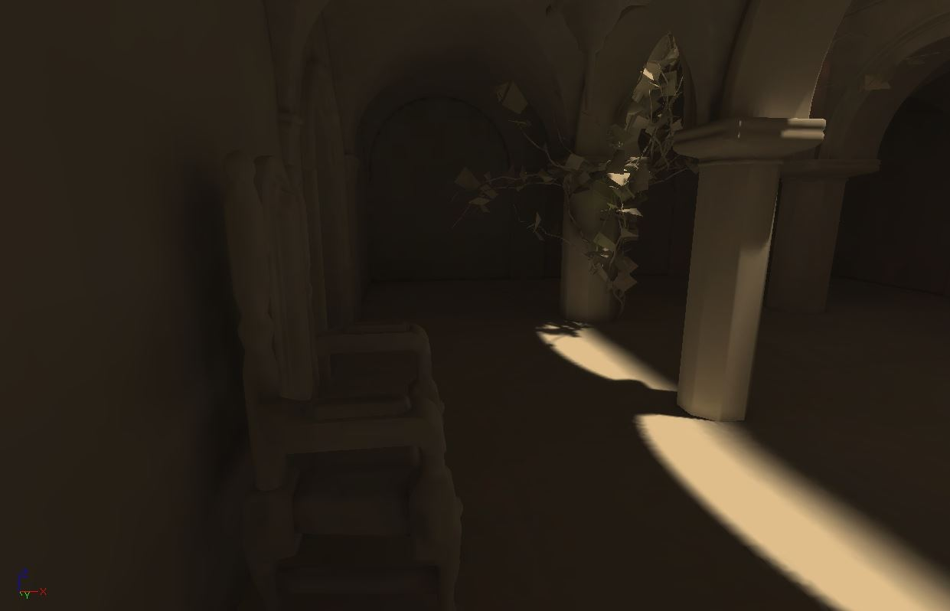
With multiple light bounces
Simulating global illumination creates much more detailed and realistic lighting than manually placing fill lights. Indirect shadows in particular are not possible with fill lights.

Slide 20
Color Bleeding
Bounced lighting picks up the diffuse color of the underlying material
This is where the term Color Bleeding comes from
Bleeding is most noticeable with highly saturated colors
You can exaggerate the effect by raising DiffuseBoost on the Primitive, Material, or Level.

Slide 21
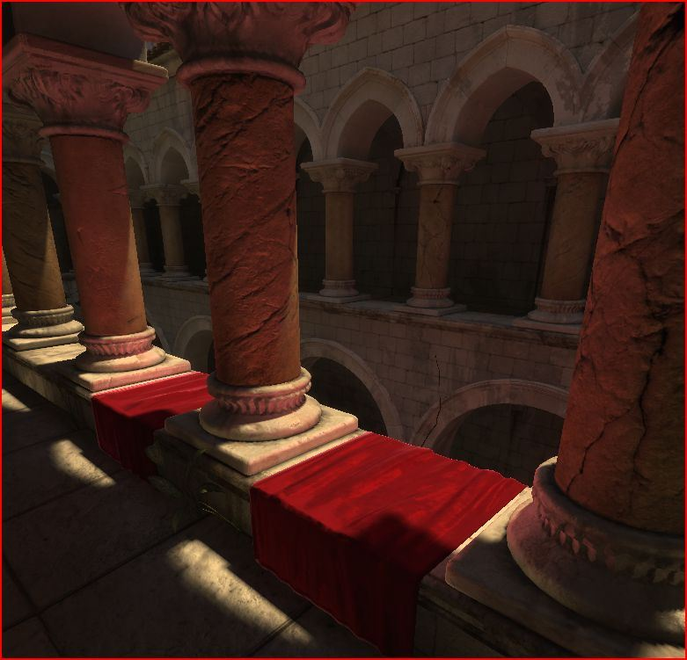
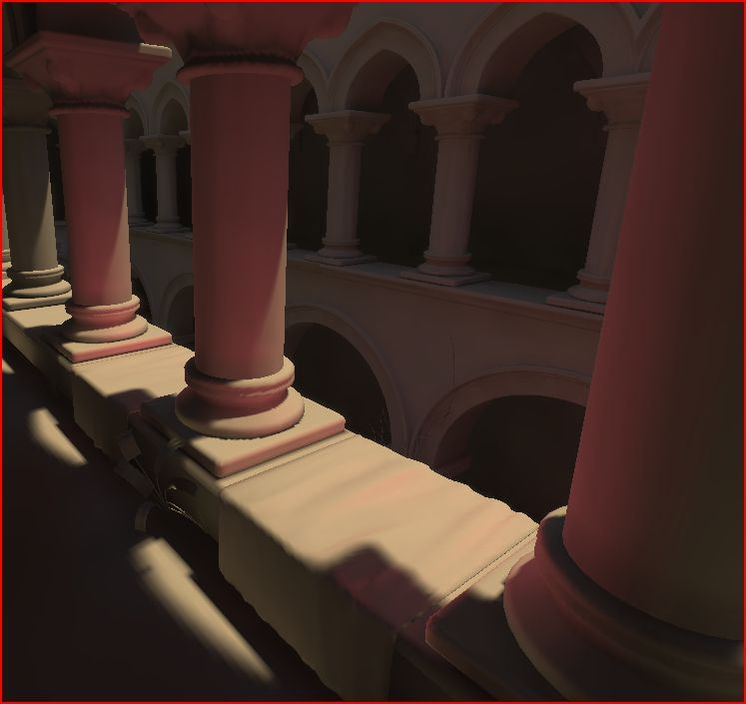
Color Bleeding

Slide 22
Ambient Occlusion
Lightmass calculates detailed indirect shadows automatically, but it can be useful to exaggerate indirect shadows for artistic purposes or to enhance the perception of proximity in a scene
Ambient occlusion is the indirect shadowing you would get from a uniformly bright upper hemisphere, like an overcast sky
Ambient occlusion requires a fairly high lightmap resolution to look good, since it changes quickly in corners.
Ambient occlusion requires a fairly high lightmap resolution to look good, since it changes quickly in corners.

Slide 23
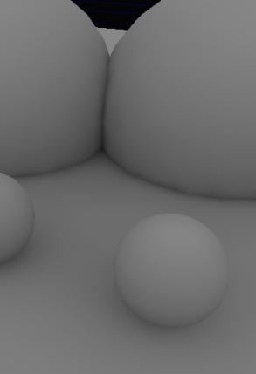
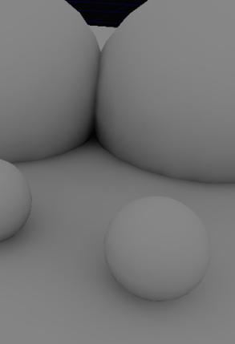
Ambient Occlusion

Slide 24
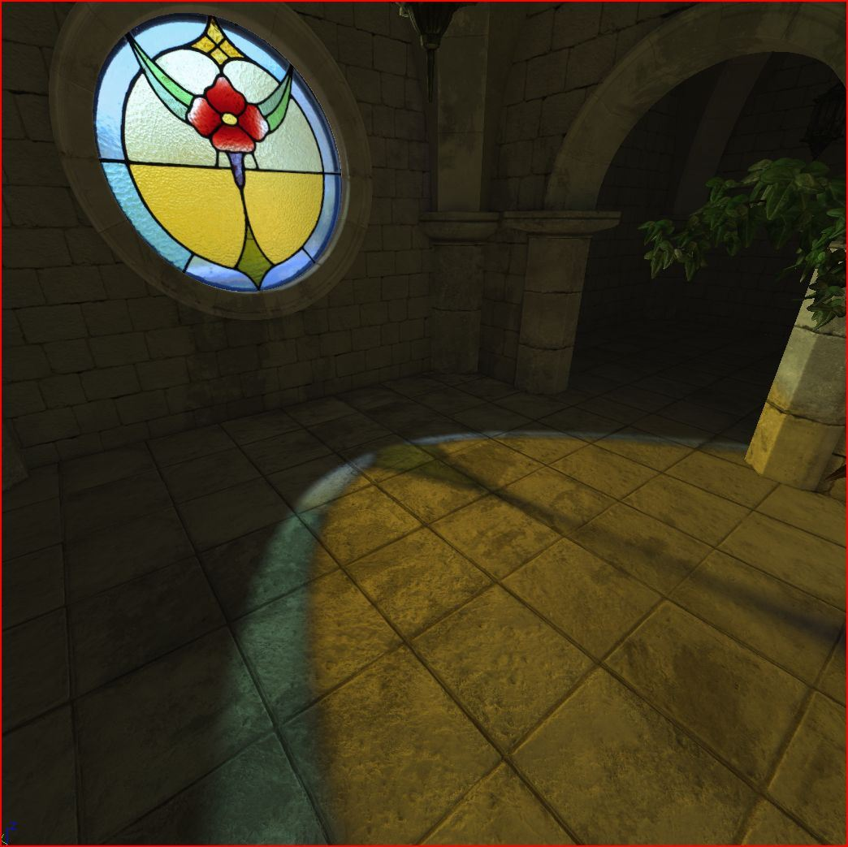
Translucent Shadows
Light passing through a translucent material that is applied to a static shadow casting mesh will lose some energy, resulting in a translucent shadow.

Slide 25
Lightmaps
way of generating textures that simulate lighting of your game environment
Made outside of unreal
Very complicated
Using texture lightmaps with high resolution is the best way to get detailed, quality lighting.
Ideally, most of the lightmap resolution in your scene should be allocated around the high visual impact areas and in places where there are high frequency shadows.

Slide 26
Lightmass Importance Volume
Many maps have meshes out to the edge of the grid in the editor, but the actual playable area that needs high quality lighting is much smaller
The Lightmass Importance Volume controls the area that Lightmass emits photons in, allowing you to concentrate it only on the area that needs detailed indirect lighting
Areas outside the importance volume get only one bounce of indirect lighting at a lower quality.

Slide 27
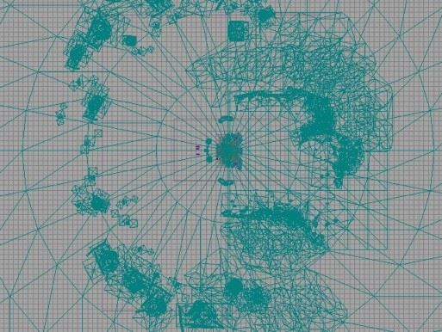
Importance Volume

Slide 28
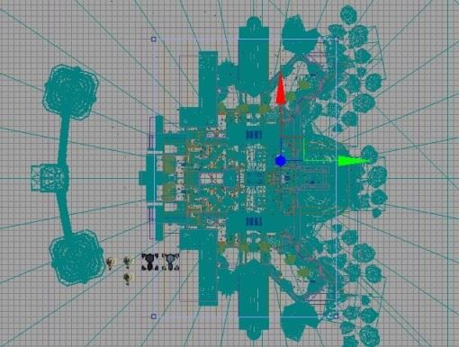
Importance Volume

Slide 29
Light Functions
Essentially a material that can be applied to filter a light’s intensity
Allows us to animate otherwise stationary lights, as well as project textures from them

Slide 30
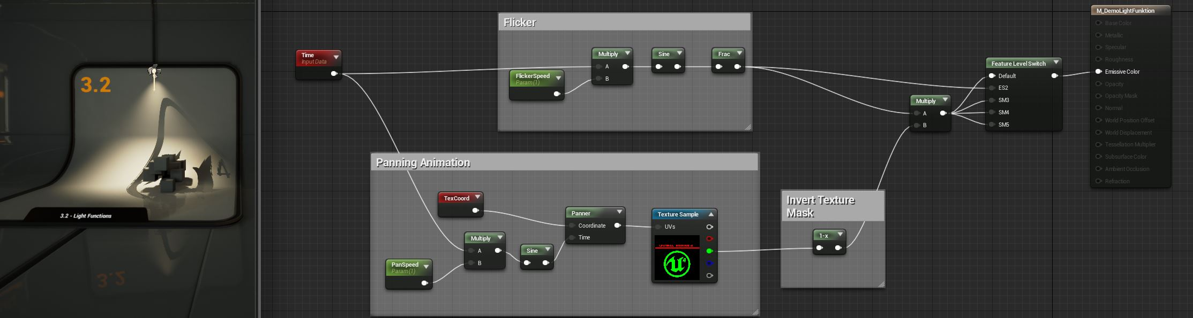
Light Functions

