Slide 1
Destructible Meshes
By: Anthony Schipani

Slide 2
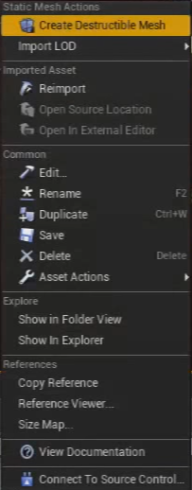
Creating a destructible mesh
Make sure the object you want to create a destructible mesh for has collision.
Right click on an object, Then choose “create destructible mesh”

Slide 3
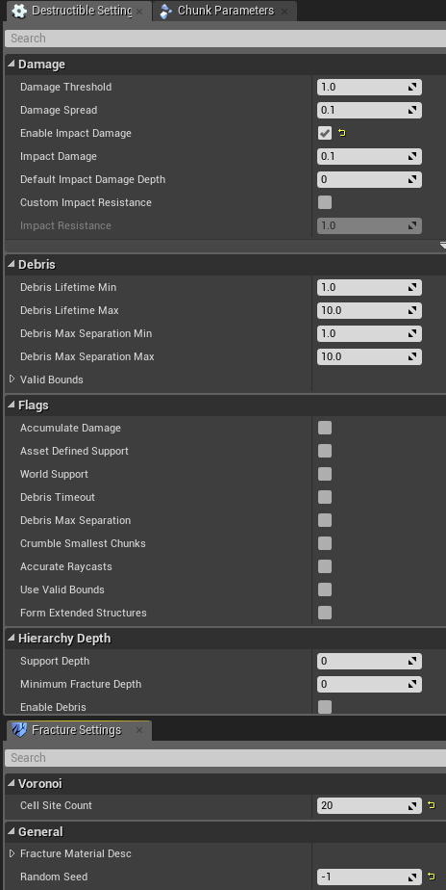
Destructible settings
Cell Site Count – The amount of pieces the mesh will break into.
Random Seed – The seed for the random number generator that controls where the fractures occur.
Enable Impact Damage – Whether to apply damage to a destructible when colliding with an object.
If you hover your mouse over the other settings it will give a destcription.
https://docs.unrealengine.com/latest/INT/Engine/Physics/Destructibles/DestructibleProperties/index.html

Slide 4
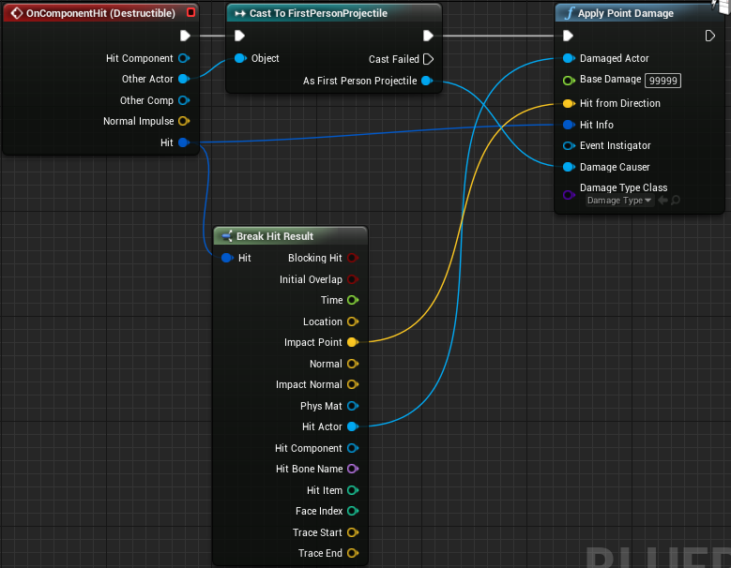
Destructible mesh blueprint
Right click the destructible Mesh and create a blueprint based off of it.
This code allows the bullets to damage the mesh.
NOTE: you can also just use the destructible itself on the map, and apply the damage from your character.

Slide 5
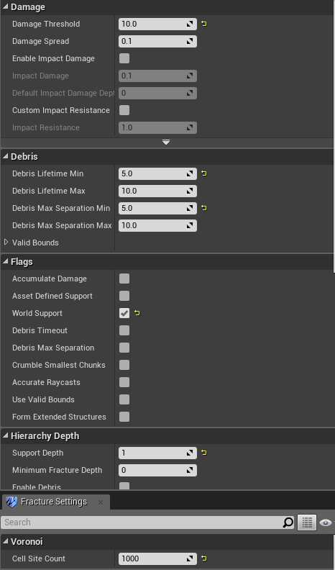
Building A destructible wall
Create a destructible mesh.
Set world Support to true, and Support Depth to 1.
Set damage Cell Site Count, and other settings to your preference.
Create a blueprint similar to the previous example, but don’t set the base damage to be so high.

Slide 6
Building reinforced pillars
The Ideal way would be to create a destructible with multiple layers, and then set the inner layer so that it cannot be destroyed.
Another way would be to create a destructible mesh, and then create a blueprint based off of it. Then within the blueprint add inner support beams to the inside of the destructible mesh.
For these I also made the base damage smaller than the base damage of the walls to make them appear stronger.

Slide 7
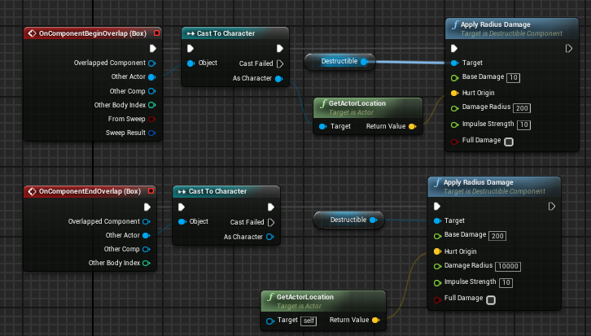
Building collapsing bridge
Create a destructible mesh and set Accumulate Damage, and World Support to true. Then I set Support Depth to 2.
This blueprint damages the bridge when you step on it, then completely destroys it when you get off of it.

Slide 8
Questions?

