Slide 1
Cinematics
Tyme LaDow

Slide 2
Basic Components
Cine Camera Actor
Camera Rig Rail
Camera Rig Crane

Slide 3
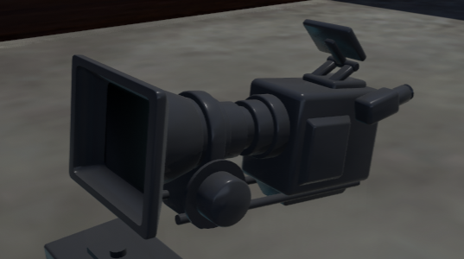
Cine Camera Actor
This is what will be the camera that the scene will follow

Slide 4
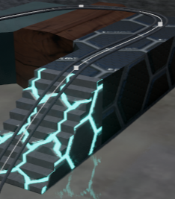
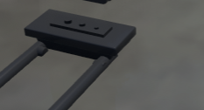
Camera Rig Rail
This is a track for the camera to follow along
Helps to make a smooth movement along the area at a normalized speed

Slide 5
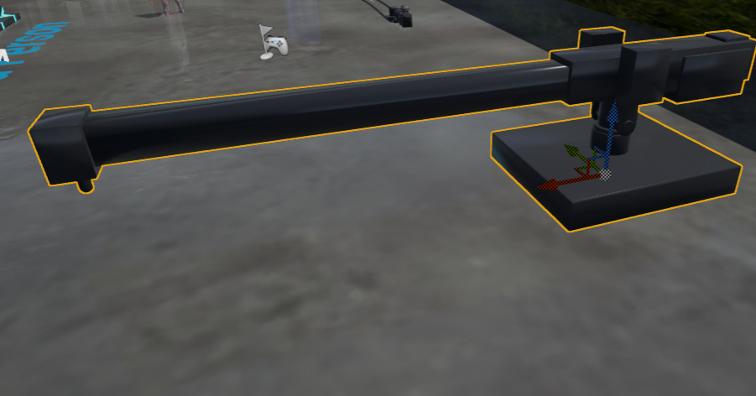
Camera Rig Crane
This acts as a swing arm for the camera
Allows of good vertical movements and certain types of spinning movements

Slide 6

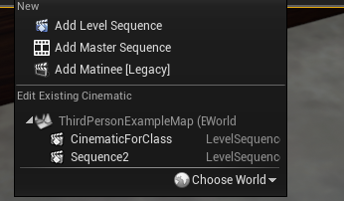
Setting up the cinematic
Press this cinematics button ->
This drop down will appear
Select Add Level Sequence

Slide 7
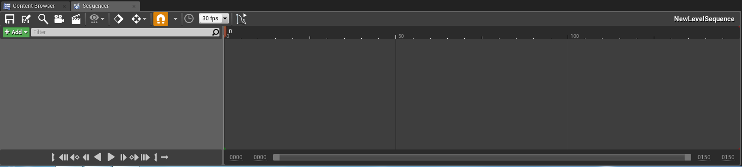
Continuing
Name and save the sequence somewhere
The sequencer will open.
It is usually best to dock it to the bottom with the content browser

Slide 8
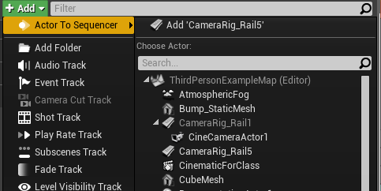
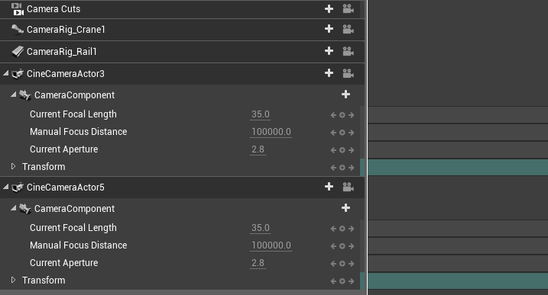
Adding the items to the sequencer
Add your cameras, rig rails, rig cranes, etc
Don’t forget a Camera Cuts track

Slide 9
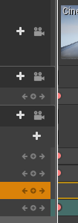
Add beginning keyframes
Press the Add Camera for the camera cut
Add the small + signs between the <- -> for the other actors tracks

Slide 10

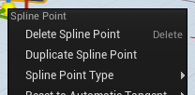
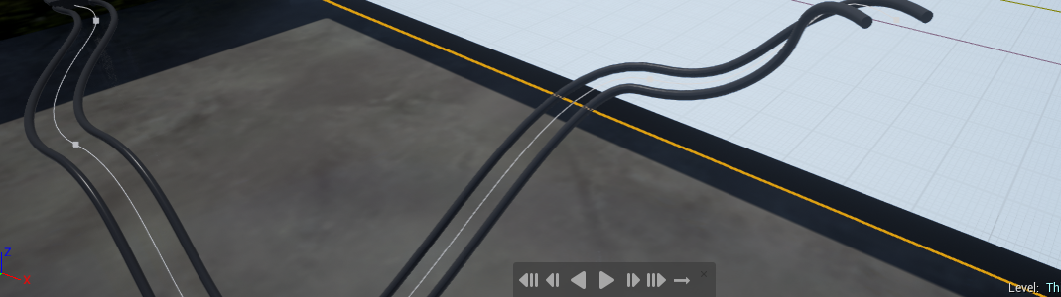
Creating Rig Track
Click on Small White square at the end of the track
Right click and press duplicate
Move and Place each spline point to make track

Slide 11

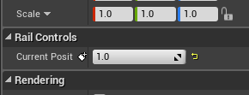

Rig Track Continued
Move red arrow in sequence to end
Click the Rig and change the Current Position to the end
Make a keyframe again

Slide 12

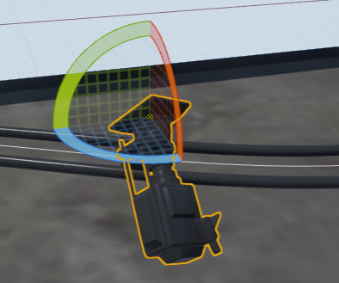
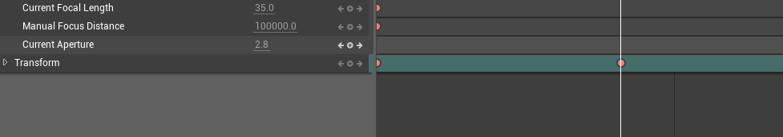
Select Along the various Points and Move the Camera

Slide 13
Playing the Cinematics
You can play on begin, or on a trigger of some sort
Two styles of Playing them

Slide 14
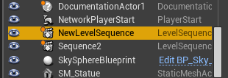
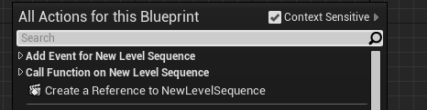
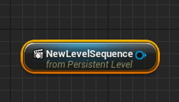
On Begin Play
Open Level Blueprint (also style 1)
On Begin Play, add a reference to the Cinematic
->

Slide 15
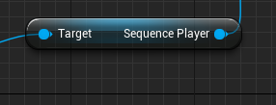
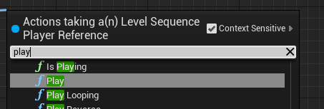
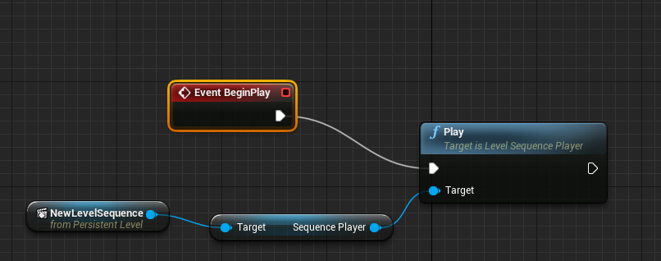
Continued
Get Sequence Player
Add play

Slide 16
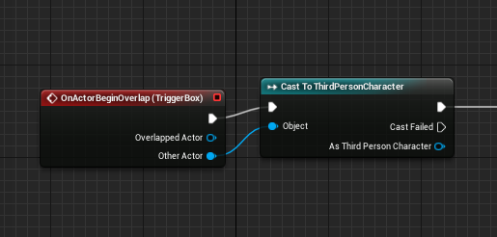
On Trigger
Open Level Blueprint (also style 2)
OnActorBeginOverlap (or whatever Trigger)
Cast to character (or to whatever causes the trigger to go off)

Slide 17
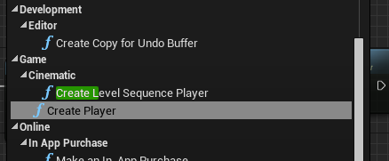
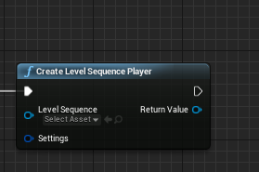
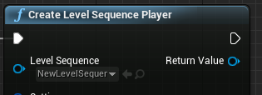
Continued
Create Level Sequence Player
Set Sequence

Slide 18
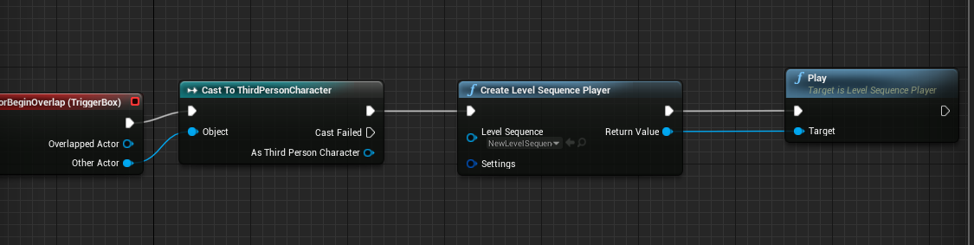
Play trigger
Add same Play as on begin

Slide 19

Bits and Pieces
Multiple Cameras?
  Just add a second Camera track to the Camera Cuts
  Weirdly Spinning or some odd movements?
  Open Curve editor (probably for rotation)

Slide 20
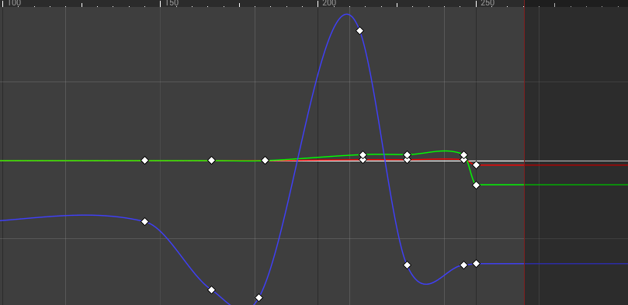
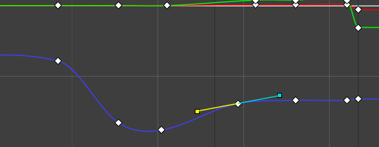
Weird Spinning Continued
Find the REALLY weird curve
Fix that

Slide 21
Finished!

