Slide 1
Importing Data
Supplemental Material

Slide 2
But First:
Today: Last Lecture
12/7 Work Day for Chapter 2 of PowerPoint
12/9 Review/Questions
12/12 Final exam for 10:00 class 10:15 to 12:15
12/14 Final exam for 11:00 class 10:15 to 12:15
If you want to change your test time you should talk to me about this by Friday.

Slide 3
Homework
Week 11 homework has been graded.
There is a drop box for those that missed points.
It closes 12/13.
But it is not for late homework.
I will started grading PowerPoint homework.
This homework can still be turned in through tomorrow.
No redo on this homework.
Week 15 homework is due 12/13.
No more late homework will be accepted.
No redo on this homework.

Slide 4
The Final Exam
Remember it is comprehensive
Make sure you can:
Do citations, build a bib, foot notes, …
Use if, pmt, vlookup
And also
Mail merge
Pivot tables
PowerPoint

Slide 5
Aligning Objects
Did you notice that PowerPoint assists you in aligning objects?
Both with placement
And Resizing

Slide 6
Gridlines:
On the view menu you can turn on gridlines
Or a guides.

Slide 7
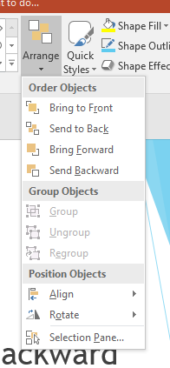
Stacking Order
Objects have an order
Objects placed first are further back.
Send forward, send to front, send Backward
Popup Menu or Design Tools: Format: Arrange
Group binds select object together.

Slide 8
Linking And Embedding
Link: An object in a PowerPoint slide references another program.
Embed: An object is created by placing another program into a PowerPoint slide.
Source: Microsoft Support

Slide 9
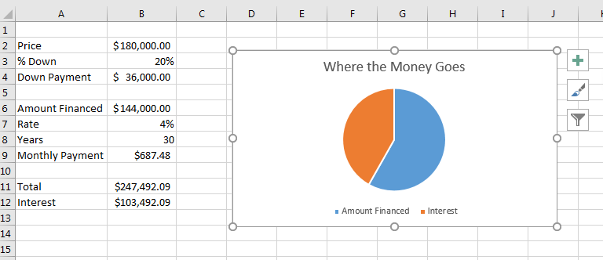
Link
I have this worksheet:
A Screen Shot

Slide 10
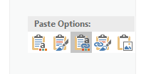
Link
I copy the chart from the worksheet
And I have the option to past a link or embed

Slide 11
Embed
Same Story

Slide 12
Or Insert Object

Slide 13
Linked objects
Updated when you open or change the object
But you need to have the object, error if it is not there.
I would be careful with linking
Put both objects on a USB drive or use from the OneDrive.

