Slide 1
Chapter 2, Presentation Development
Planning and preparing a presentation

Slide 2
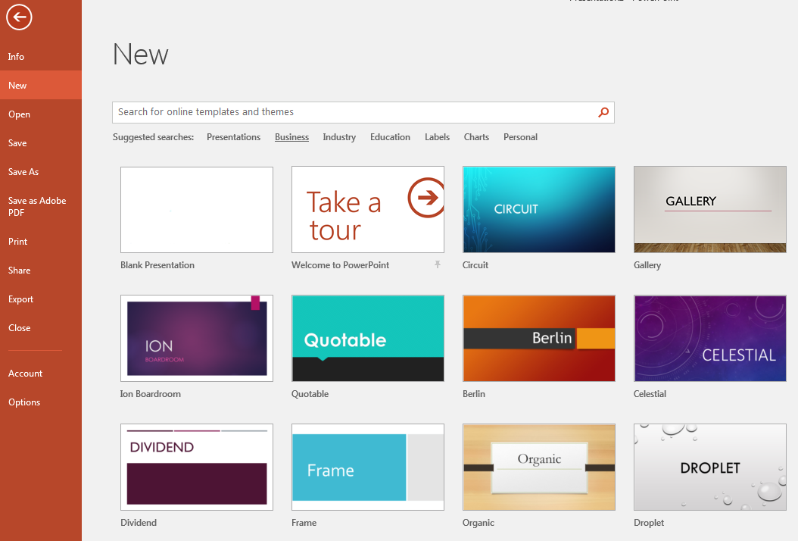
Templates
They are there just like word.
You may need to modify an existing presentation when changing templates.

Slide 3
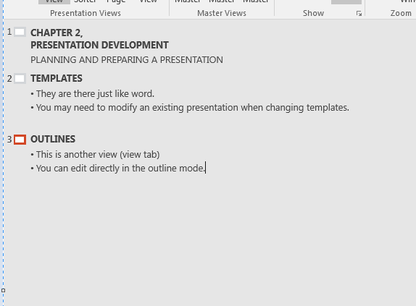
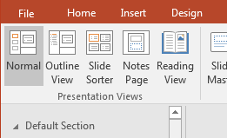
Outlines
This is another view (view tab)
You can edit directly in the outline mode.
And Add items
Or here for a new slide
Click here for new line

Slide 4
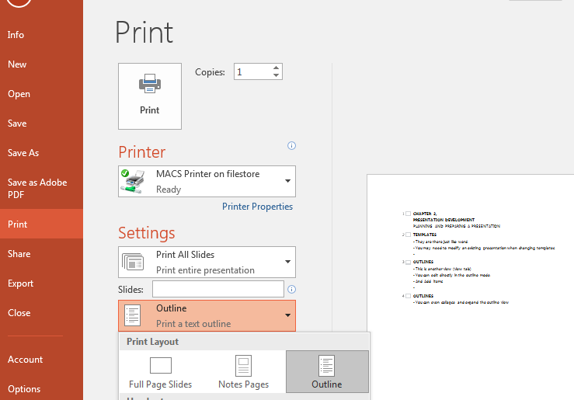
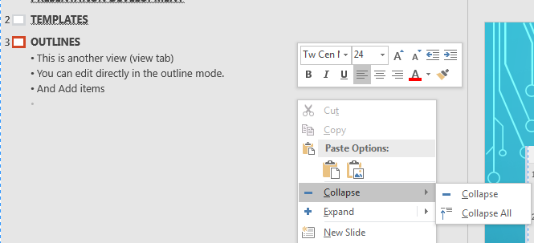
Outlines
You can collapse and expand the outline view
Or print just the outline

Slide 5
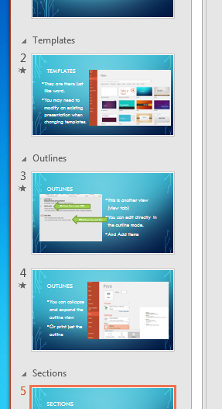
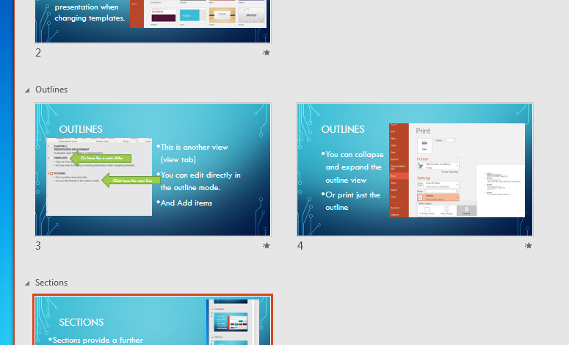
Sections
Sections provide a further level of organization
Grouping in
outline
slide sorter view

Slide 6
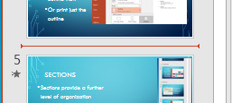
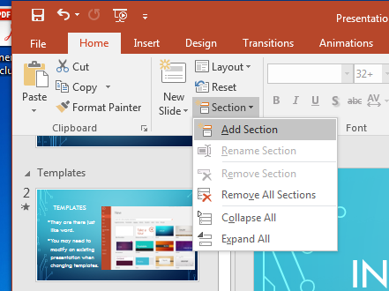
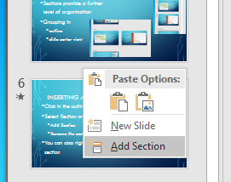
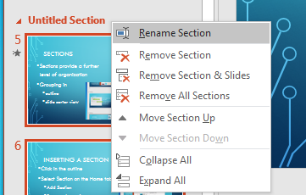
Inserting a Section
Click in the outline
Select Section on the Home tab.
Add Section
Rename the section.
You can also right click in the outline and add a section

Slide 7
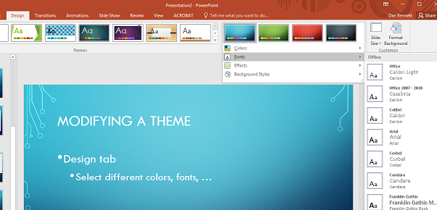
Modifying a Theme
Design tab
Select different colors, fonts, …
Probably best done before working on the presentation

Slide 8
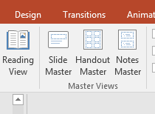
Modifying a Slide Master
In the View Tab
Master Views group
Slide Master
Select slide type to change
Changes the entire presentation.
Probably best done early in the design.

