Slide 1
Presentation Enhancement
PowerPoint Chapter 1, Part II

Slide 2
Look over the different types of slides
Home Tab
Slides Group
New Slide Drop Down

Slide 3
Tables
Frogs | Toads | Snakes
Kermit | Mr. Toad | Kaa
Frogger | Hypnotoad | Nagini
Prince Charming | Trevor | Jömungandr
Same interface as word
Insert tab, tables
Enables the Table Tools special Tab
Inserting an Excel spreadsheet is cool!

Slide 4
Inserting Pictures, Word Art and Other Objects
Just like in word.
Insert and pick what you want.
Shapes and Text Boxes work well together.
Look a frog!

Slide 5
Animations
Animations allow you to add motion to a slide.
I usually animate bulleted lists
But you can also animate other things.
Even Appear with text.
To really mark what you are talking about
And then they go away
Another Frog!

Slide 6
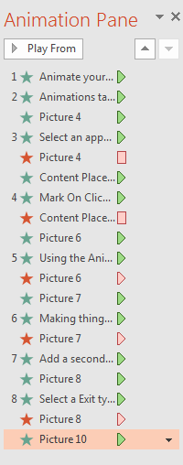
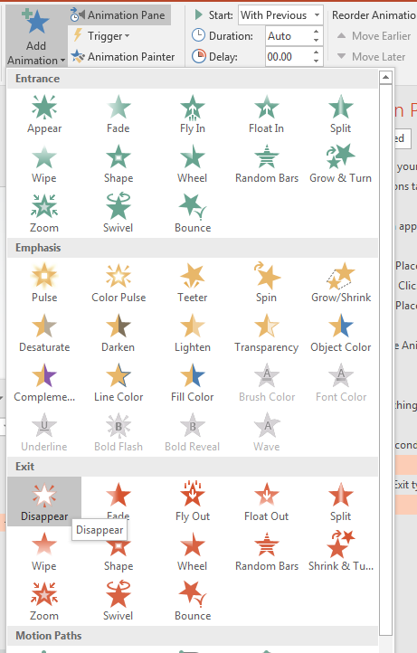
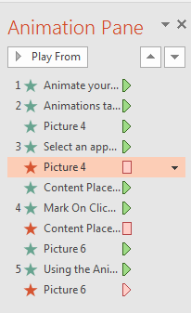
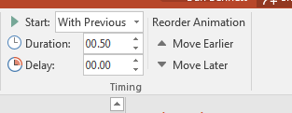
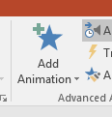
To Do this.
Animate your text using
Animations tab
Select an appear method
Mark On Click, With Previous …
Using the Animation Pane you can reorder or change action.
Making things go away
Add a second animation
Select a Exit type
You may need to move things in the Animation Pane

Slide 7
Try this

Slide 8
Animations
This is just the basic of animation.
But it is probably sufficient.
Please:
Don’t overuse animations.
Keep the animations simple.
Keep the animations consistent.

Slide 9
Transitions
Changing to the next slide.
Transitions tab.
Select one
Apply to all

